Slide 1
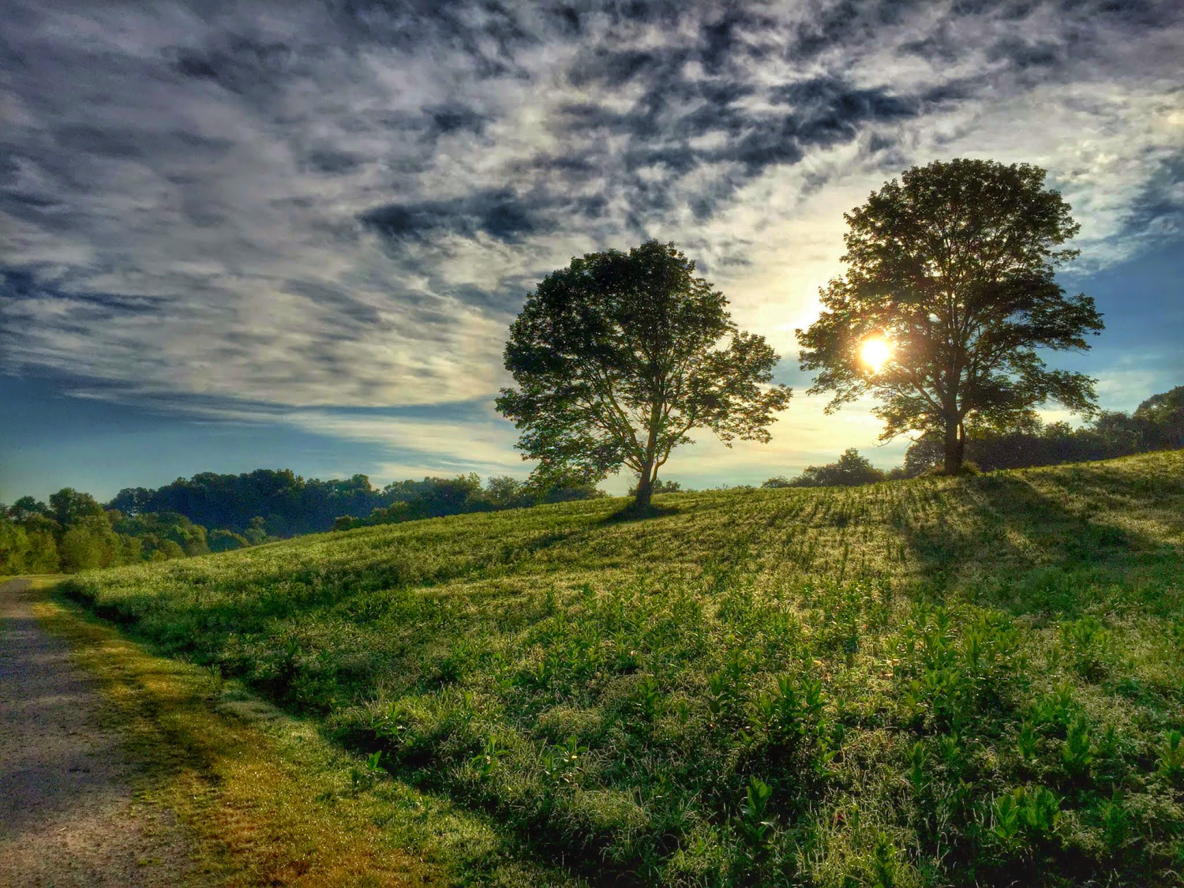
The Darby Creek Watershed
Resilience, Conservation and Management Plan

Slide 2

Your Homework
Please provide your correct name on zoom so we know who you are!

Slide 3
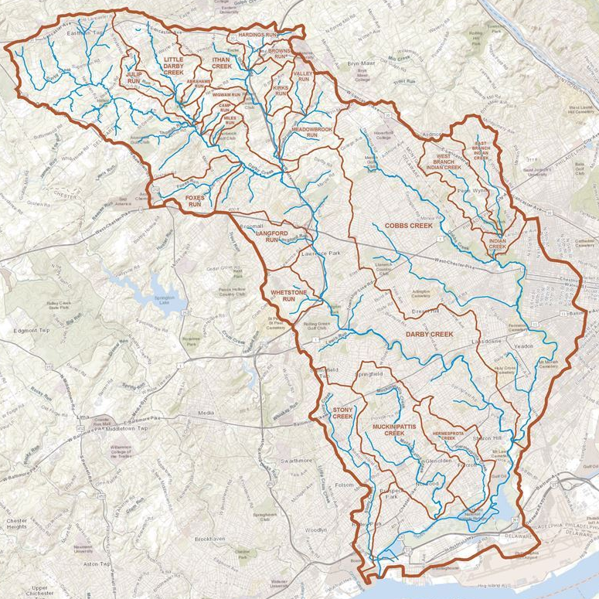
The Darby Creek Watershed
FLOW FACTS:
Area: 78 square Miles (50K acres +/-)
123 Linear Miles of Stream
Population within Watershed: Approximately 500,000 people

Slide 4
The Darby Creek Watershed
FLOW FACTS:
Area: 78 square Miles (50K acres +/-)
123 Linear Miles of Stream
Population within Watershed: Approximately 500,000 people
YOU ARE HERE

Slide 5
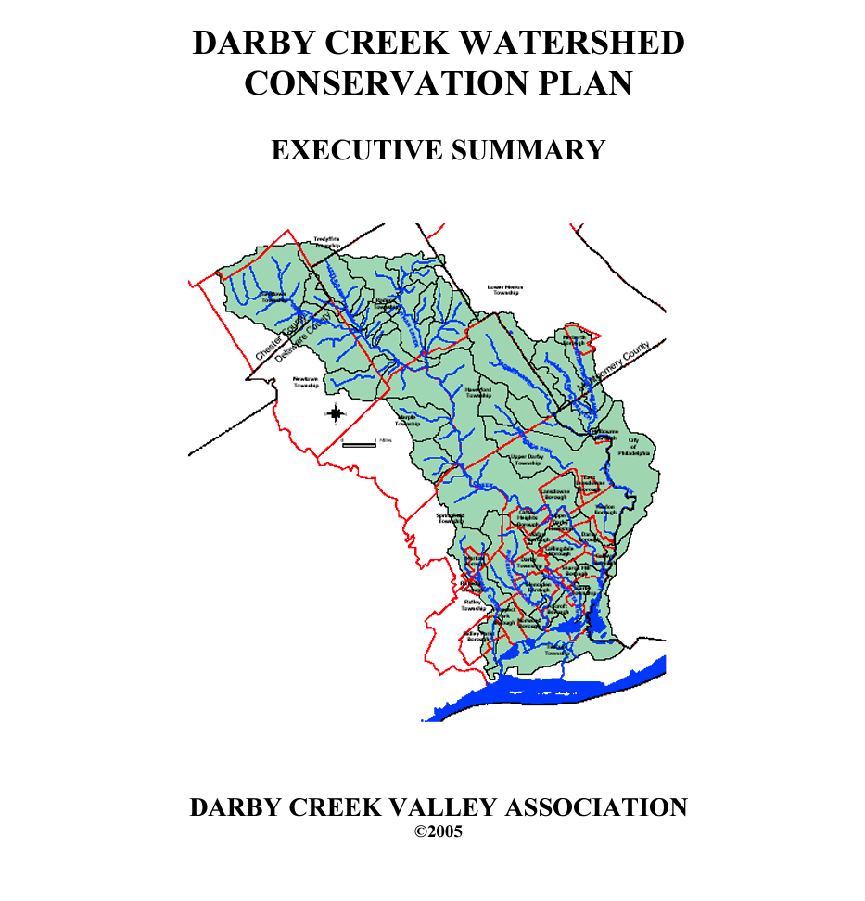
Time to Update

Slide 6
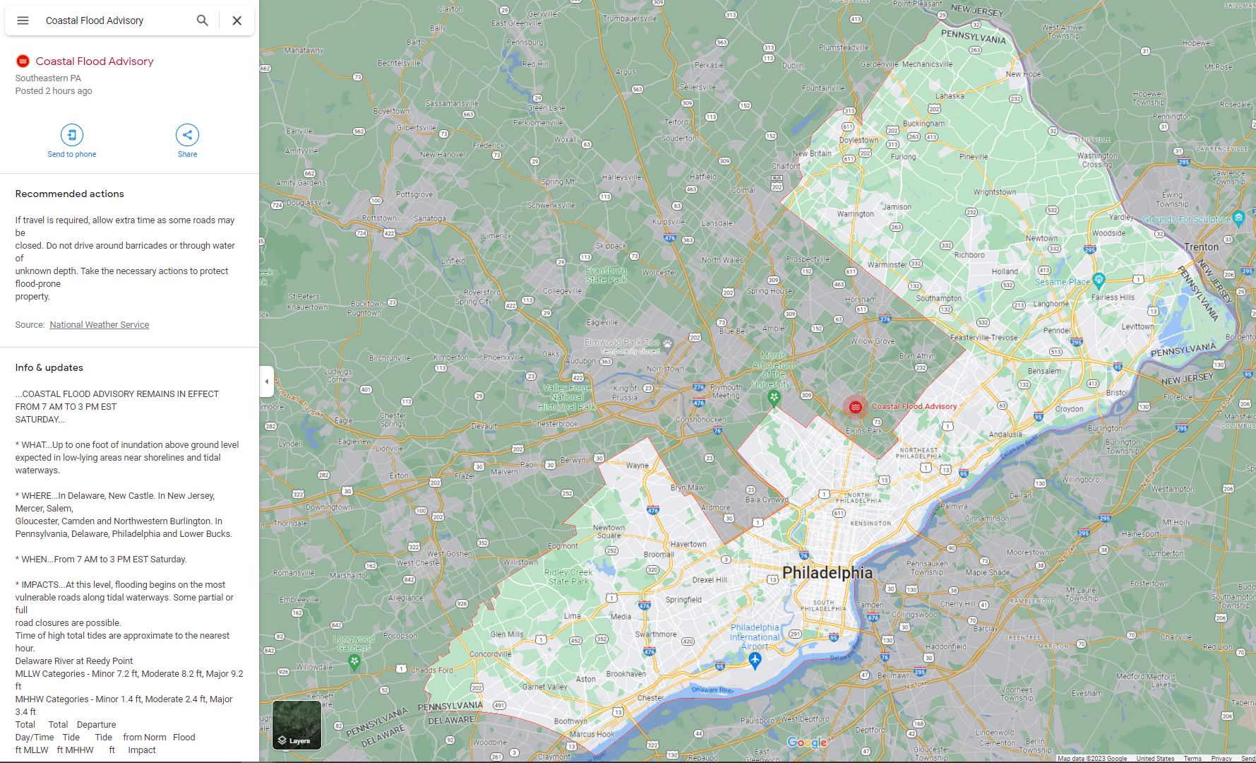
Issues: Regional Flooding

Slide 7
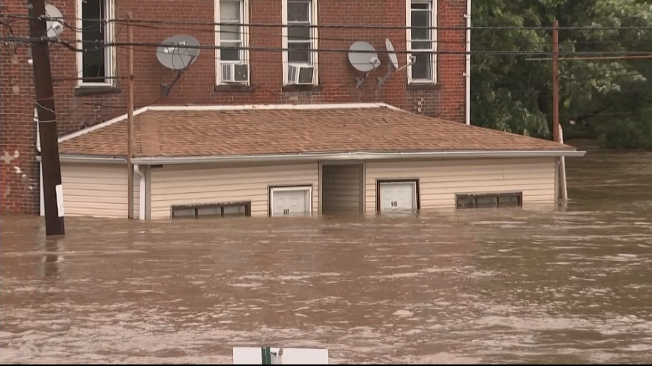
Issues: Local Flooding
(Credit: CBS3)

Slide 8
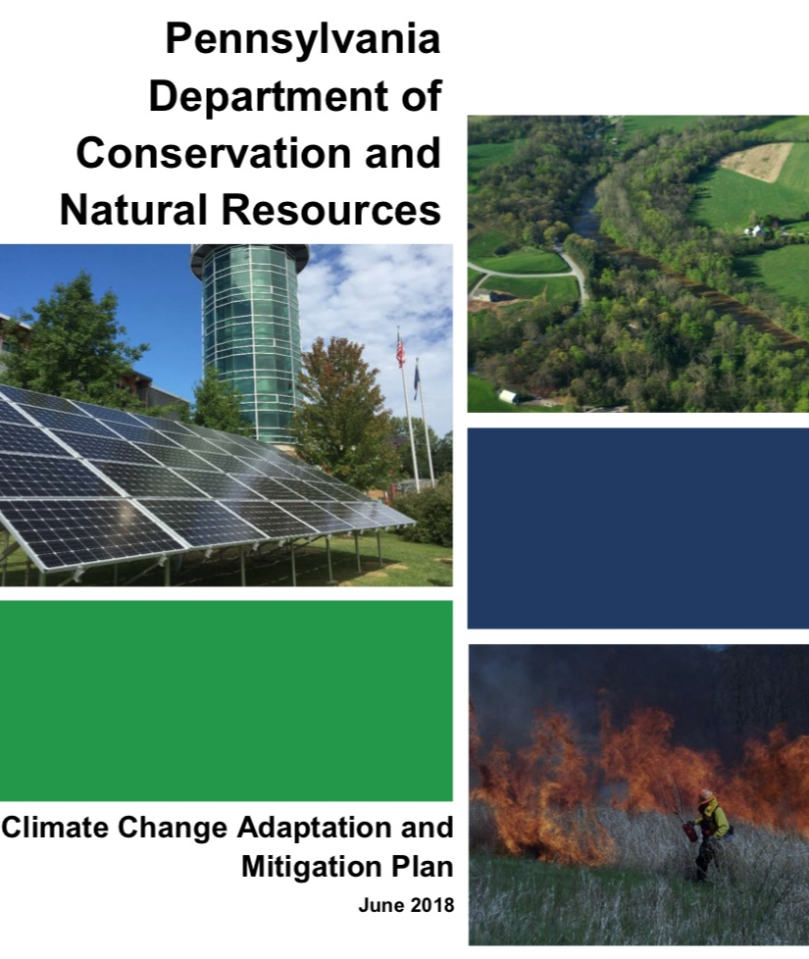
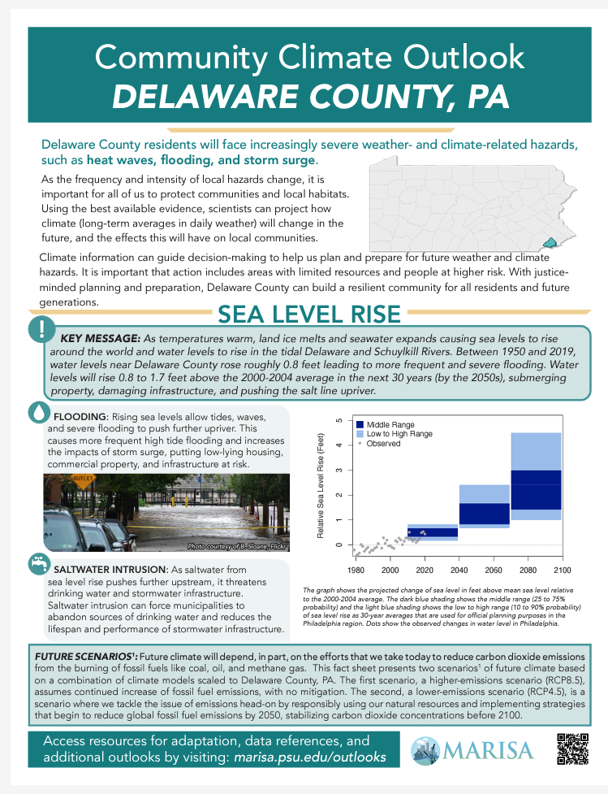
Causes: Climate Change

Slide 9
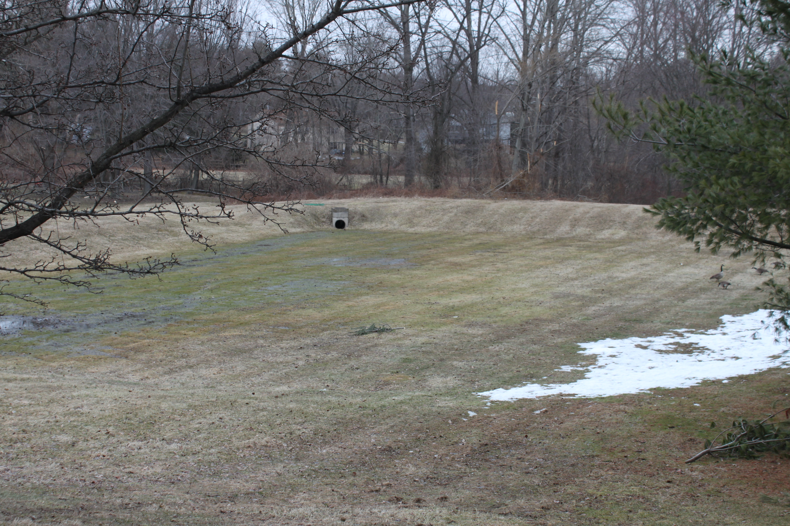
Causes: Outdated Stormwater Management

Slide 10
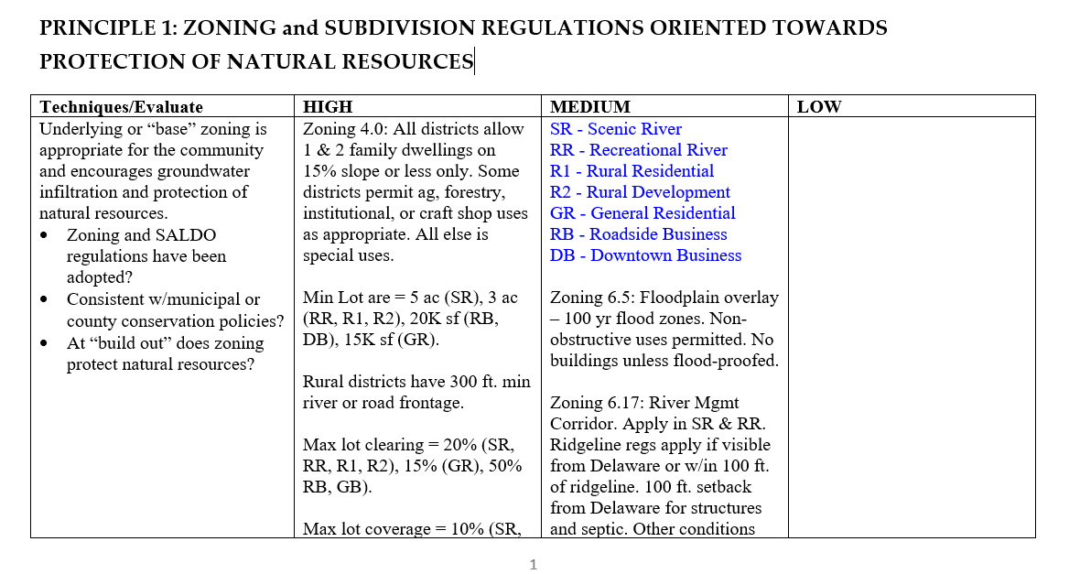
Causes: Weak Ordinances, Poor Enforcement

Slide 11
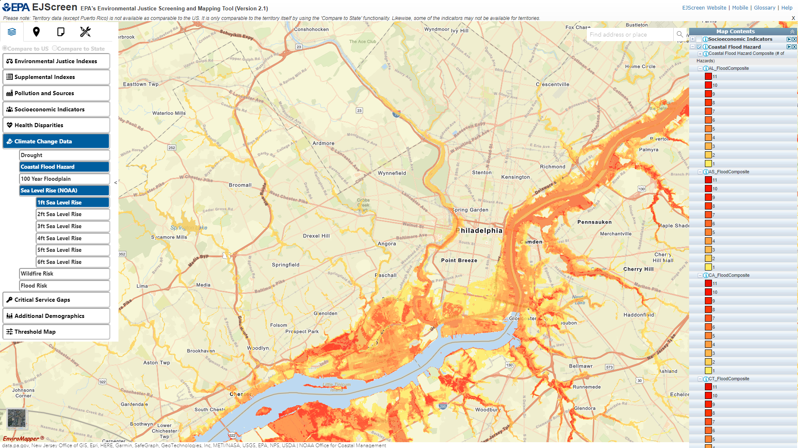
Causes: Environmental Injustice

Slide 12

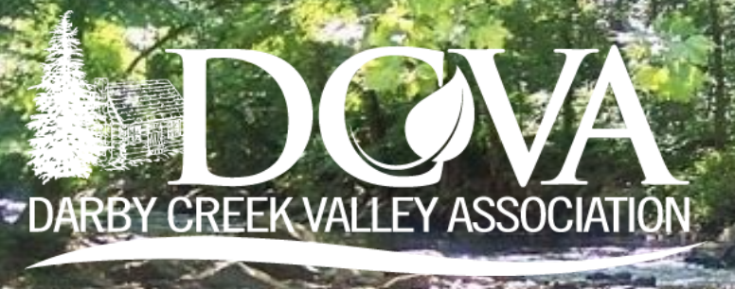

The Funders

Slide 13
The Project Team
Steering Committee
Jaclyn Rhoads, DCVA Board President
Robin Mann, DCVA Board
Aurora Dizel, DCVA Staff
Ashley Dolceamore,
Bonnie Hallam
Faith Zerbe
Jesse Hart
John Lesher
Roy Hunter
Temwa Wright
William Lighter
Rebecca Yurkovitch
Brian Razzi
Marie Gazillo
Rich Mooney
Ruth Mooney
Natural Lands
Rick Tralies, PLA
Senior Director of Landscape Planning
rtralies@natlands.org
Kate Raman, AICP
Conservation Project Manager
kraman@natlands.org
Nick Upmeyer, PLA
Landscape Planning Designer
nupmeyer@natlands.org
Megan Boatright
GIS Program Director

Slide 14
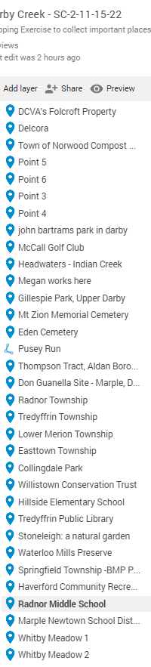
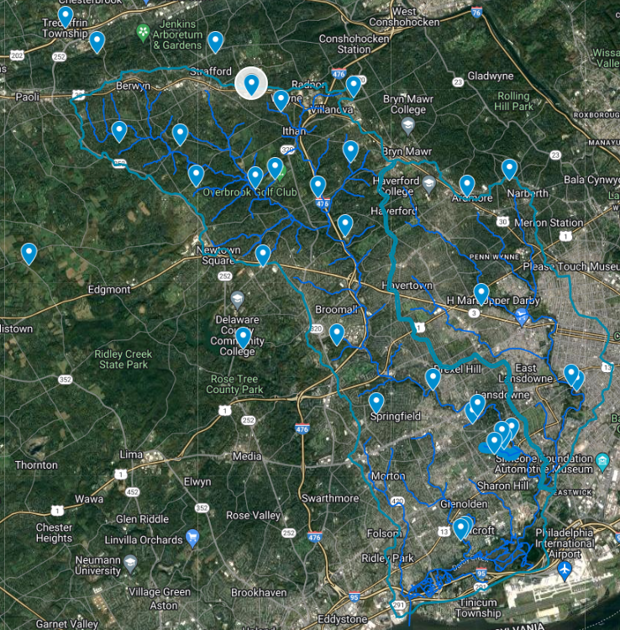
Review: Map of Important Places
Good Examples:
Radnor Middle Sch.
Whitby Meadows/ Cobbs Creek Park
Issues:
Dumping at Collingdale Park
Direct stormwater flow at Aldan Swim
Opportunities:
Golf Courses
Cemeteries
Parks
Open Spaces
Notes:
Large photo, with first bullets over
We will say the "why points"
What are we trying to accomplish?
Gain an understanding of the regulatory tools communities are currently using
Figure out what’s working or not working and WHY
Identify where the watershed may be unprepared for current or future development trends
Understand communities ordinances in the context of their community character
Why are we doing this now?
Inform our approach to some KPI’s – elected officials, appointed volunteers, municipal staff
Identify products or resources to include in the plan, such as model ordinances & funding sources
Learn about successful ordinances and share them across the watershed

Slide 15
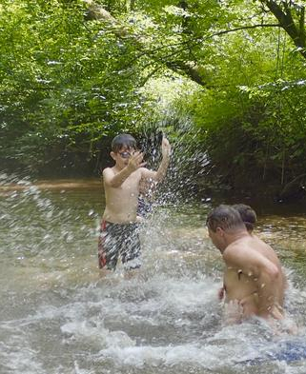
Review: One Big Idea
Summary
Create a single, creek long park and trail, like Pennypack and Wissahickon
Daylight some streams for ecological restoration, water management and education
Educate residents so they know what a watershed is and which one they live in
Small is the new big! Create many small projects distributed across the watershed
Create a regional EAC
Establish tax relief for property owners that restore or maintain buffers
Manage salt use, warnings, citations, fines for excessive use, mandate use of brines
Notes:
Large photo, with first bullets over
We will say the "why points"
What are we trying to accomplish?
Gain an understanding of the regulatory tools communities are currently using
Figure out what’s working or not working and WHY
Identify where the watershed may be unprepared for current or future development trends
Understand communities ordinances in the context of their community character
Why are we doing this now?
Inform our approach to some KPI’s – elected officials, appointed volunteers, municipal staff
Identify products or resources to include in the plan, such as model ordinances & funding sources
Learn about successful ordinances and share them across the watershed

Slide 16
PRELIMINARY Goals
Establish a Darby Creek Watershed greenway
Monitor Stormwater Plans
Identify Parcels for Conservation
Promote Efforts to Establish, Improve and Enforce Existing Land Use and Development Ordinances
Promote Equity and Environmental Justice across the Watershed
Prepare for the increased effects of climate change, with a focus on flooding
Haven’t Gone to Public Yet
Notes:
Large photo, with first bullets over
We will say the "why points"
What are we trying to accomplish?
Gain an understanding of the regulatory tools communities are currently using
Figure out what’s working or not working and WHY
Identify where the watershed may be unprepared for current or future development trends
Understand communities ordinances in the context of their community character
Why are we doing this now?
Inform our approach to some KPI’s – elected officials, appointed volunteers, municipal staff
Identify products or resources to include in the plan, such as model ordinances & funding sources
Learn about successful ordinances and share them across the watershed

Slide 17
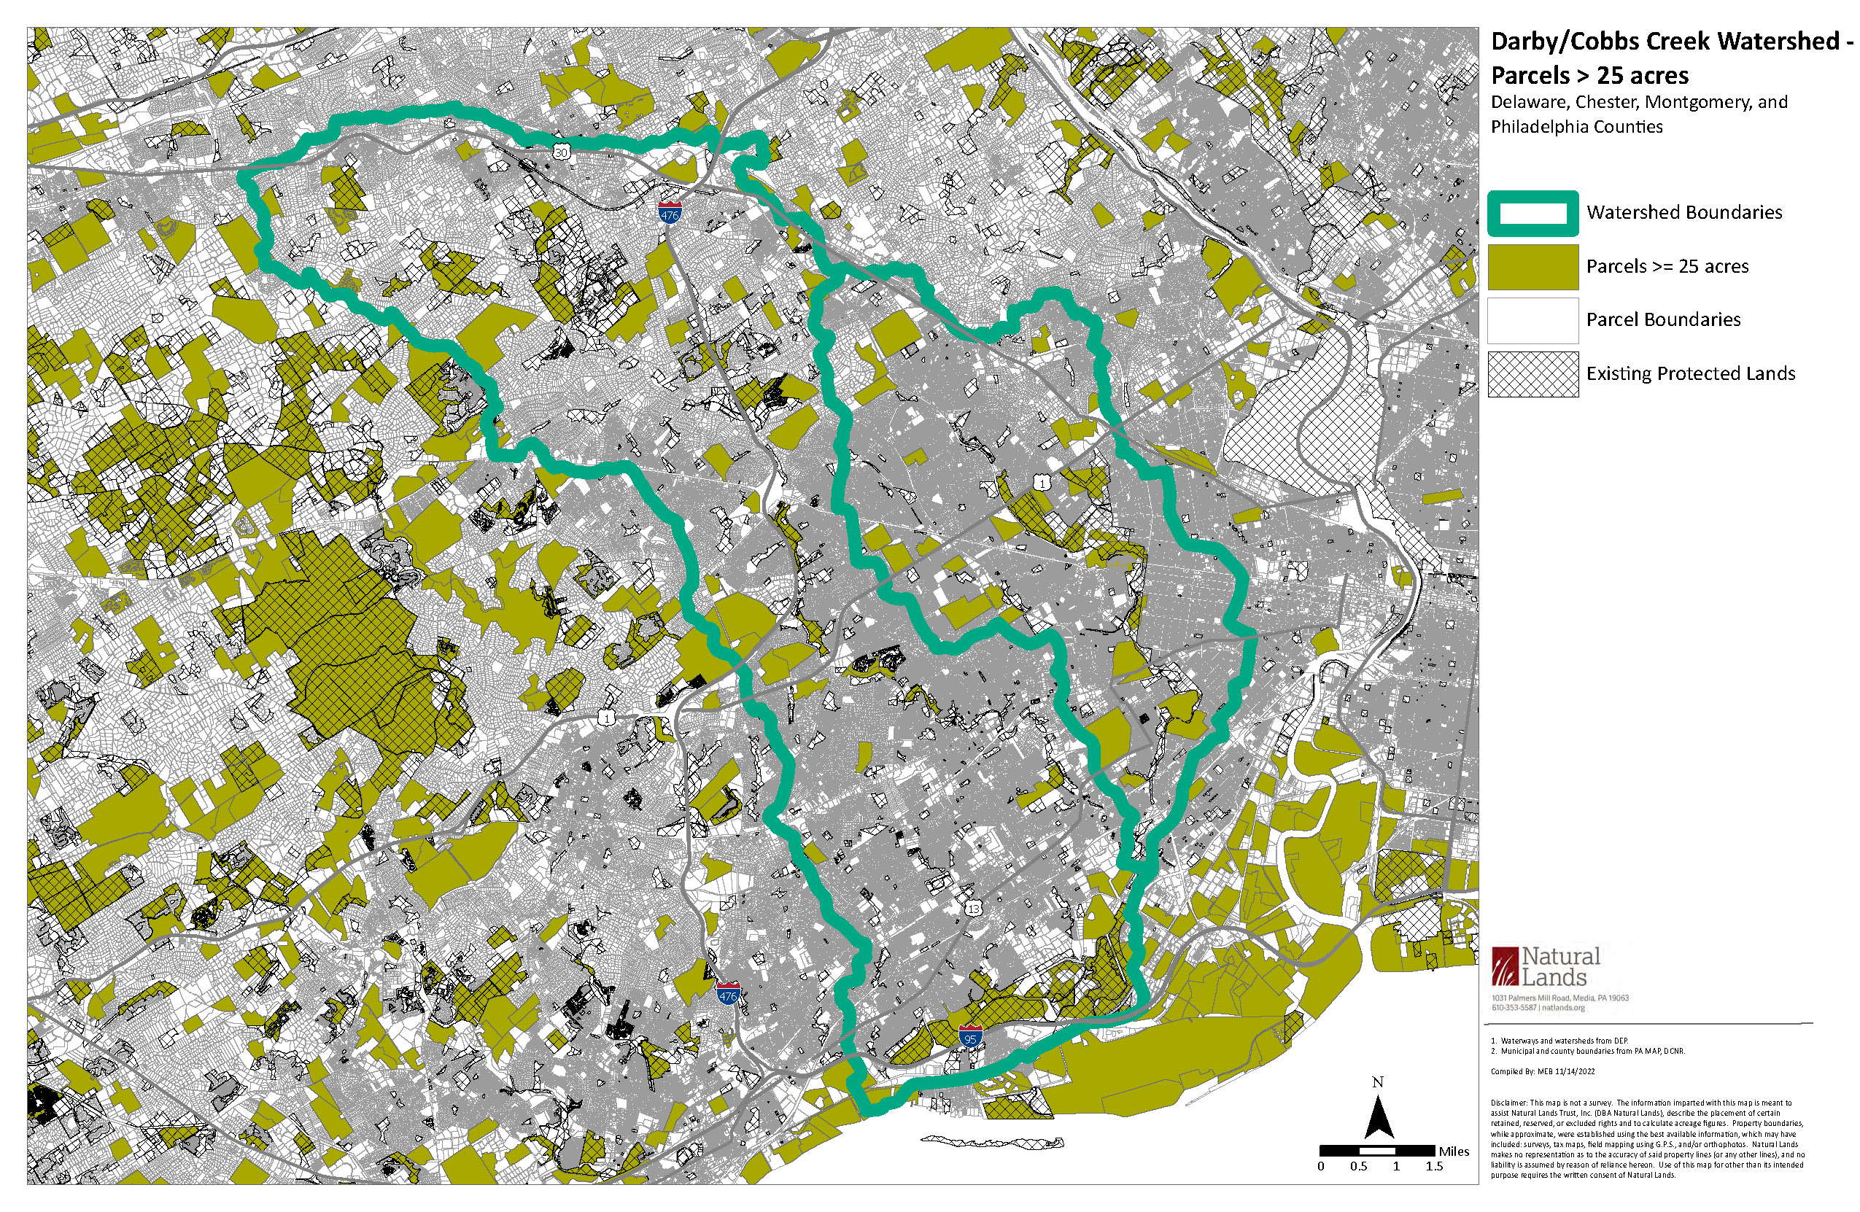
Identify Parcels for Conservation
Notes:
Large photo, with first bullets over
We will say the "why points"
What are we trying to accomplish?
Gain an understanding of the regulatory tools communities are currently using
Figure out what’s working or not working and WHY
Identify where the watershed may be unprepared for current or future development trends
Understand communities ordinances in the context of their community character
Why are we doing this now?
Inform our approach to some KPI’s – elected officials, appointed volunteers, municipal staff
Identify products or resources to include in the plan, such as model ordinances & funding sources
Learn about successful ordinances and share them across the watershed

Slide 18
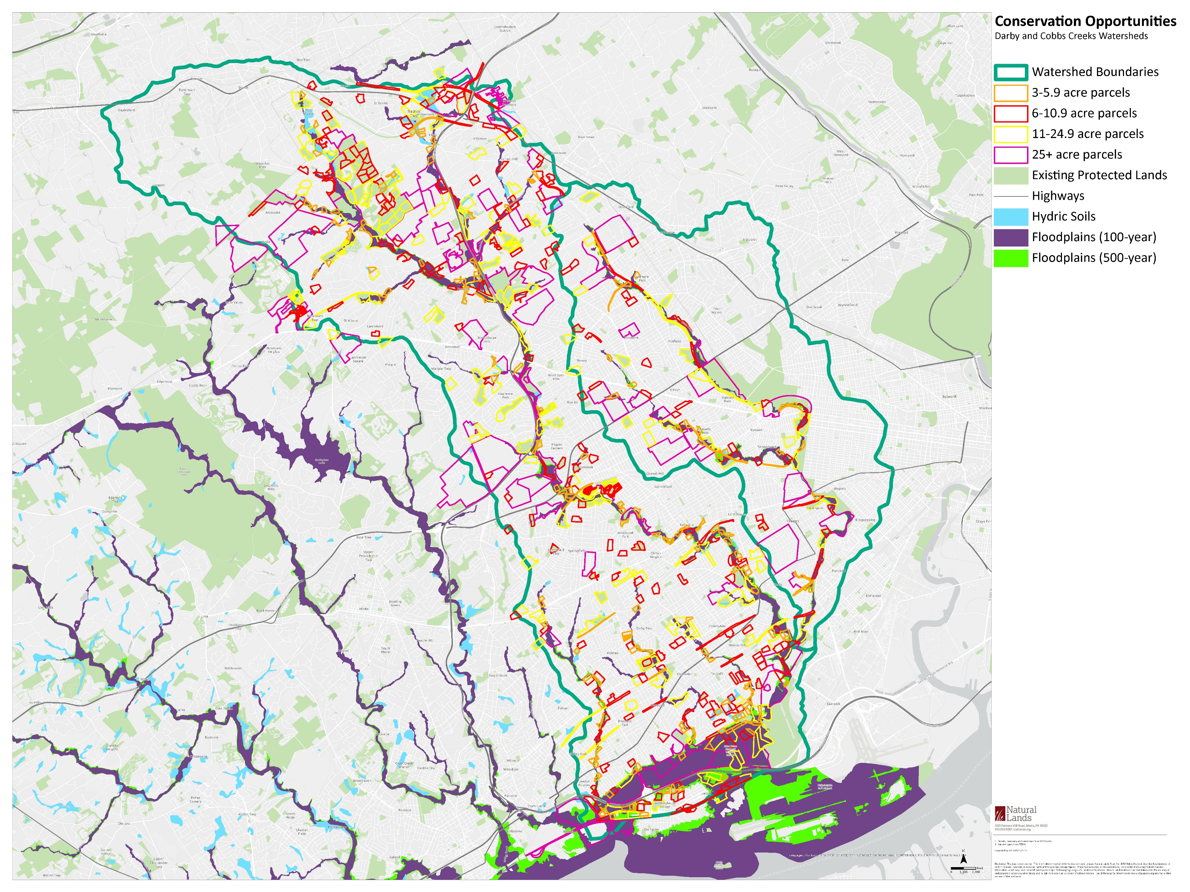
Identify Parcels for Conservation
Notes:
Large photo, with first bullets over
We will say the "why points"
What are we trying to accomplish?
Gain an understanding of the regulatory tools communities are currently using
Figure out what’s working or not working and WHY
Identify where the watershed may be unprepared for current or future development trends
Understand communities ordinances in the context of their community character
Why are we doing this now?
Inform our approach to some KPI’s – elected officials, appointed volunteers, municipal staff
Identify products or resources to include in the plan, such as model ordinances & funding sources
Learn about successful ordinances and share them across the watershed

Slide 19
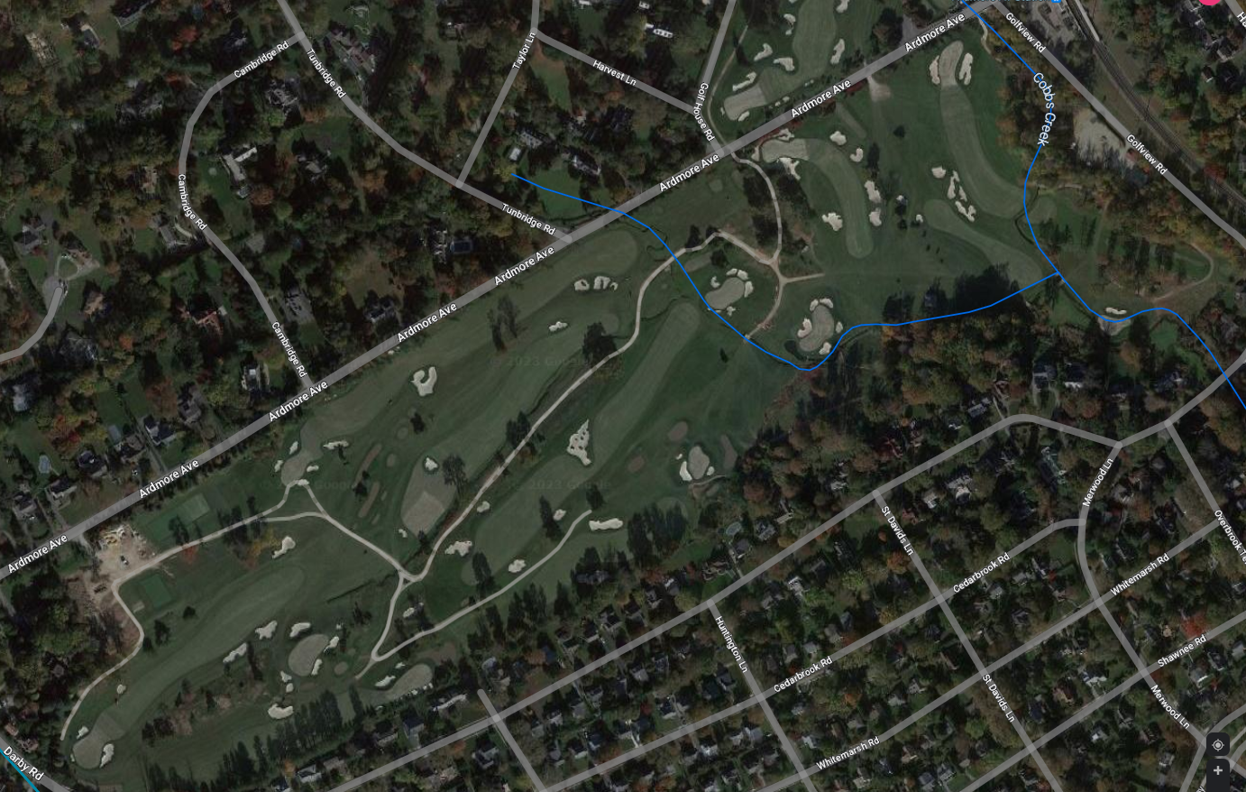
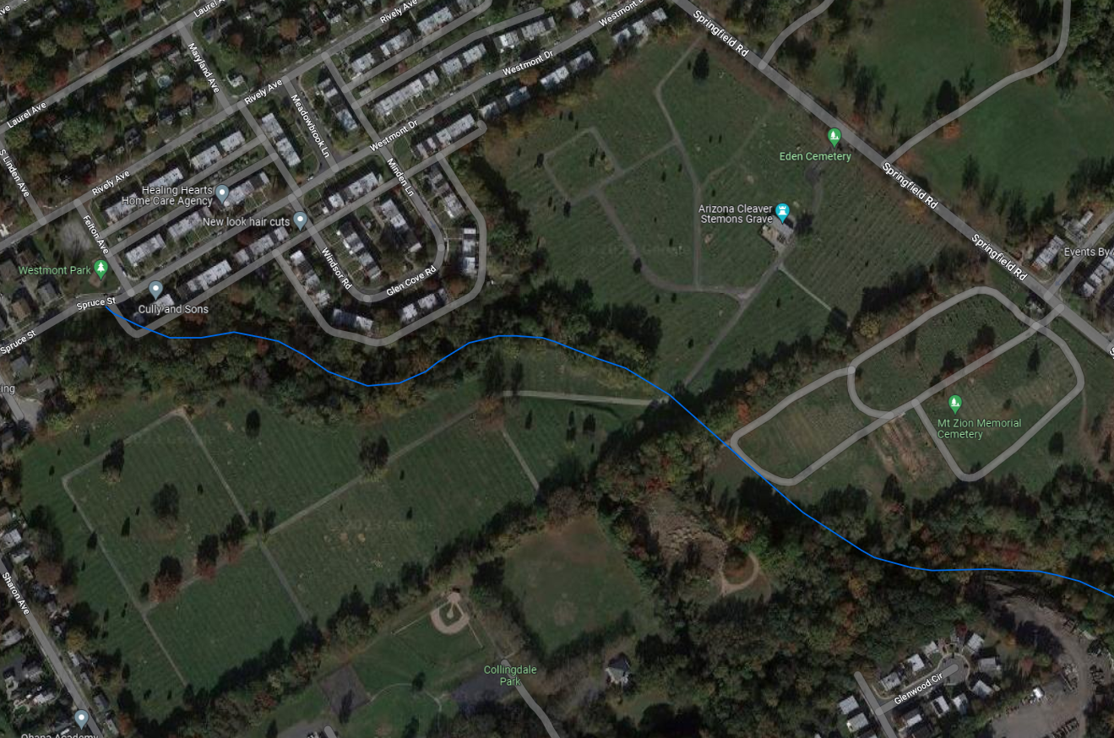
Identify Parcels for Conservation
Some quick observations…
Not many very large parcels…only ninety-one over 25 acres…and most are golf, cemetery, or developed – some institutions.
A lot of golf courses, but less land than we might think:
Watershed total: 49,000 acres.
Golf course: 1,000 acres or roughly 2% of watershed
A lot of cemeteries, but less land than we might think:
Watershed total: 49,000 acres.
Cemeteries: 1,126 acres or roughly 2% of watershed
Many small parcels will need to make a difference!
Notes:
Large photo, with first bullets over
We will say the "why points"
What are we trying to accomplish?
Gain an understanding of the regulatory tools communities are currently using
Figure out what’s working or not working and WHY
Identify where the watershed may be unprepared for current or future development trends
Understand communities ordinances in the context of their community character
Why are we doing this now?
Inform our approach to some KPI’s – elected officials, appointed volunteers, municipal staff
Identify products or resources to include in the plan, such as model ordinances & funding sources
Learn about successful ordinances and share them across the watershed

Slide 20
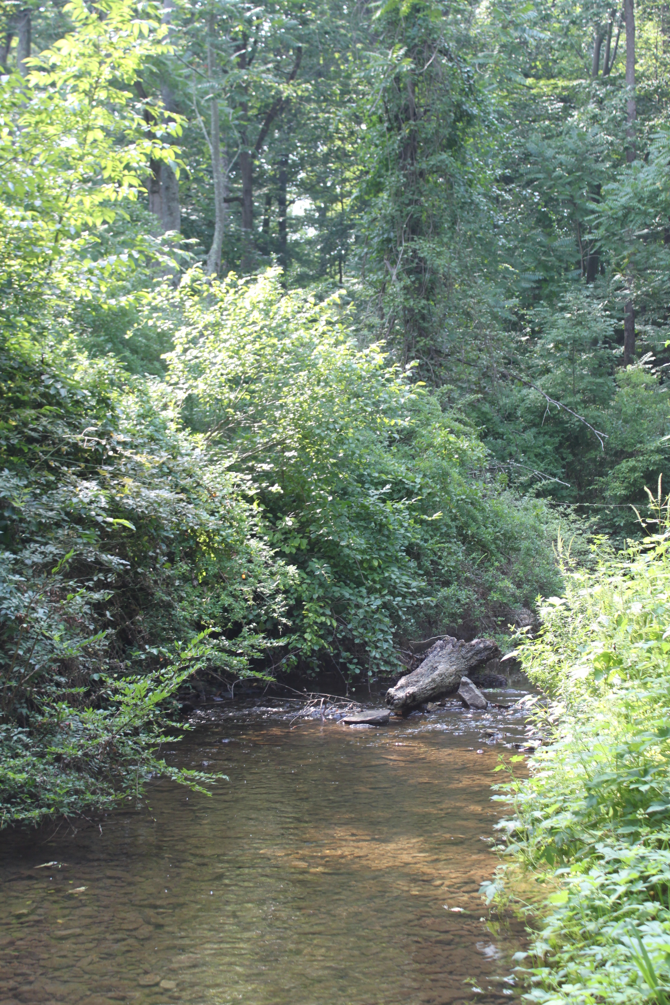
Ordinance Assessments - Goals
What are we trying to:
Gain an understanding of the regulatory tools communities are currently using
Figure out what’s working or not working and WHY
Identify where the watershed may be unprepared for current or future development trends
Understand communities' ordinances in the context of their community character
Notes:
Large photo, with first bullets over
We will say the "why points"
Why are we doing this now?
Inform our approach to some KPI’s – elected officials, appointed volunteers, municipal staff
Identify products or resources to include in the plan, such as model ordinances & funding sources
Learn about successful ordinances and share them across the watershed

Slide 21

Ordinance Assessments – Non-Goals
What we are NOT trying to do…
Grade, score or rank the communities
Assess them through a one size fits all lens

Slide 22
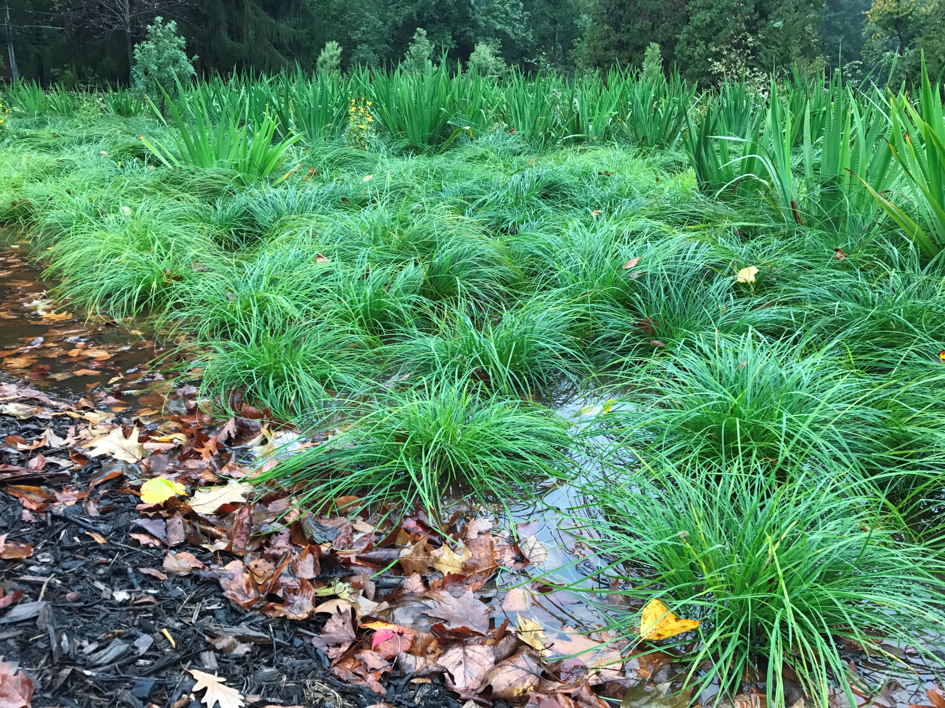
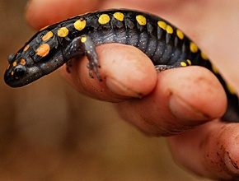
Ordinance Assessments – Wetland Protections
Notes:
What are we assessing? Why?
Wetlands are important areas for storing water
enhance groundwater infiltration as well as sediment, nutrient and pollutant filtration.
What we might find: wetland buffers and ensuring wetland locations are noted on applications

Slide 23
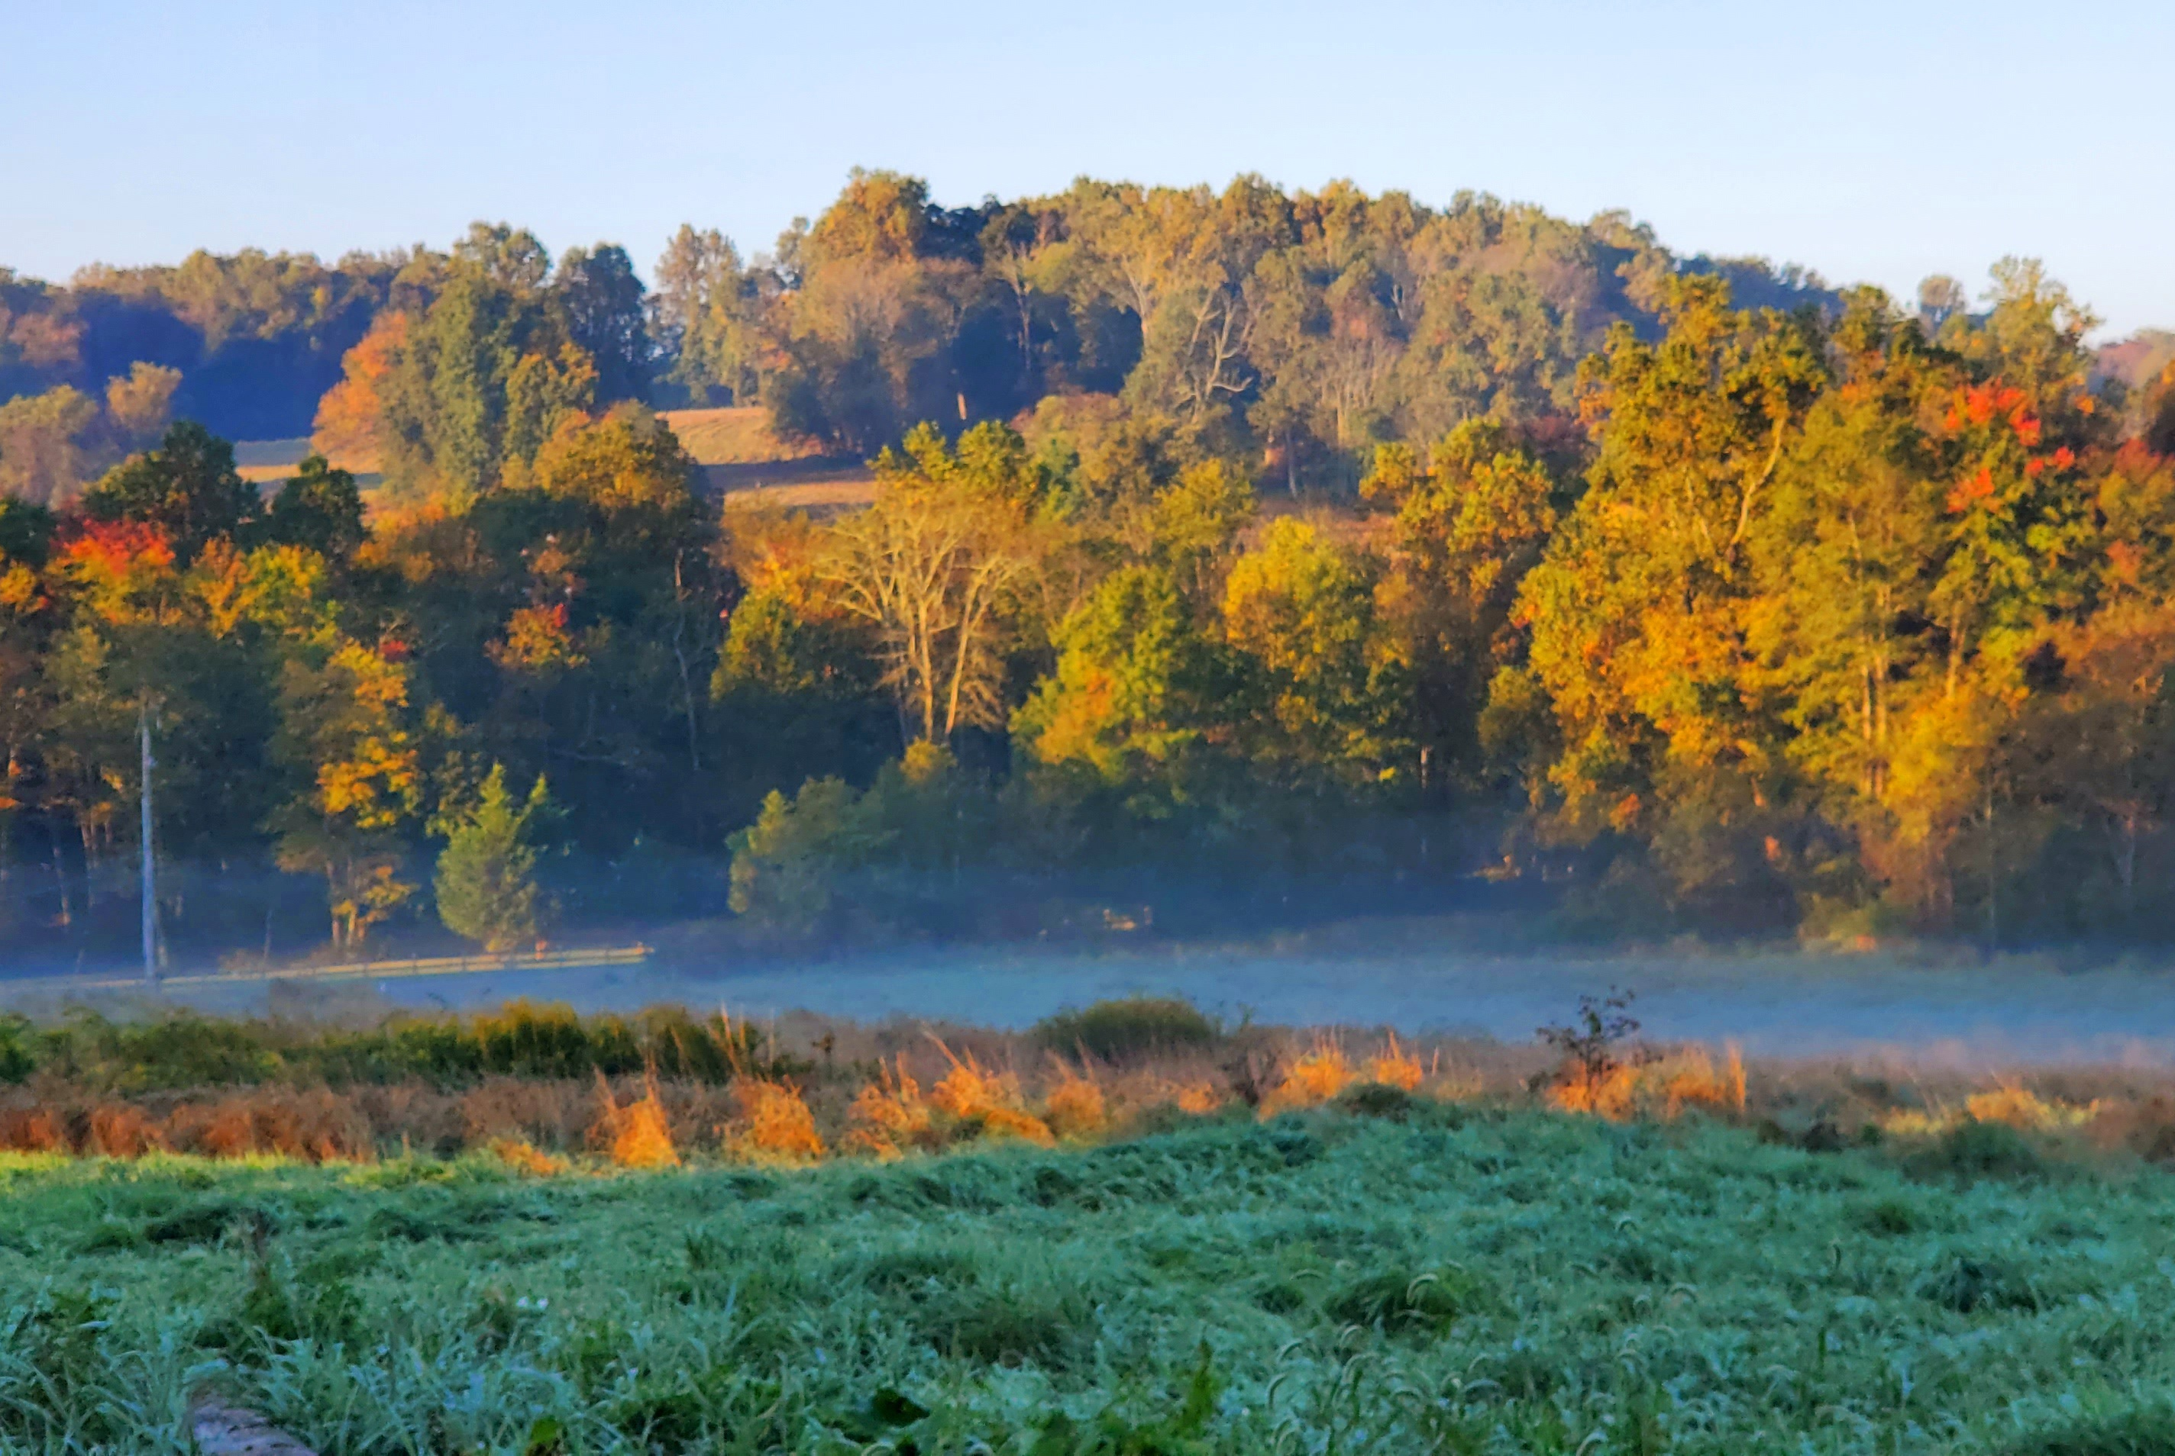
Ordinance Assessments – Tree Protection
Notes:
What are we assessing? Why?
Keeping existing trees is a good idea. Trees take time to grow and leaving trees on site will be beneficial
What might we find:
Does existing vegetation need to be noted on places including existing trees and species
tree clearing limits on new subdivision and land development applications.
Requirements that trees be replaced if a certain % of trees are removed
Are native trees encouraged

Slide 24
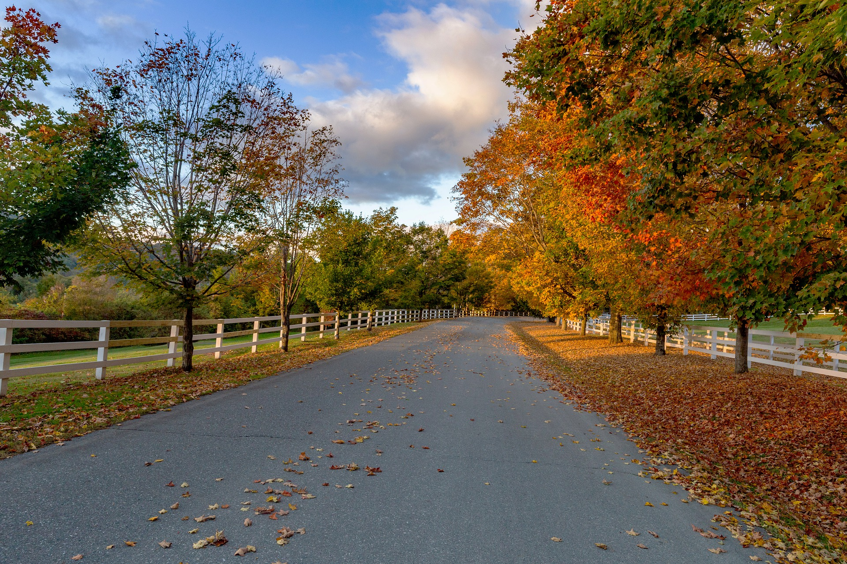
Ordinance Assessments – Landscaping Standards
Notes:
What are we assessing? Why?
Landscaping Standards: What do new developments need to consider in terms of additional landscaping?
Landscaped areas help absorb stormwater and reduce runoff
These places are also more attractive and property values are generally higher when residential areas are landscaped
Commercial areas should be landscaped as well
Landscaping Requirements in the SALDO
Landscaped stormwater basins
Landscape buffers
Street trees

Slide 25
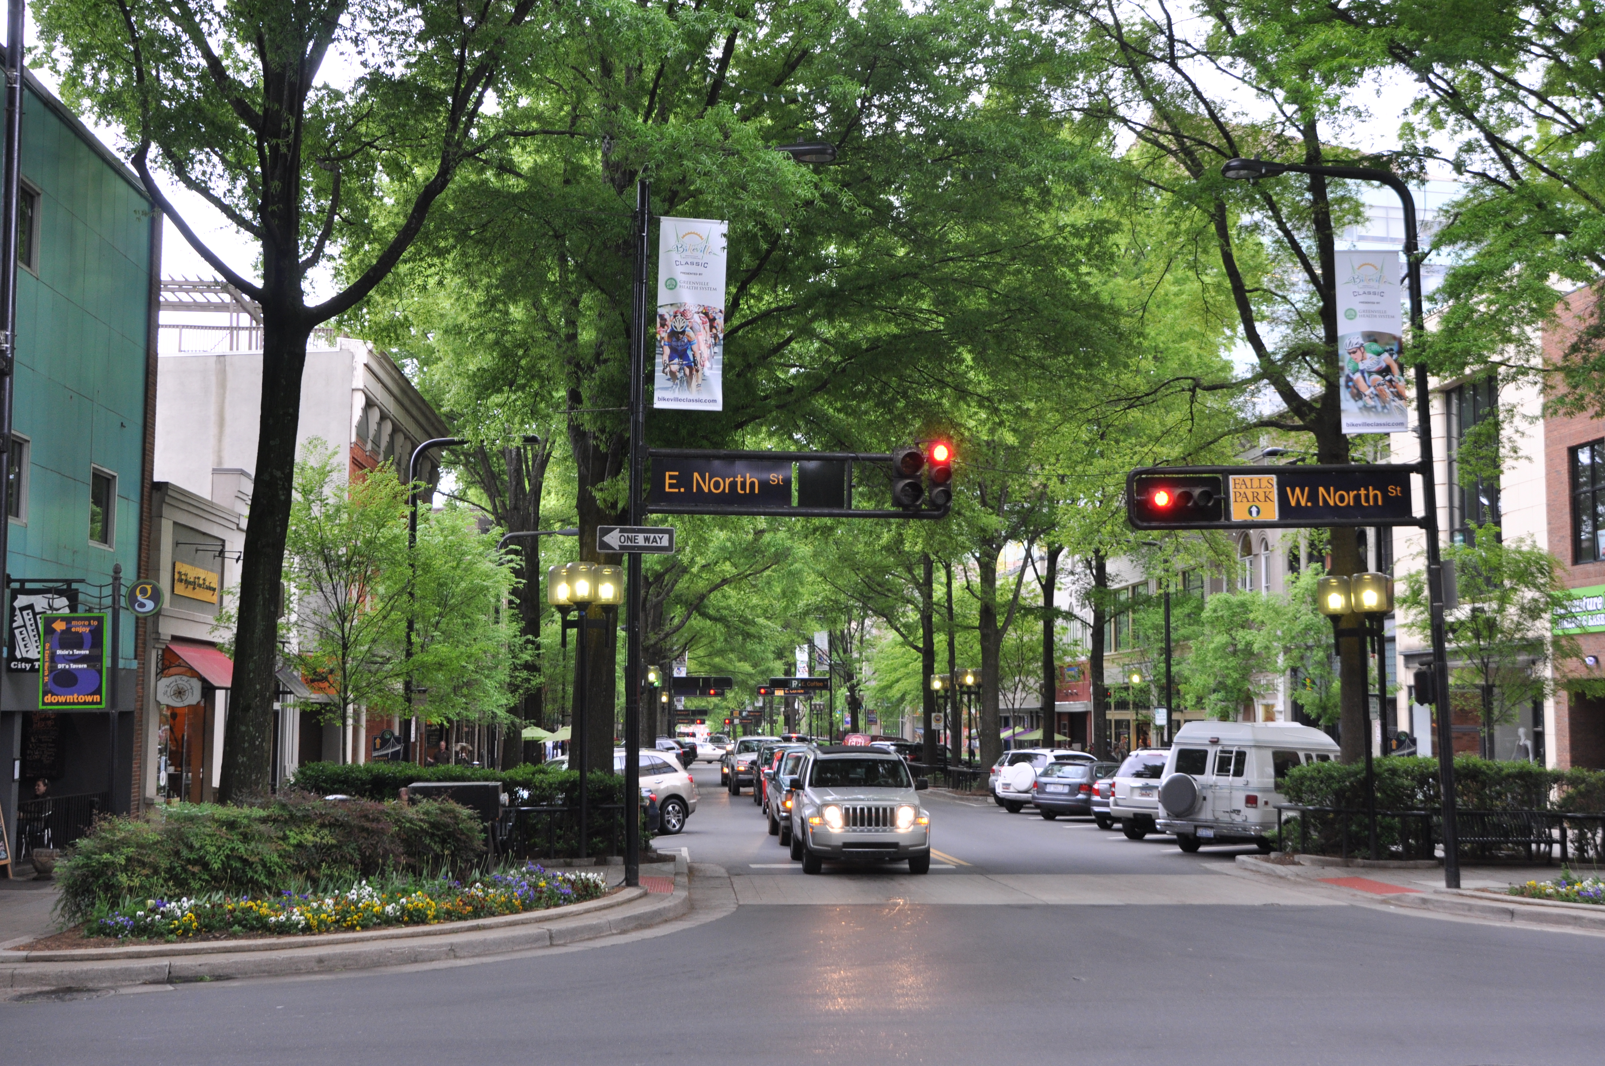
Ordinance Assessments – Landscaping Standards
Notes:
What are we assessing? Why?
Kate: Is this photo too rural? Do we have anything more urban? More urban option (Greenville, SC) has to be licensed
https://commons.wikimedia.org/wiki/File:Greenville_SC_downtown_%2816584220864%29.jpg
Wanted to provide a more urban example: This is Greenville SC’s main street. Mature trees are located between the roadway and the sidewalk
Street trees should be required in both residential and commercial areas.
Landscaping Requirements in the SALDO
Landscaped stormwater basins
Landscape buffers
Street trees
Street trees can also enhance property value.
“Based on 2,608 real-estate transactions, researchers in Portland, Oregon, have documented that homes along tree lined streets sold, on average, for $7,130 more than homes without street trees
(Donovan and Butry, 2010).

Slide 26
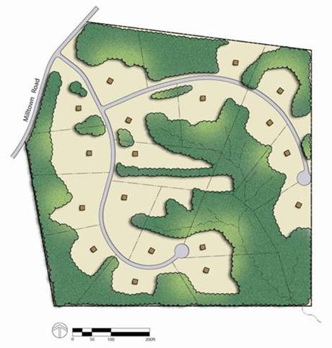
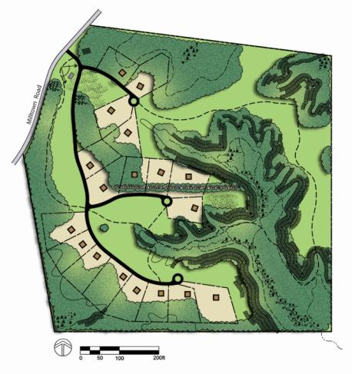
Ordinance Assessments: Conservation Design
Notes:
26
ID open space (wetlands, forested areas, streams, steep slopes) etc
Locate House Sites—away from natural features, keep views in mind, single loaded streets,
Locate Infrastructure (Roads)
Draw Lot lines
What are we assessing? Why? Focus on environmental features
Usable open space (flat and dry) would be required IN ADDITION TO areas that must remain open because they can’t be built on (steep and wet)
We understand that some communities in the watershed are more built out than others.
The 4 step design process will be more applicable for some municipalities than others.
This option can apply to redevelopments to enhance resilience

Slide 27
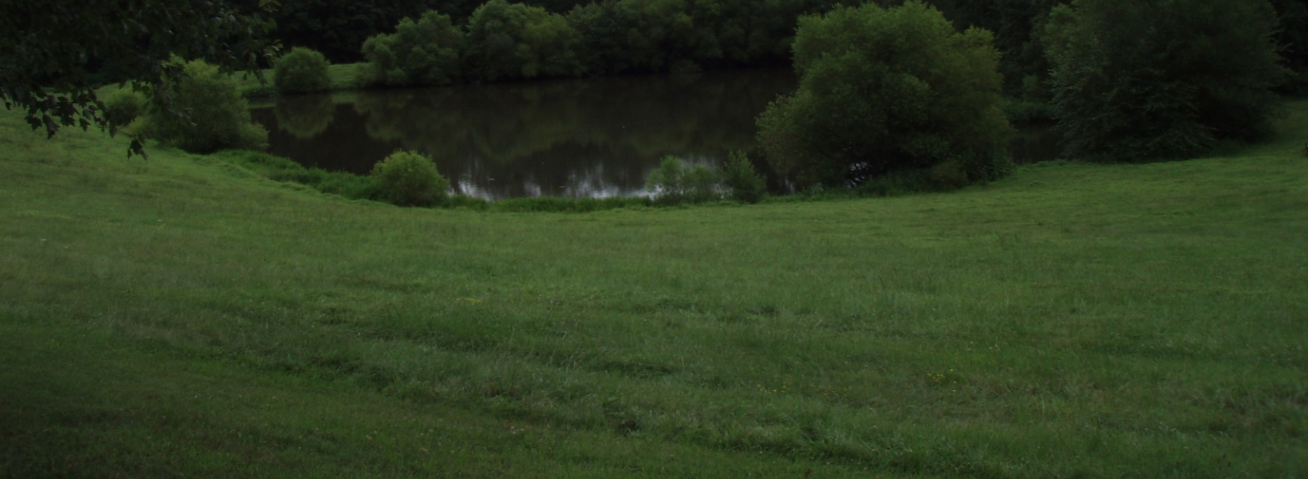
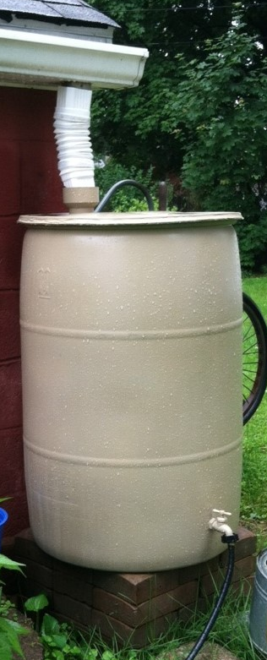
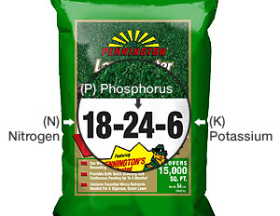
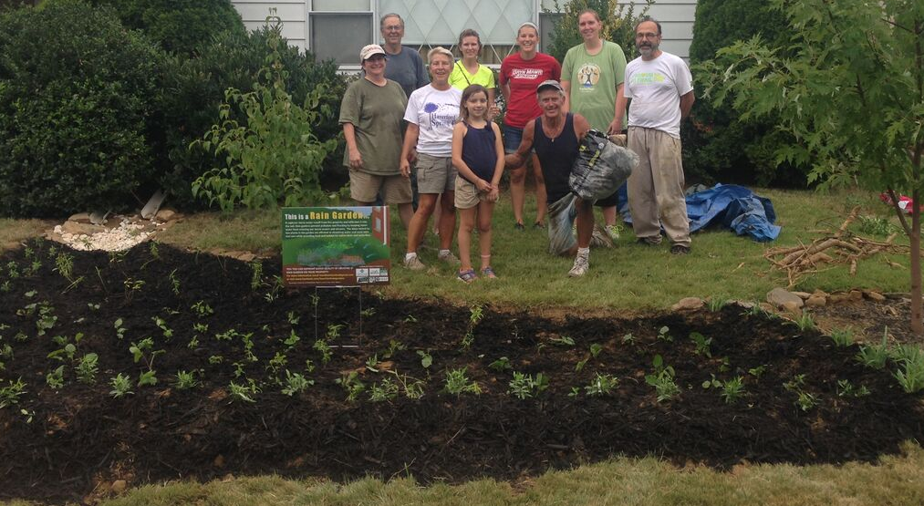
Ordinance Assessments – Site Practices
© Eastern Del. Co. Stormwater Collaborative
© Eastern Del. Co. Stormwater Collaborative
Notes:
What are we assessing? Why?
Kate
The site practices are for landowners and developers that want to go that extra mile
These practices are newer and should be permitted and encouraged
Non-profits are doing this work, including Eastern DelCo Stormwater Collaborative
Lawn reduction or removal?
Rooftop downspouts disconnected when storage tanks, pervious area adjacent ·
Rain barrels and temporary storage allowed/credited ·
Greywater for exterior uses ·
Requirement to conserve native soils
Permit required (or other protection/ownership) for removal of trees within public right of way

Slide 28
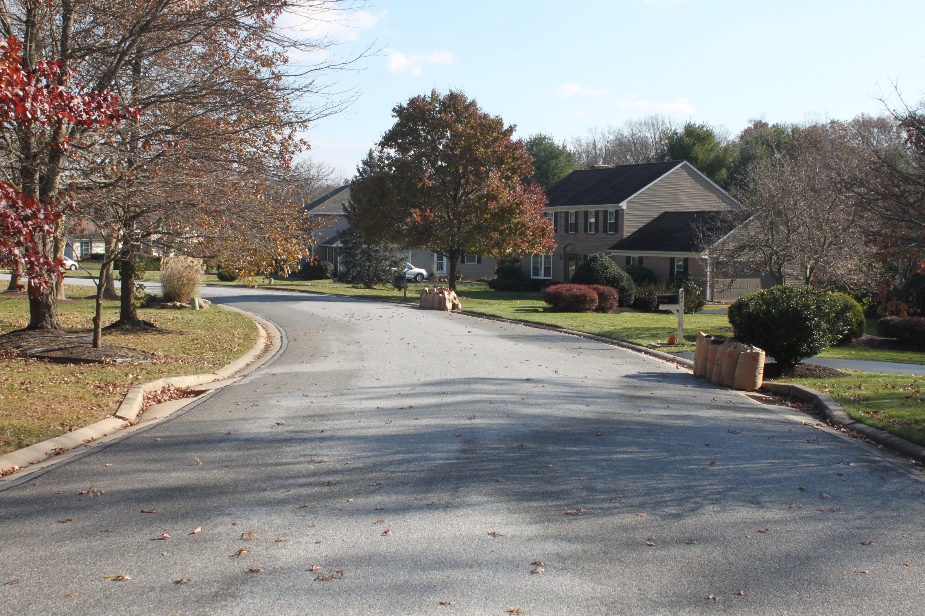
Ordinance Assessments - Streets
Notes:
Nick
Street Design:
Wider streets (w/curbs) convey/contribute to more runoff
Create need for more (grey) infrastructure, more municipal responsibility
Direction of flow - upper v. lower watershed
What are we assessing and why in terms of the watershed
Wider the street, more stormwater, more into streams, more erosion, more flooding downstream
Make sure we tie it to the watershed
Widths vis a vis parking

Slide 29
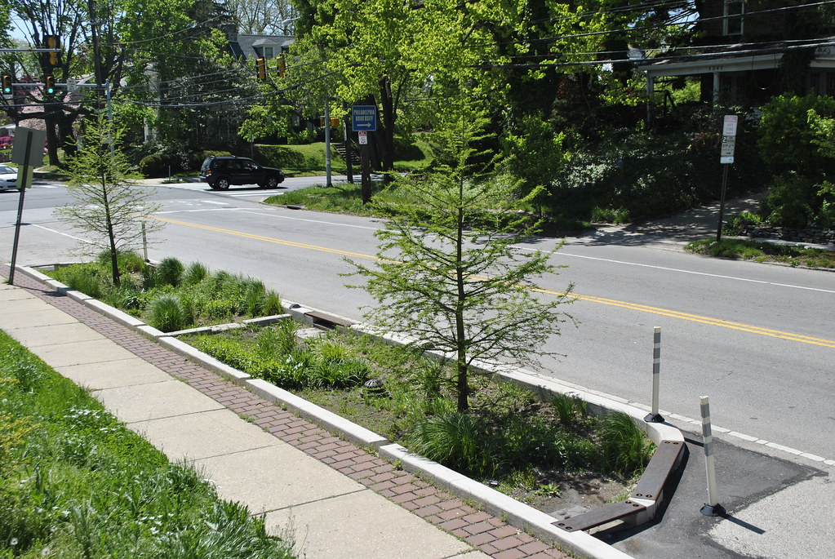
Ordinance Assessments - Streets
Notes:
Nick
Street trees every 30’
Curbing requirements waived to allow stormwater infiltration
Width requirement W, W/O parking - Road diet/minimum width
BMP bumpouts – direct runoff
Streets as conveyance

Slide 30
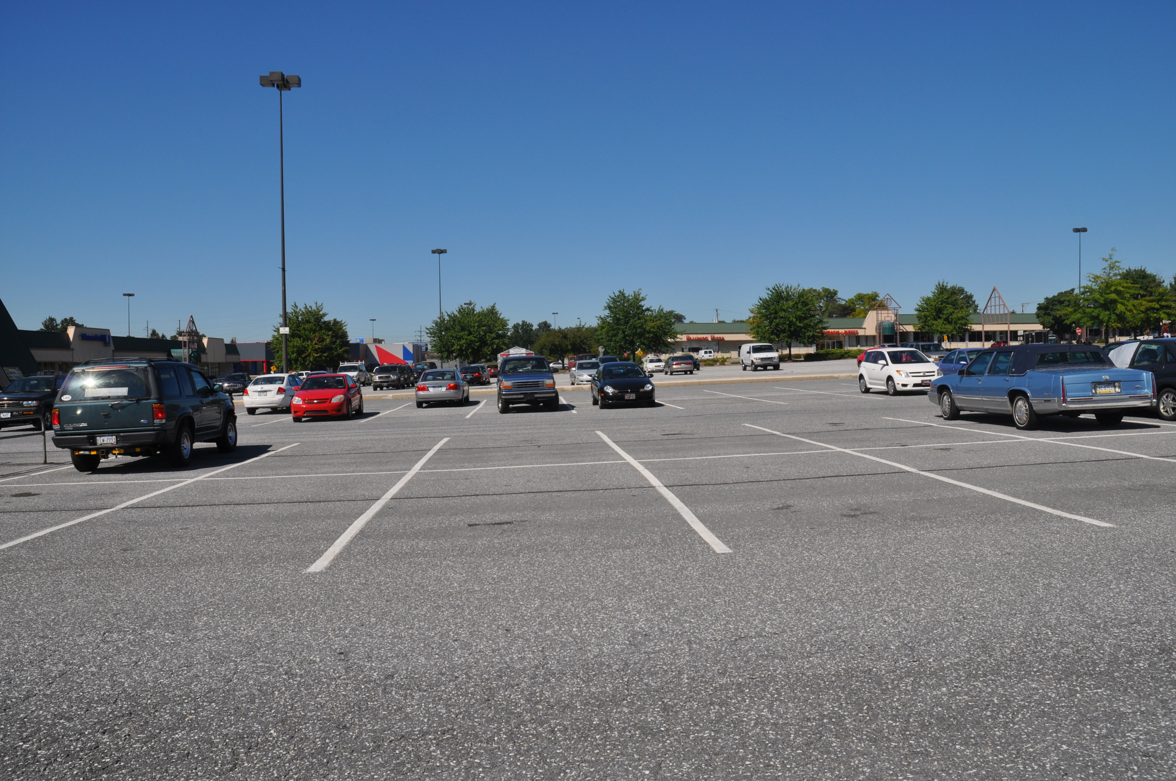
Ordinance Assessments - Parking
Notes:
Nick
Parking lot – probably too many spaces, shared parking, reserve parking, MAXimum ratios, landscaping for swm, minimum landscaping
Amounts of impervious surface
Landscaping as GSI
Are they permitted within riparian buffers?

Slide 31
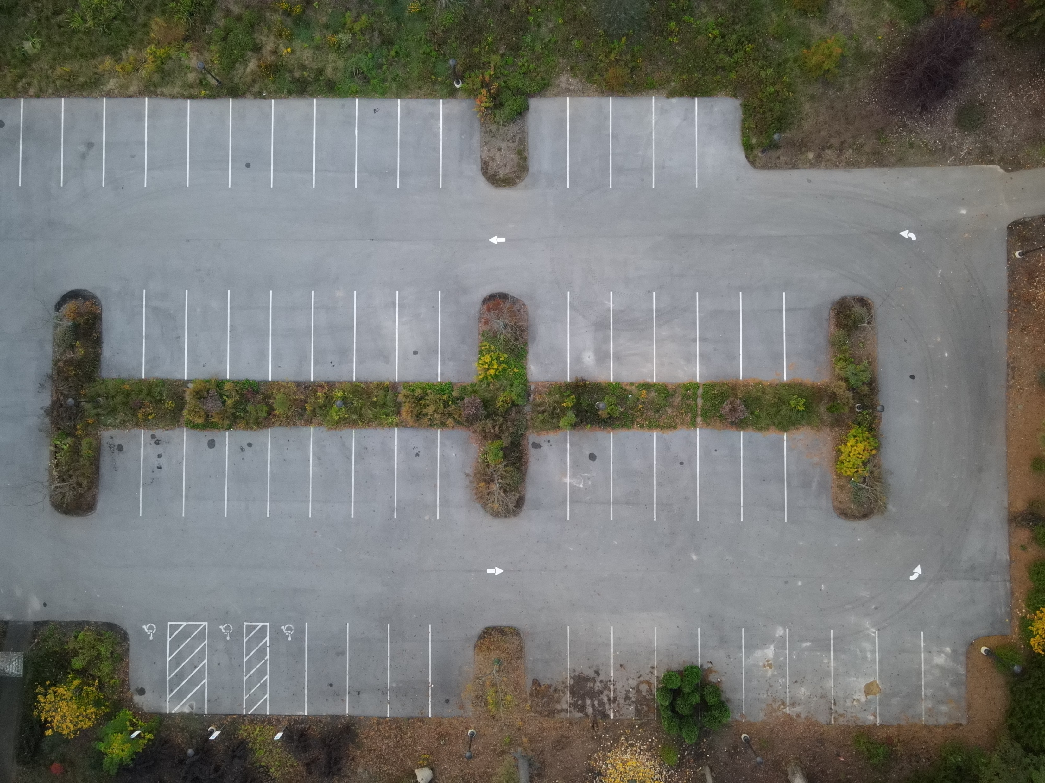
Ordinance Assessments - Parking
Notes:
Nick: Parking lot – probably too many spaces, shared parking, reserve parking, MAXimum ratios, landscaping for swm
Curb Cut/No Curb – permitted or required?
Permeable paving
Stall dimensions

Slide 32
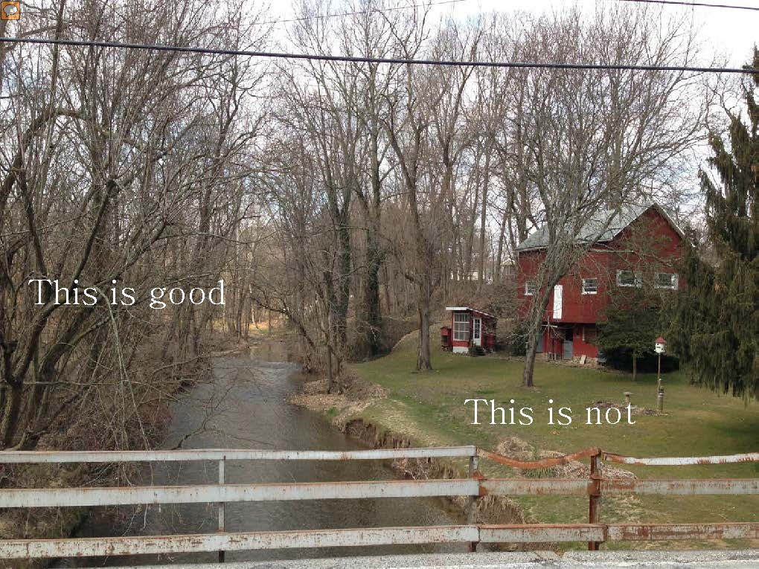
Ordinance Assessments – Riparian Buffers
Notes:
Nick
We know they are good and want them:
Filter nutrients, pesticides, animal water, sediment
Stabilize eroding banks
Shade, shelter and food for aquatic organisms
We know that they aren’t practical everywhere and aren’t trying to make a judgement, but we do want to get a sense of how comprehensive codes are in the
Every foot of tree cover next to a stream is important.
While even 30 feet removes 65% of sediment, what people don’t understand is that it’s the fine silts and clay that clog fish gills.
Those fine silts and clay aren’t removed until we get to about 100 feet of forested buffer.

Slide 33
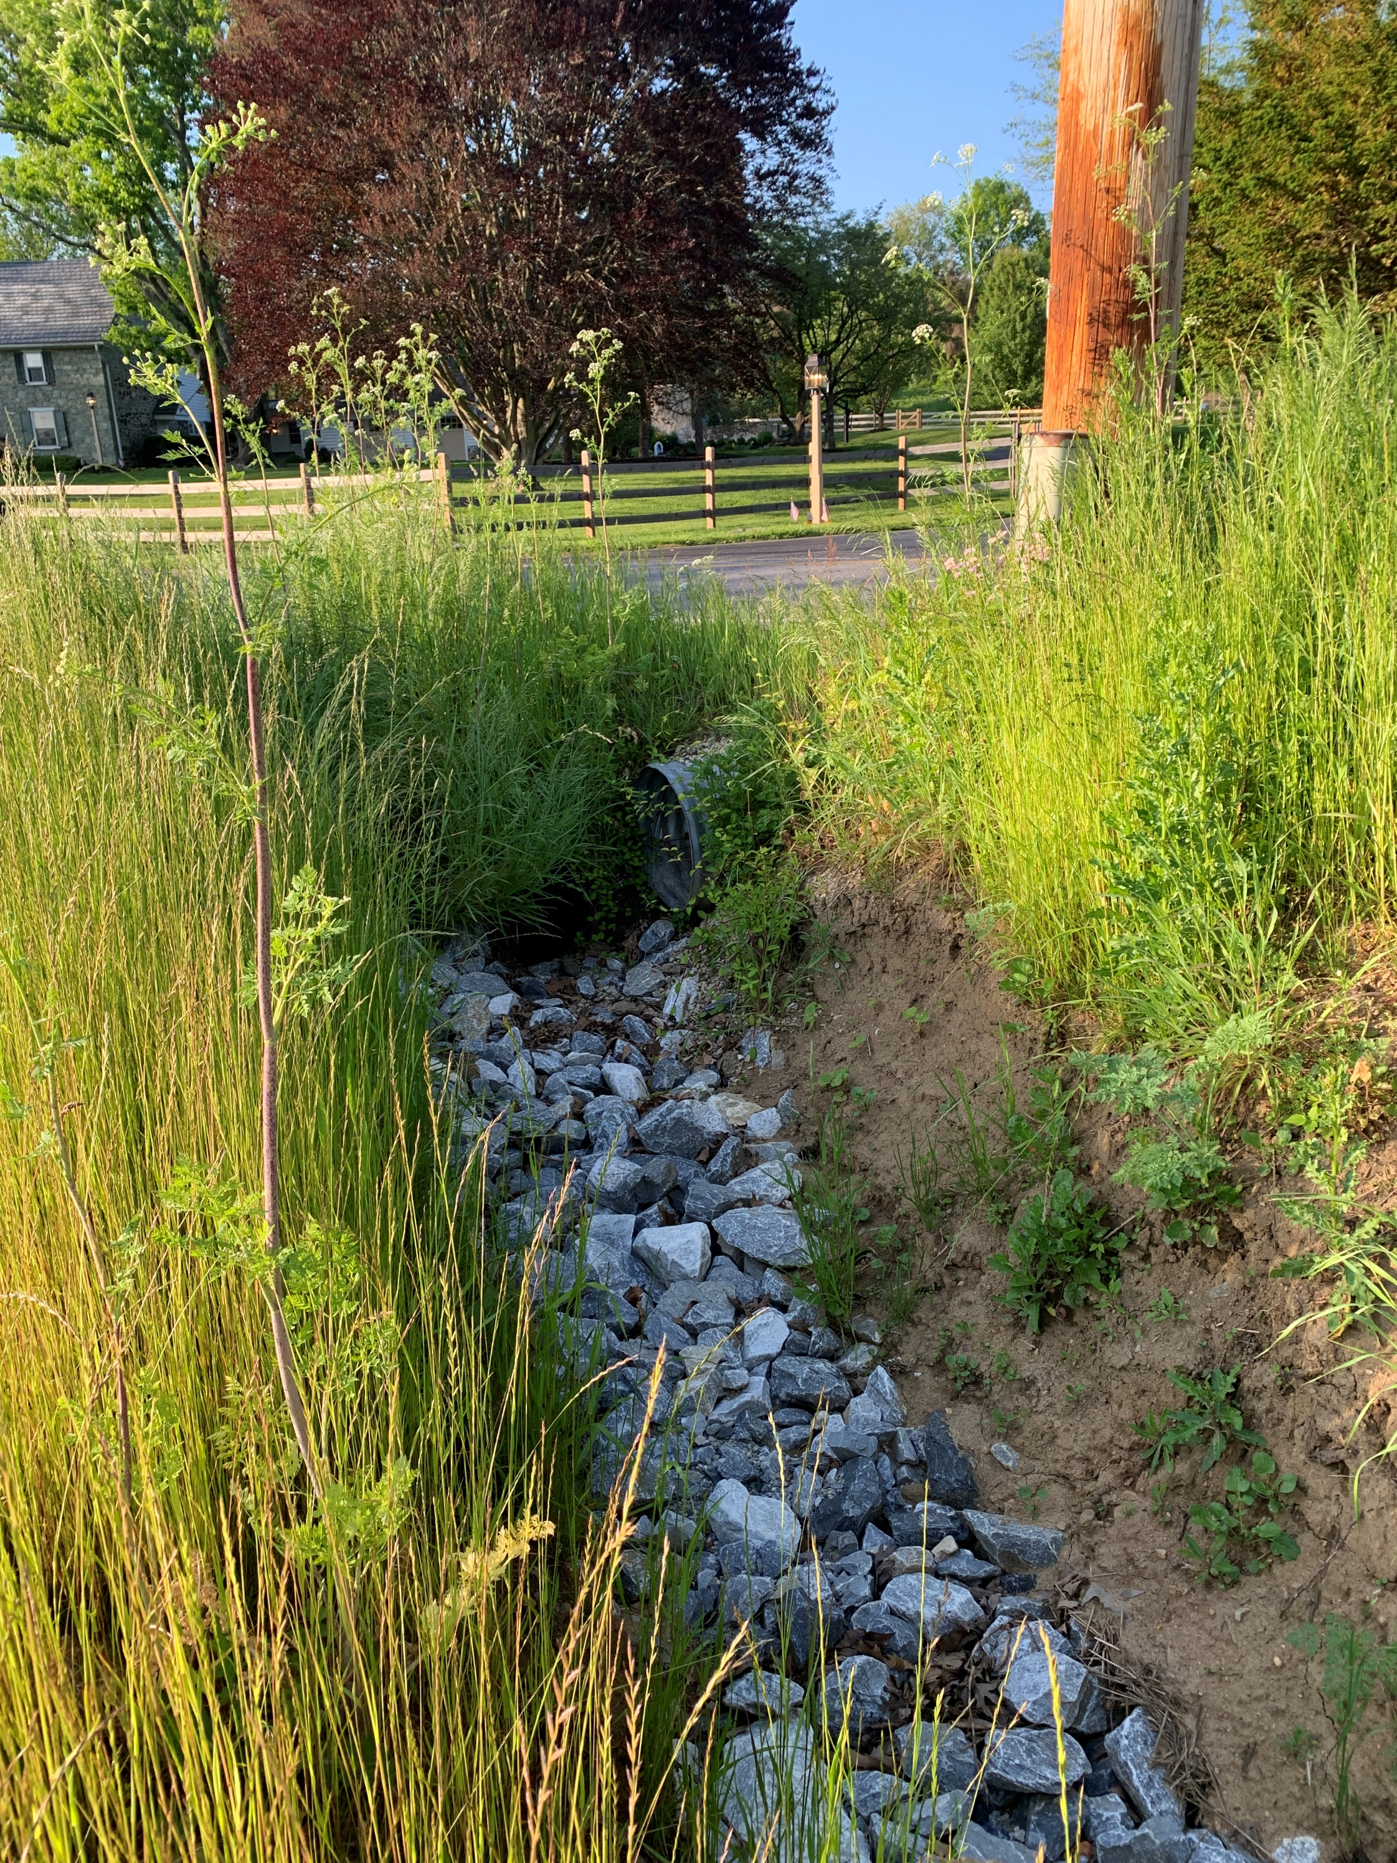
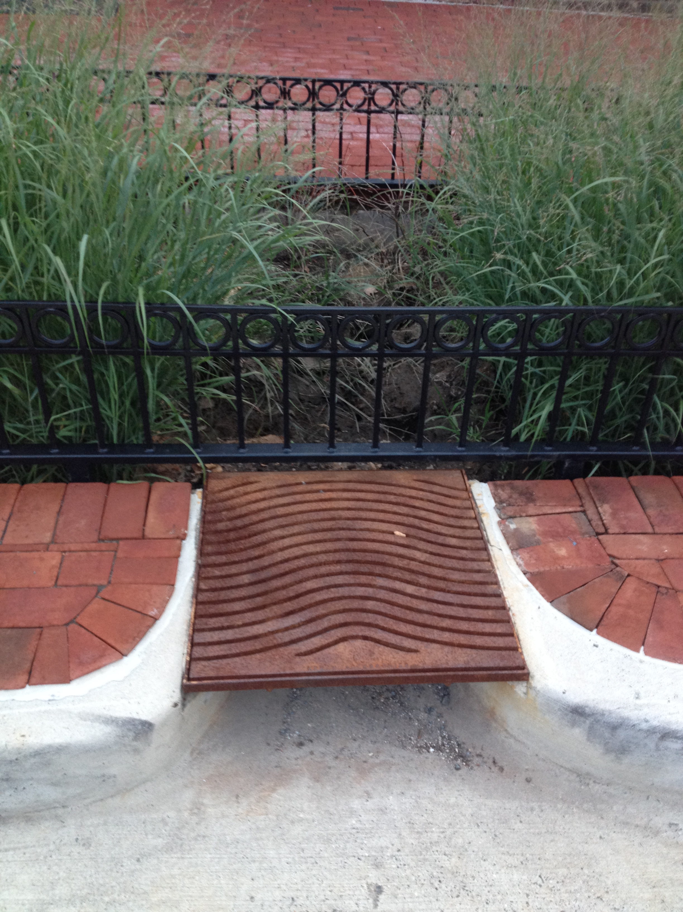
Ordinance Assessments – Stormwater Management
Notes:
Nick
Why – to promote infiltration
Prevent Flooding downstream,
Flooding
Curbs/Street Bumpouts
Reduction in post-construction runoff
Maintenance of BMPs
Impervious reduction
Manage erosion

Slide 34
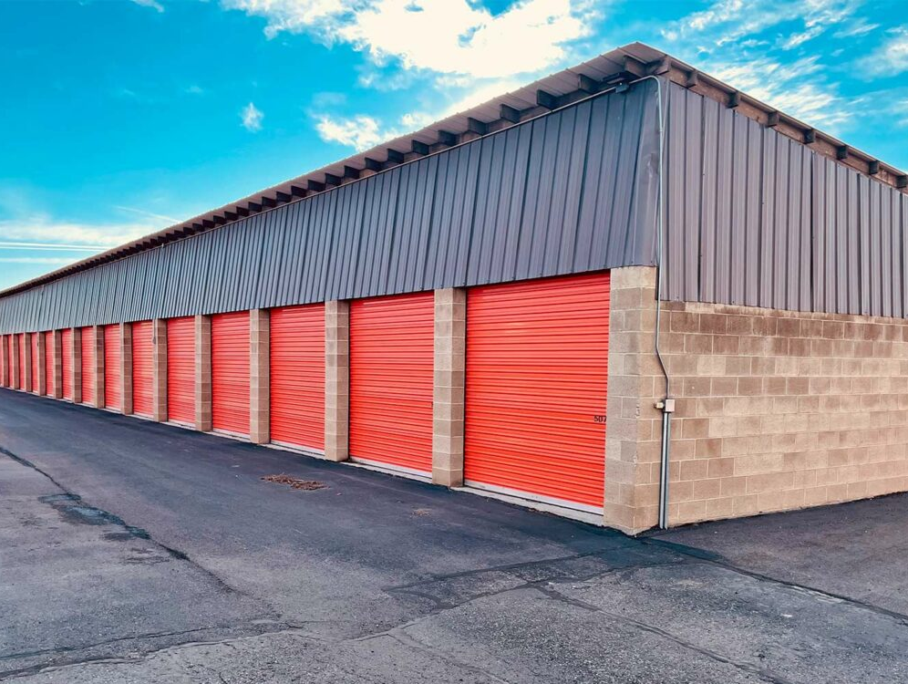
Ordinance Assessments – High Intensity Uses
Notes:
Digital billboards
Warehouses
Noise/Light Pollution
Where is it permitted?
Appropriate on greyfields, close access to highways, where re-development is being encouraged
Environmental Impact Statements
Perceived Threat/Trend?
Make sure we stop and ask what is happening now, what is coming up?
Pause -

Slide 35
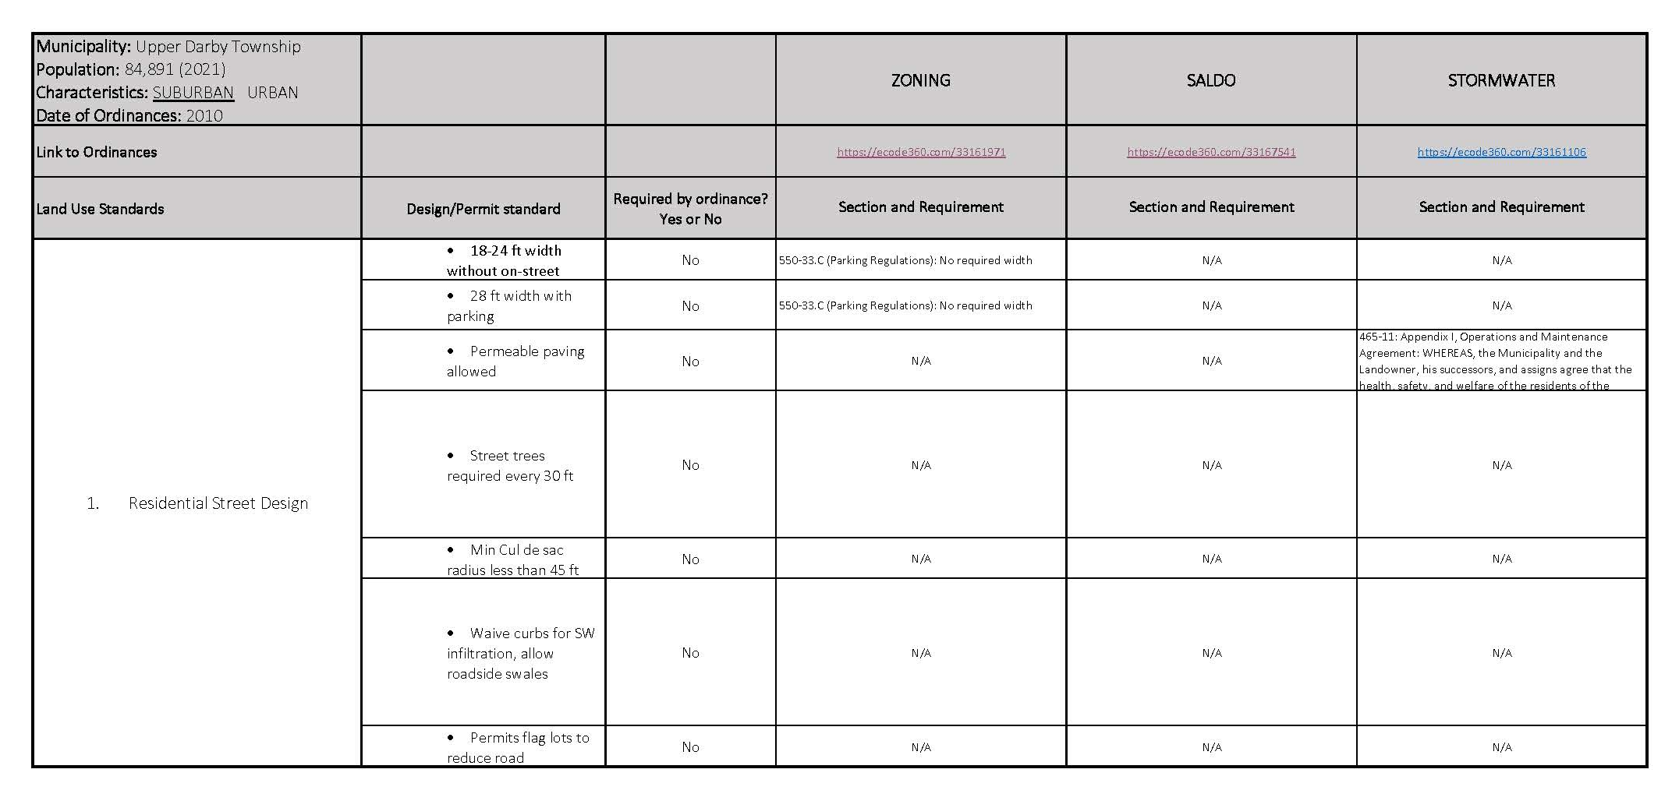
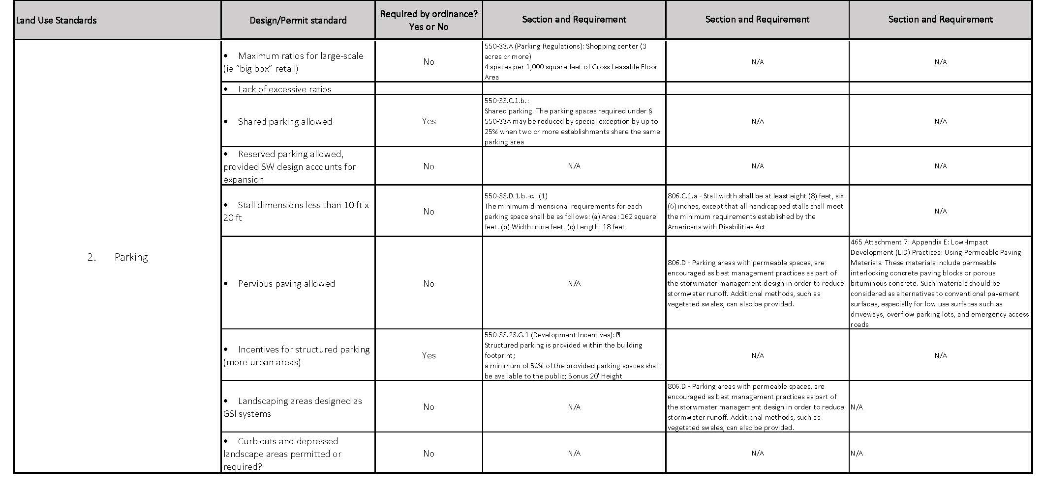
Ordinance Assessments – Summary Sheet
Notes:
Importance of assessing municipalities in context – suburban v. urban, top of watershed v. bottom etc.
Reiterate we are not scoring, but looking for gaps, outdated ordinances
Working on assessment on Upper Darby – pilot version to see if it works and compile
Stop and ask what we’ve missed – are there ordinances that we have missed? What codes are missing?

Slide 36

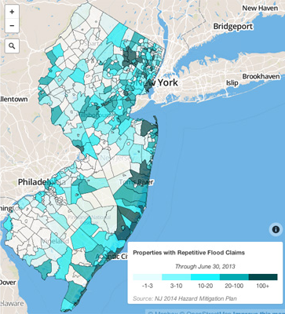
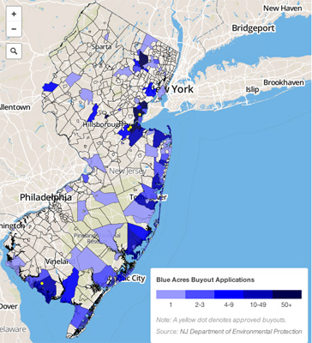
NJDEP: Blue Acres Program
Notes:
36
In 2012, I was working for the State of New Jersey and assisted with the Sandy Recovery
Program began in the 1990s and was greatly expanded after Superstorm Sandy in 2012.
These are funds that flow through the state from FEMA
This program works with willing landowners to buy properties that have been damaged by floods
Properties that have submitted multiple flood claims are prioritized
Maps on the screen show census tracts
****PA does not have a similar program focused on flooding but there are other grants available. The claims data from FEMA helps municipalities understand where flooding is an issue. We are working to access this data
****Data does not tell the whole story, not every landowner gets flood insurance
federal aid will depend on an ongoing assessment of storm damage by the Federal Emergency Management Agency,
OPA- to DEP for recovery efforts, then worked with the Office of Water Resource Coordination

Slide 37
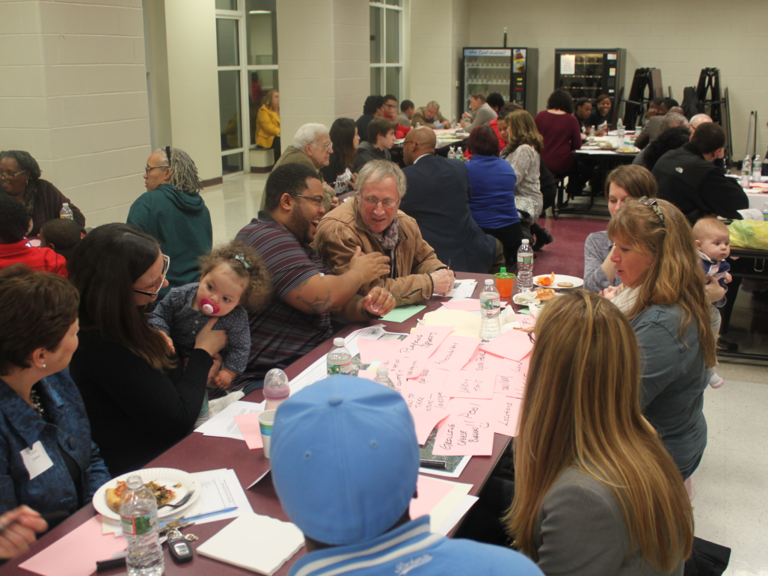
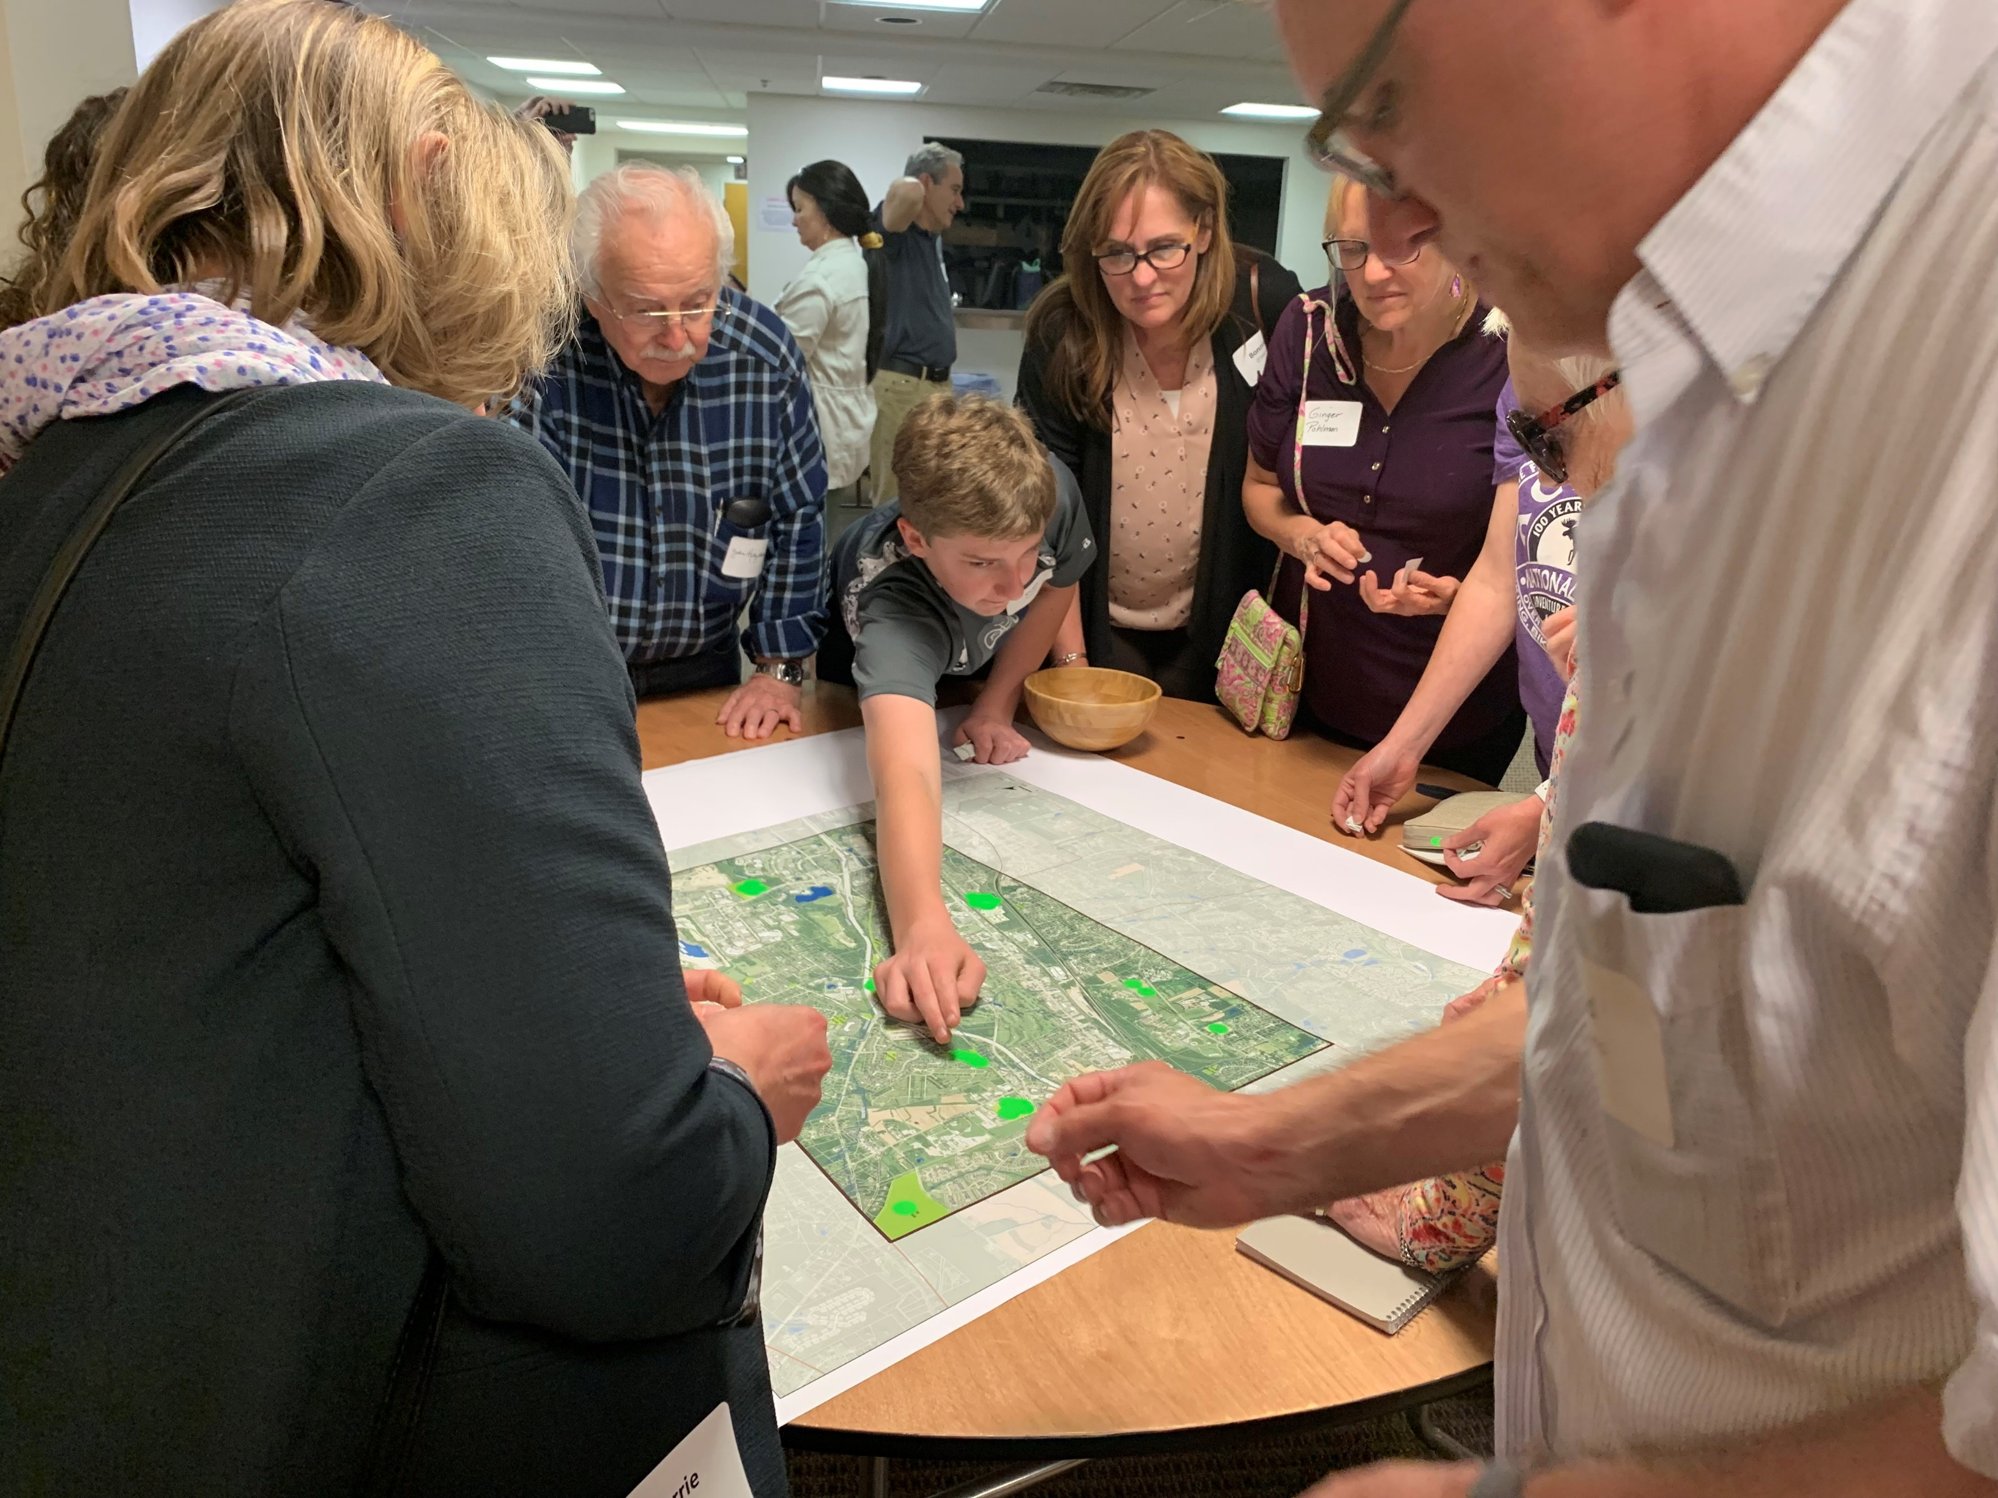
Next Steps
Keep gathering information:
Ordinance Reviews
Map Studies
Site visits & meetings
Begin public process:
Public meetings
Key Person Interviews
Focus Groups
Notes:
37
In 2012, I was working for the State of New Jersey and assisted with the Sandy Recovery
Program began in the 1990s and was greatly expanded after Superstorm Sandy in 2012.
These are funds that flow through the state from FEMA
This program works with willing landowners to buy properties that have been damaged by floods
Properties that have submitted multiple flood claims are prioritized
Maps on the screen show census tracts
****PA does not have a similar program focused on flooding but there are other grants available. The claims data from FEMA helps municipalities understand where flooding is an issue. We are working to access this data
****Data does not tell the whole story, not every landowner gets flood insurance
federal aid will depend on an ongoing assessment of storm damage by the Federal Emergency Management Agency,
OPA- to DEP for recovery efforts, then worked with the Office of Water Resource Coordination

Slide 38

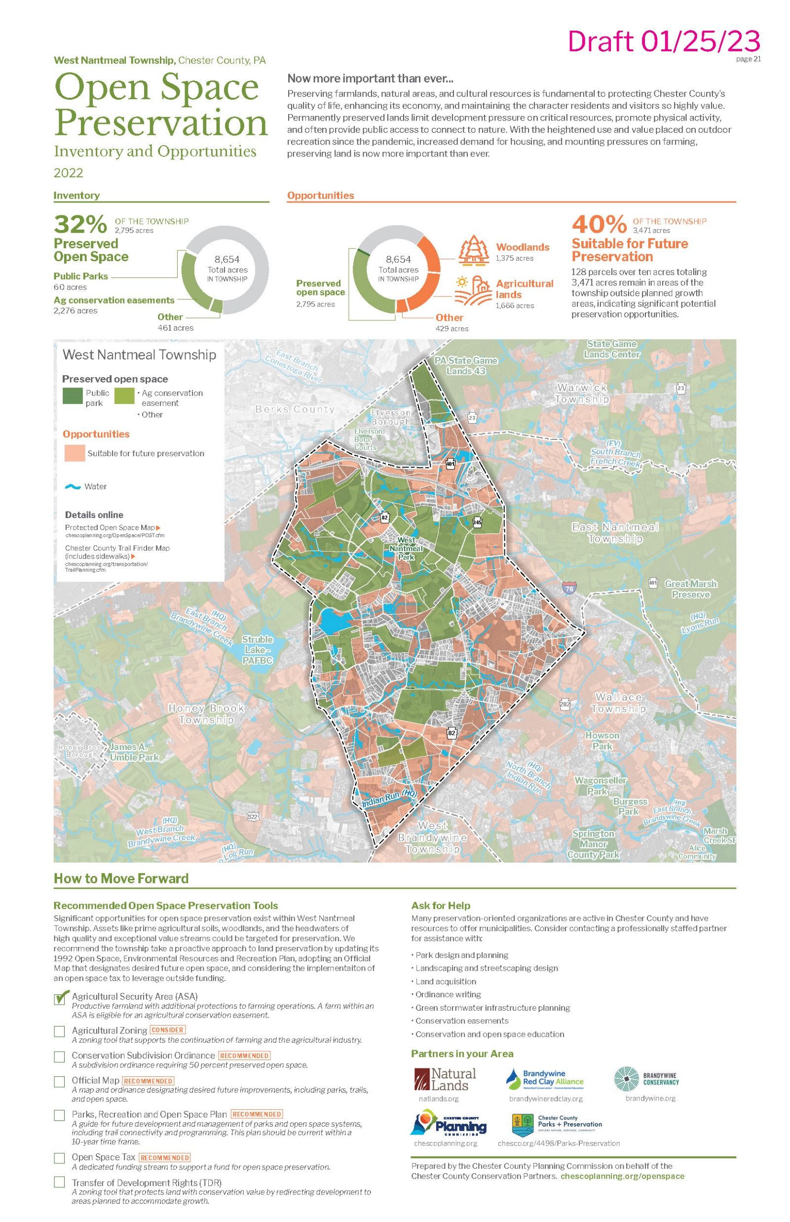
End Product???
Written Report
Toolkit Pieces
Notes:
38
In 2012, I was working for the State of New Jersey and assisted with the Sandy Recovery
Program began in the 1990s and was greatly expanded after Superstorm Sandy in 2012.
These are funds that flow through the state from FEMA
This program works with willing landowners to buy properties that have been damaged by floods
Properties that have submitted multiple flood claims are prioritized
Maps on the screen show census tracts
****PA does not have a similar program focused on flooding but there are other grants available. The claims data from FEMA helps municipalities understand where flooding is an issue. We are working to access this data
****Data does not tell the whole story, not every landowner gets flood insurance
federal aid will depend on an ongoing assessment of storm damage by the Federal Emergency Management Agency,
OPA- to DEP for recovery efforts, then worked with the Office of Water Resource Coordination

Slide 39
Your Homework
QUESTIONS?

Slide 40

thank you.

