Slide 1
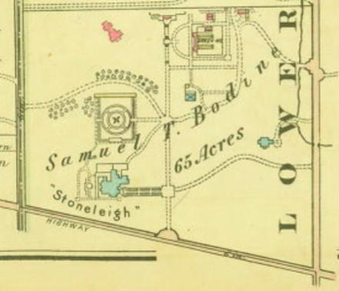
Save and Preserve Oakwell:
A Once-Secret Garden Under Threat.
DCVA Annual Meeting
Jamie Singer
Oakwell Volunteer
Lower Merion
Credit: Radnor Historical Society, Bromley Atlas 1926

Slide 2
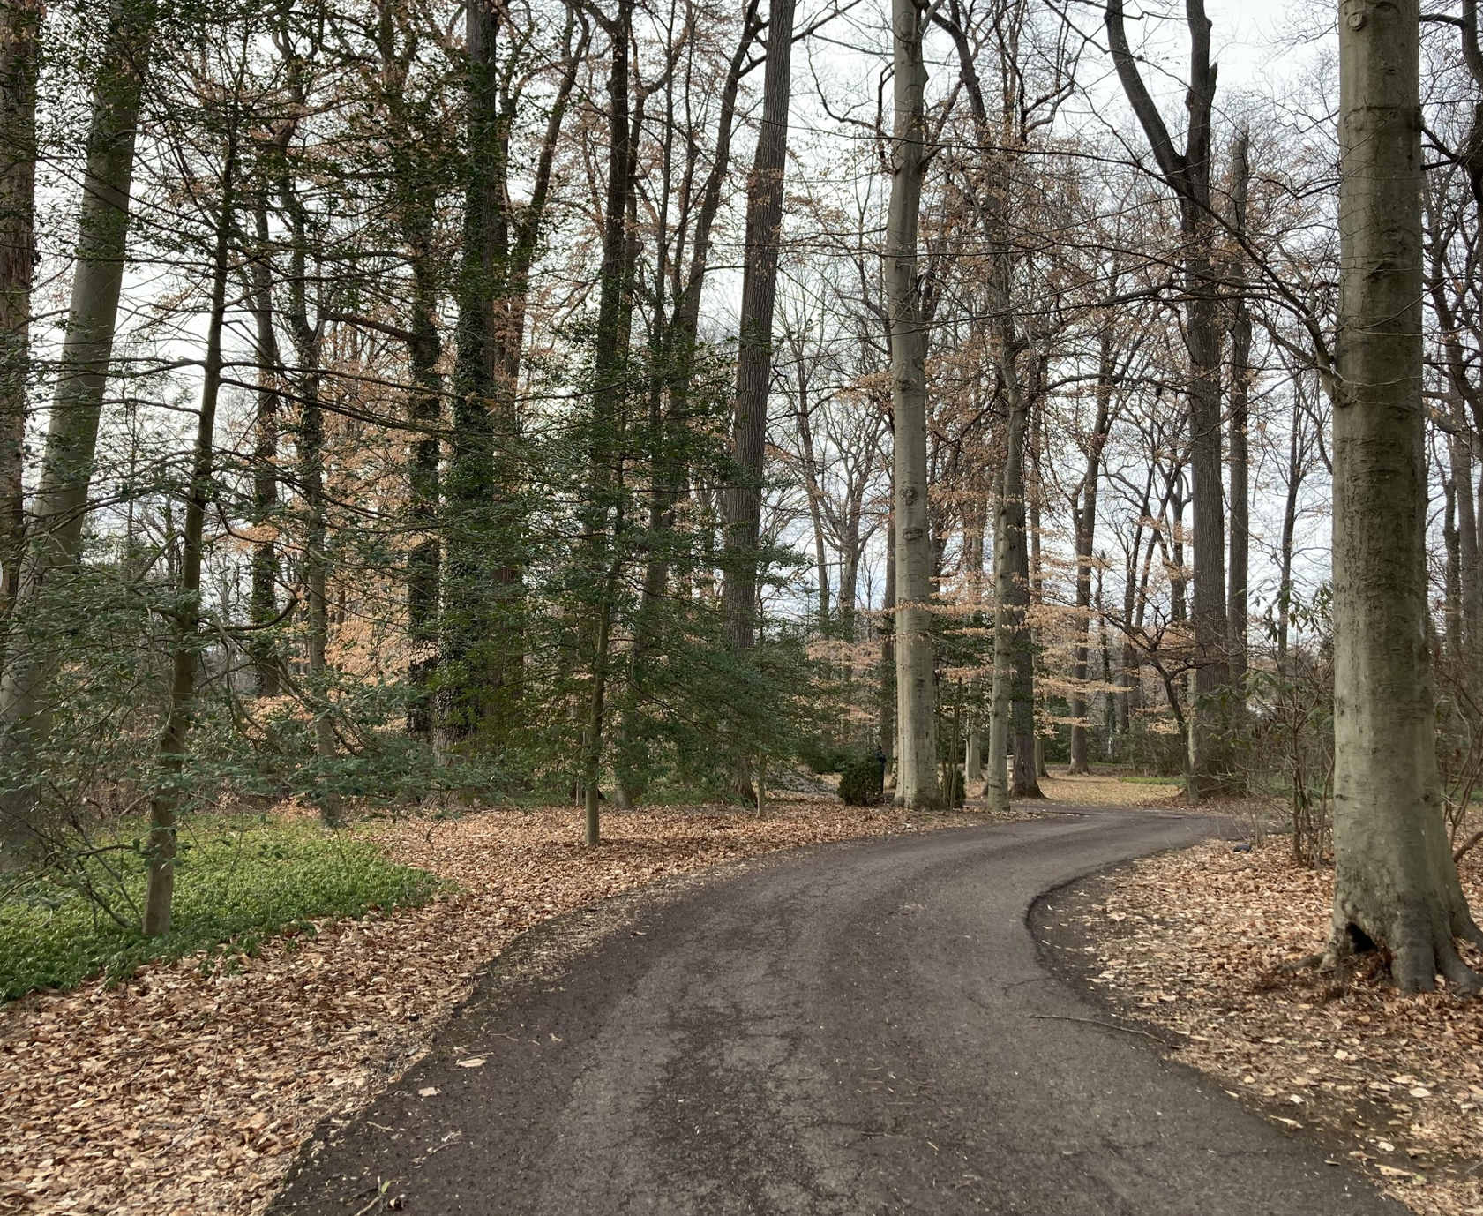
Plan & Purpose of this presentation
Brief background on Oakwell
Why is Oakwell in danger?
Efforts to save this storied place of beauty, biodiversity, and history
Credit: Save/Preserve Oakwell

Slide 3
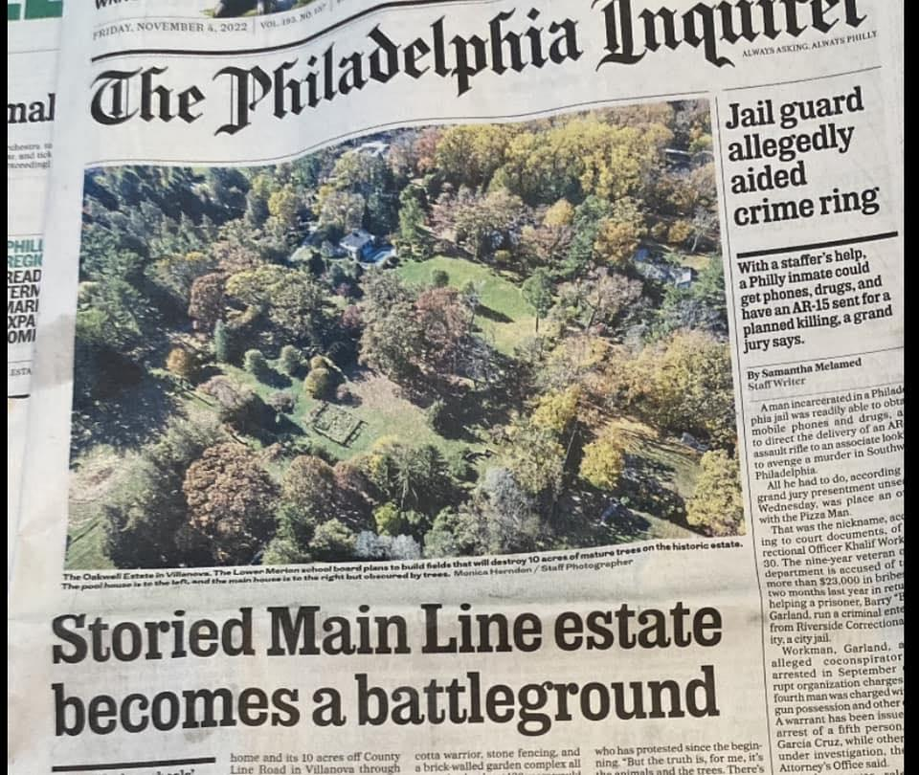
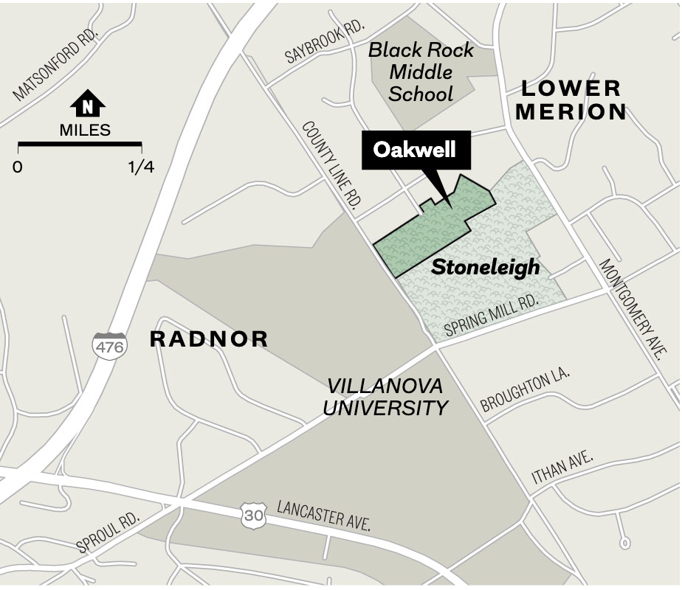
13.4 acres
42 acres
Credit: Philadelphia Inquirer 11/3/22
Notes:
This is a map taken from a front page article published in Philadelphia Inquirer. “Storied main line estate becomes a battleground”
This is Stoneleigh’s 42 acres. And adjacent to Stoneleigh is what’s labeled here as Oakwell, with a shape that equals 13.4 acres.

Slide 4
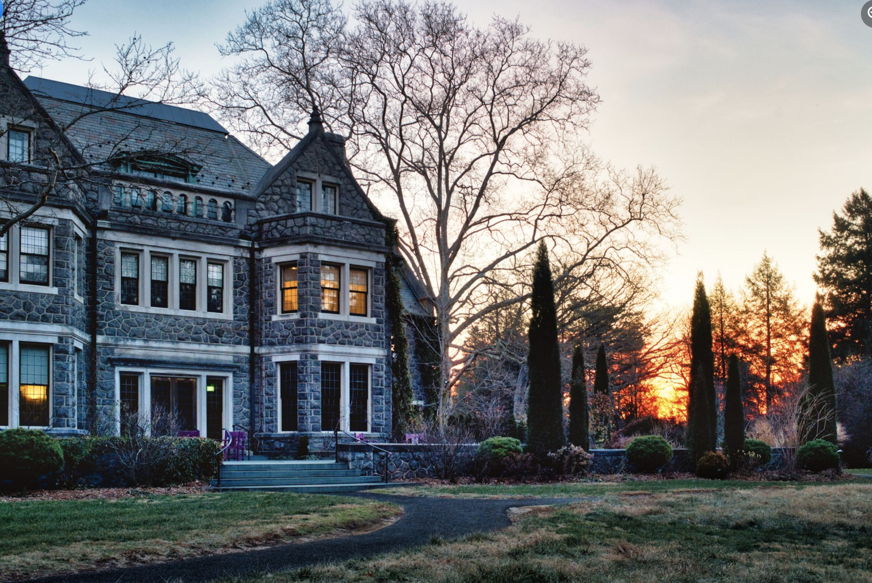
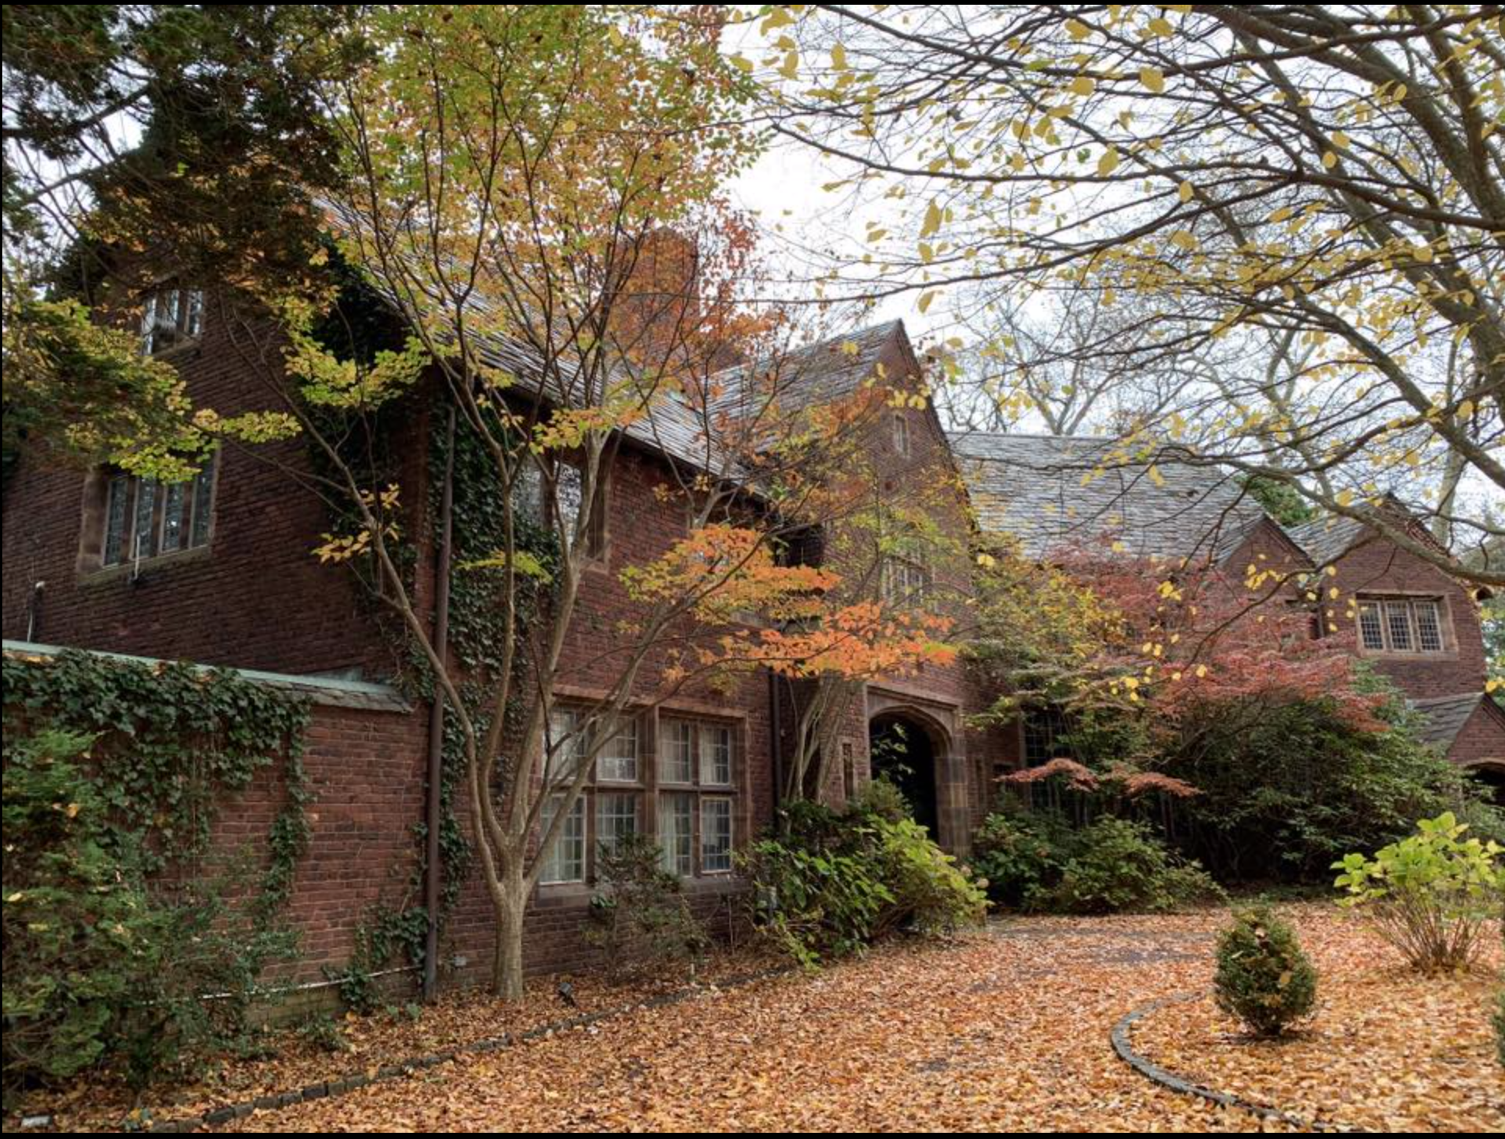
Stoneleigh and Oakwell: Sister Estates
Stoneleigh (1877)
Oakwell (1920)
Credit: Stoneleigh: a natural garden
Save/Preserve Oakwell

Slide 5
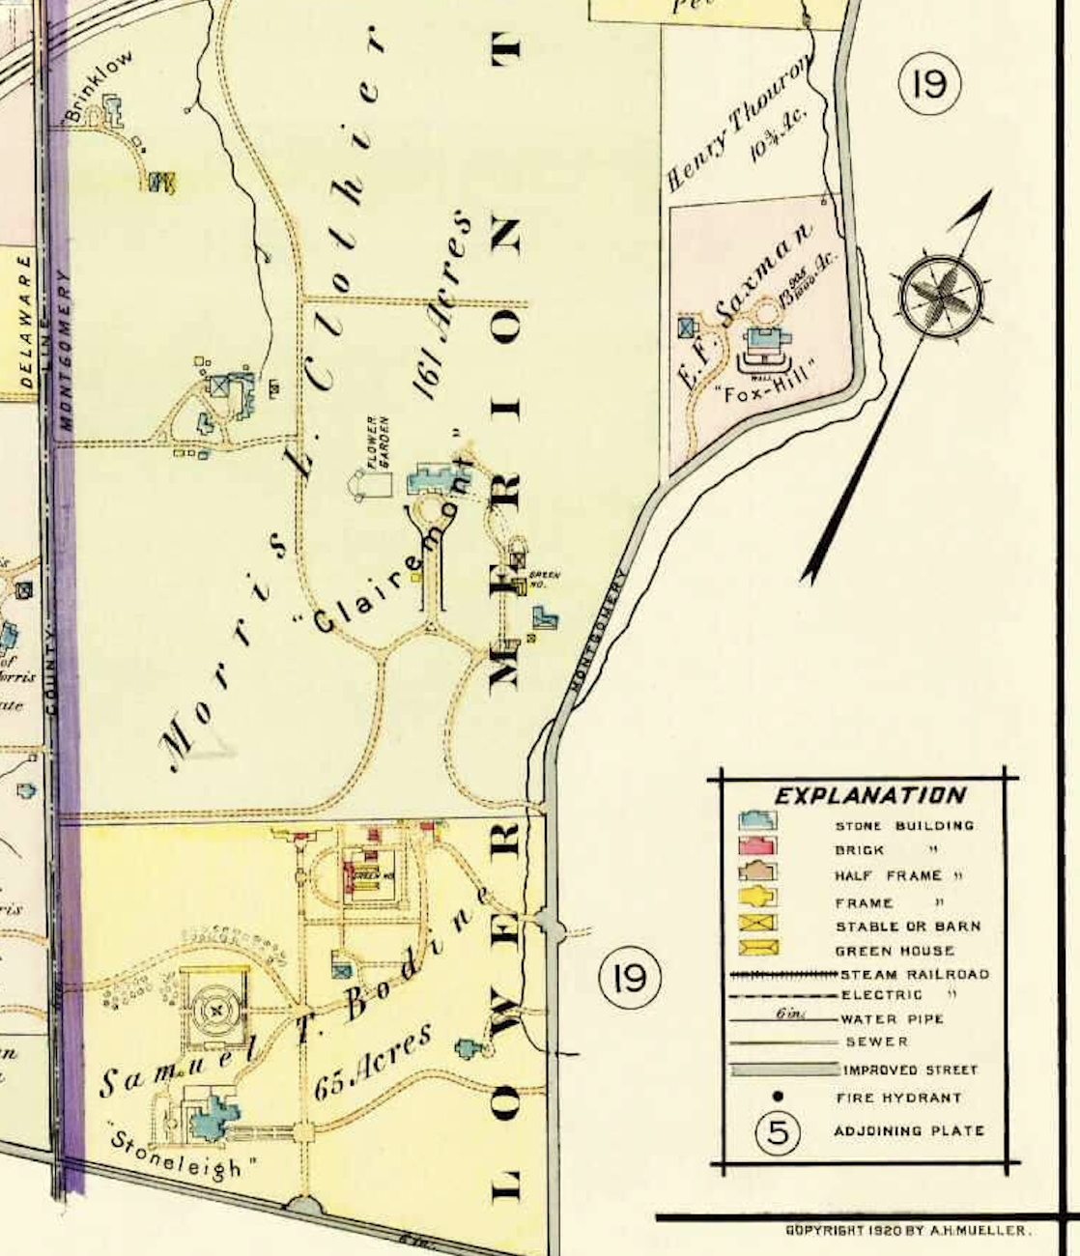
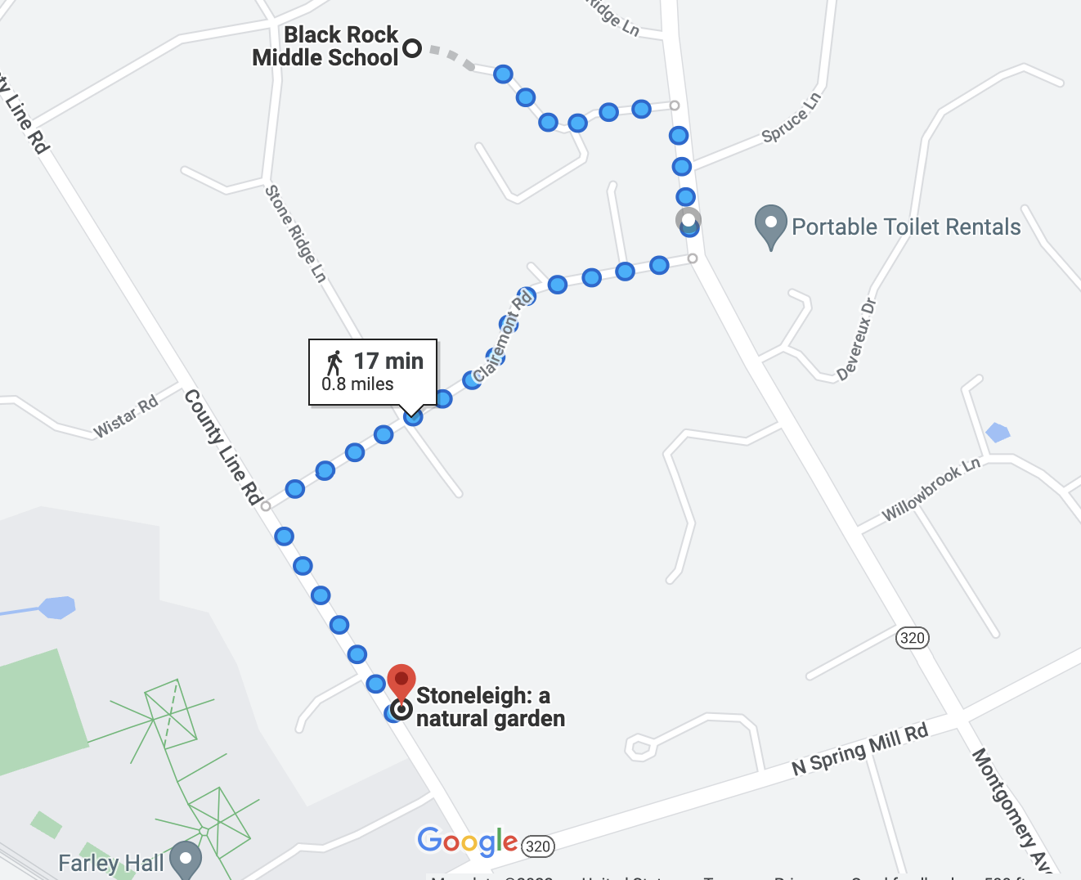
1920
Credit: Google, Radnor Historical Society Mueller 1920
Notes:
contrast between current landscape - middle school and stoneleigh, and the estate as is was in 1920 - adjacent to Morris Clothier’s much larger Clairemont estate

Slide 6
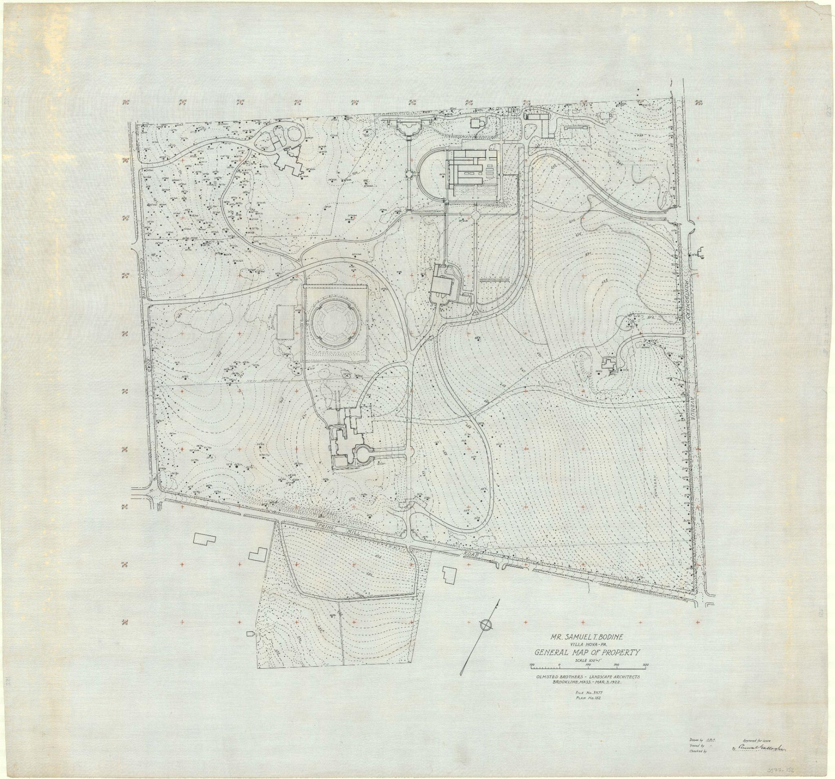
Olmsted Brothers
Stoneleigh’s 65 acres 1922
Credit: NPS Olmsted Archives
Notes:
Map by Olmsted Brothers - premiere landscape architects of early 20th century.
The map shows every inch of stoneleigh 100 years ago

Slide 7
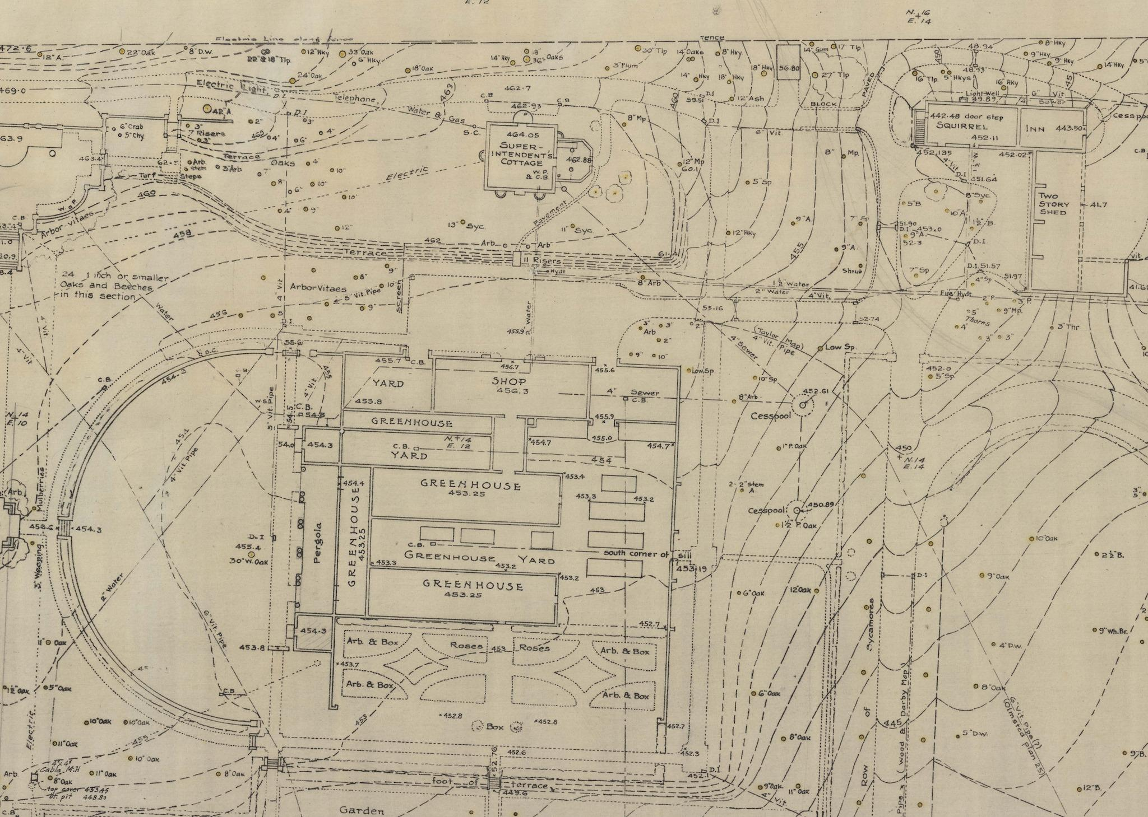
Credit: NPS Olmsted Archives
Notes:
1921 survey of the part of the property
Greenhouse complex, Superintendents Cottage here,
inn dormitory here, tea house here
Species name, diameter at breast height. Can determine century of grown and carbon storage

Slide 8
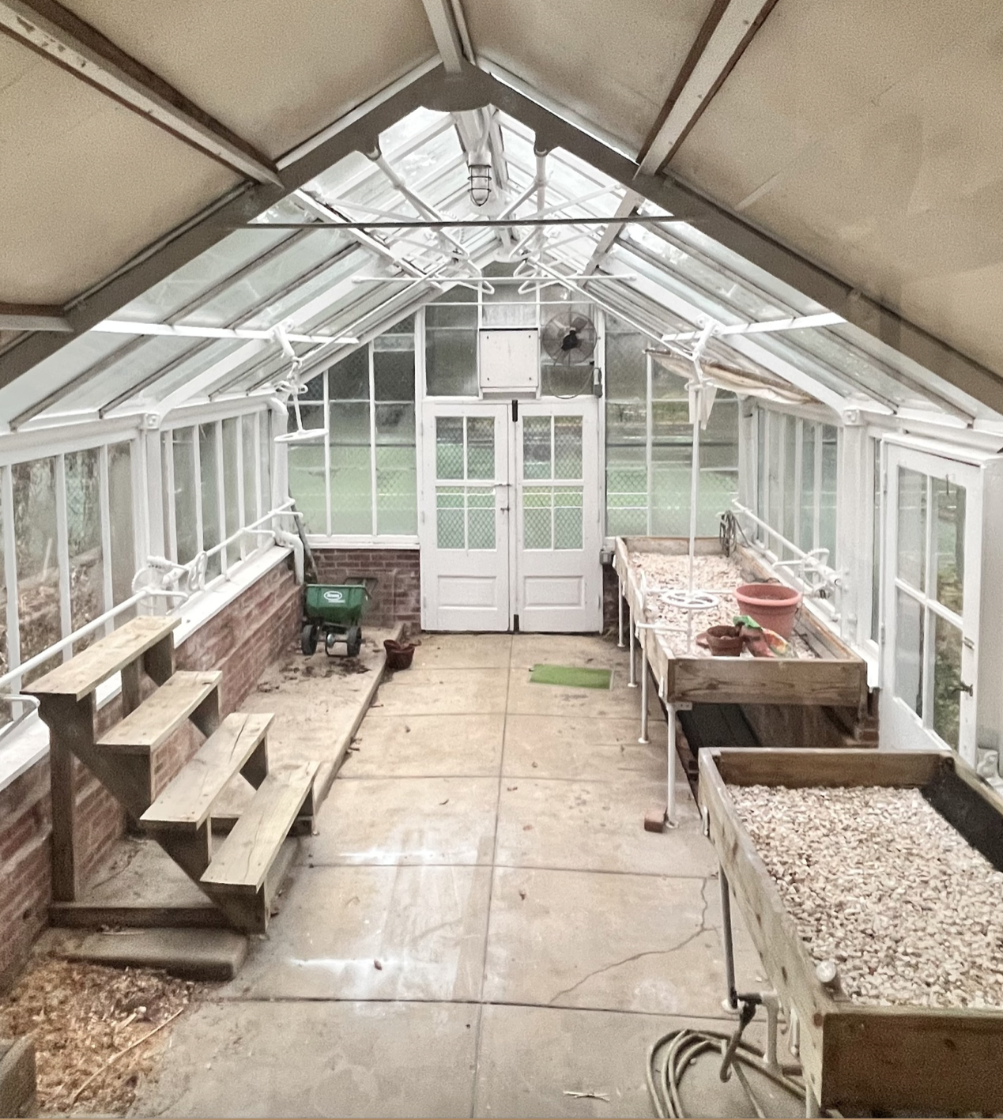
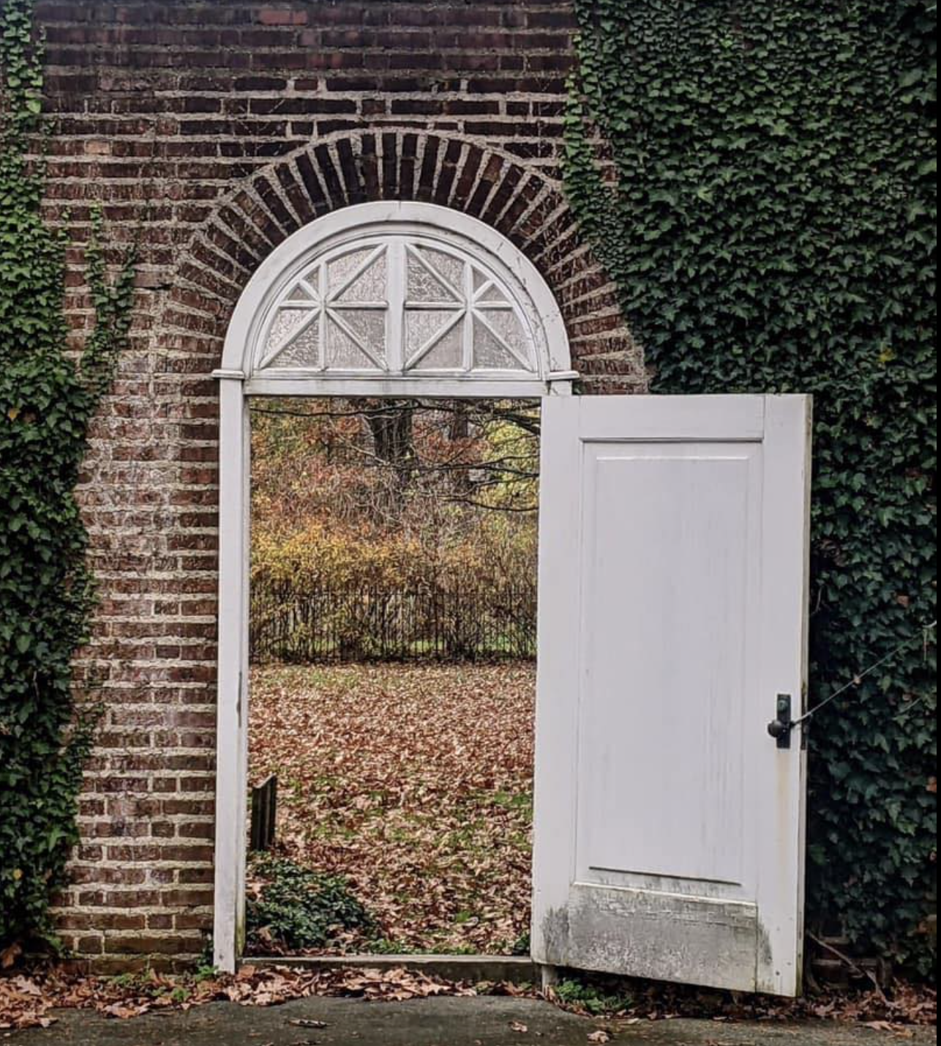
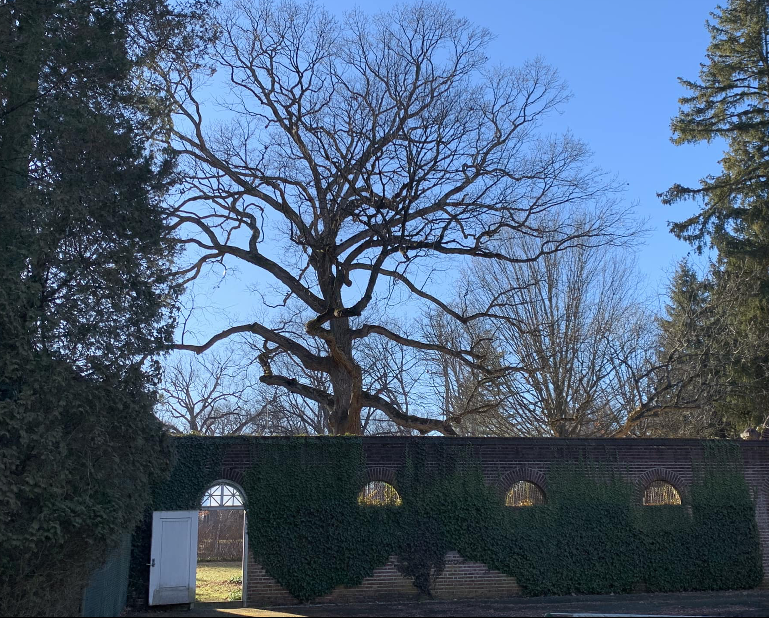
Greenhouse Complex…Now
Credit: Betley, Save/Preserve Oakwell

Slide 9
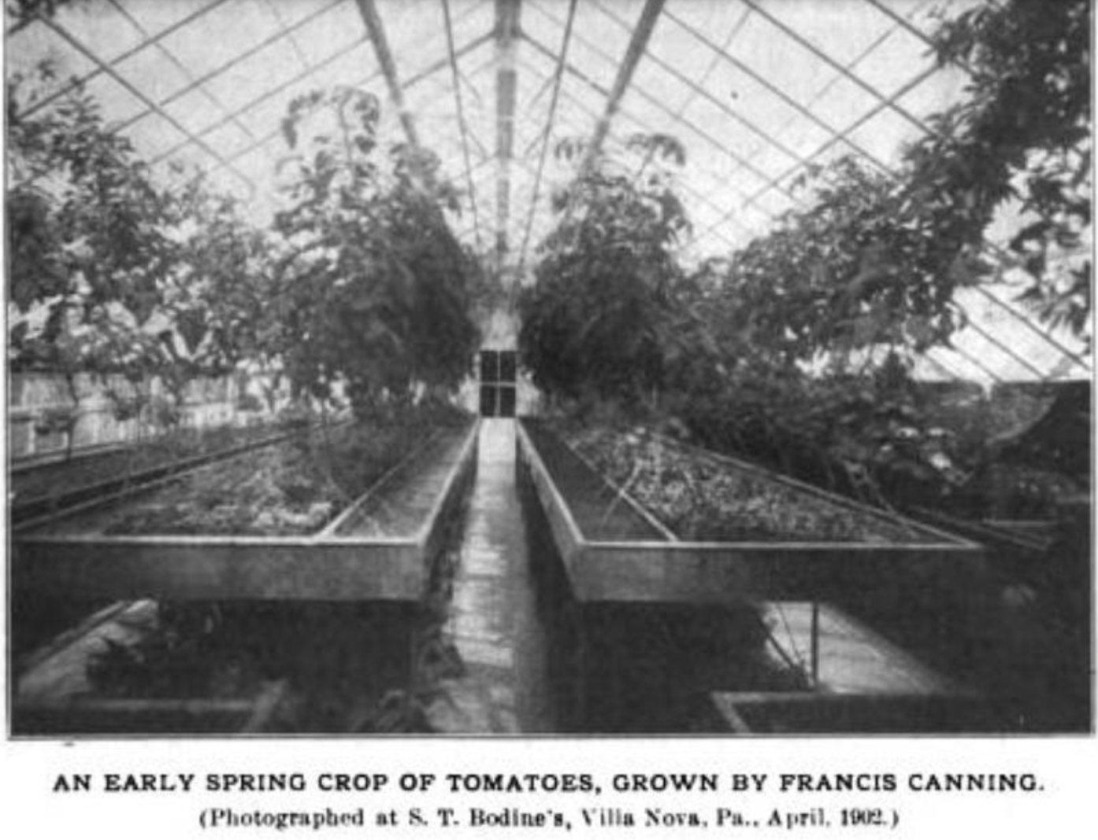
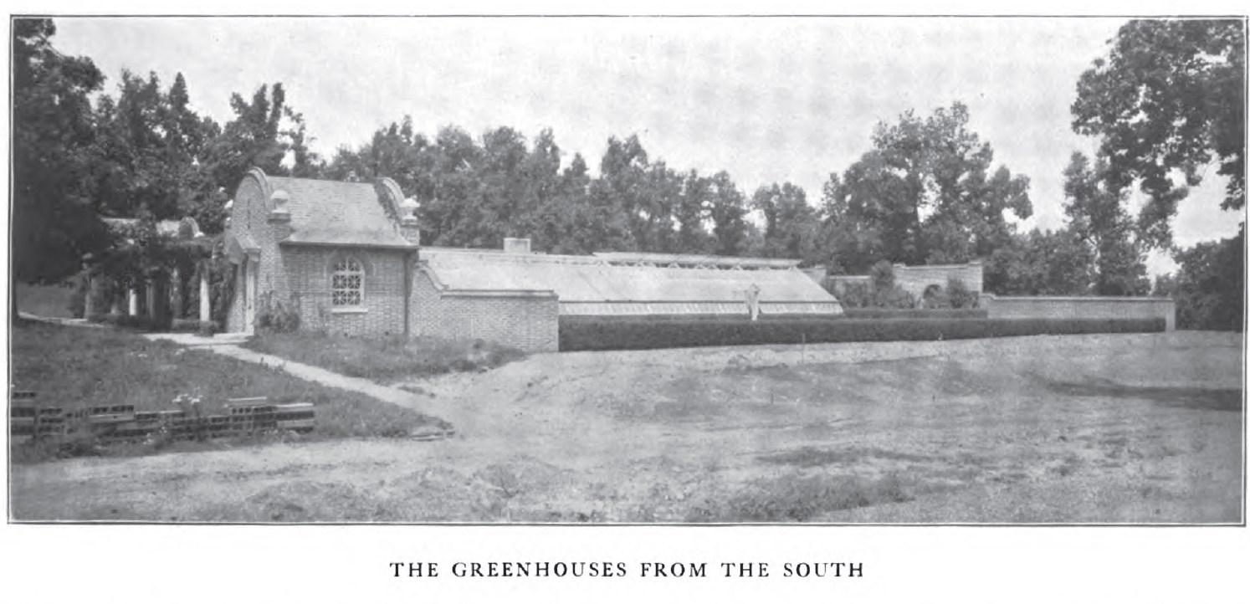
…and then
Credit: House and Garden Vol 4

Slide 10
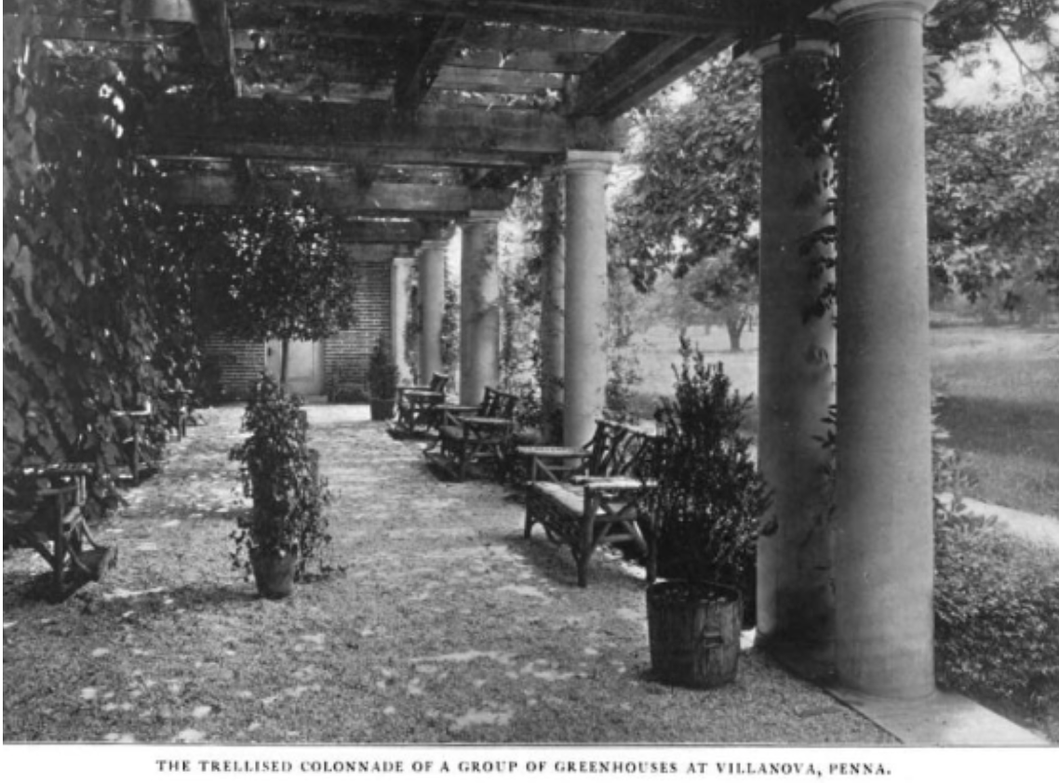
Credit: House and Garden Vol 4

Slide 11
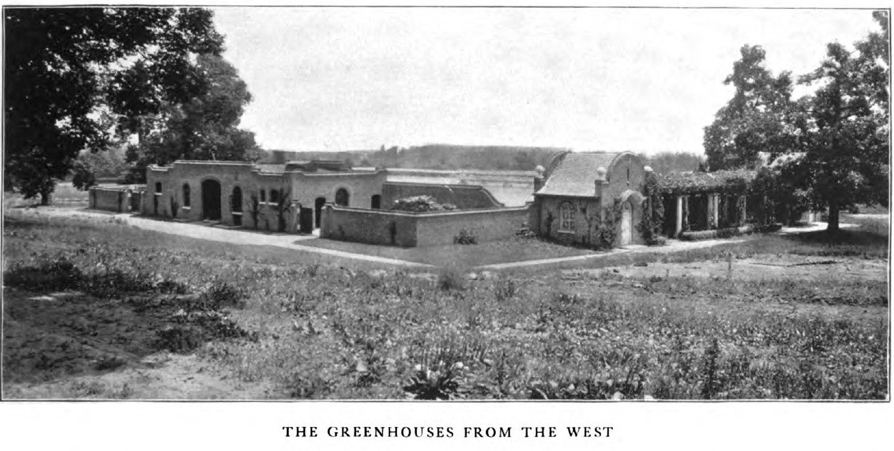
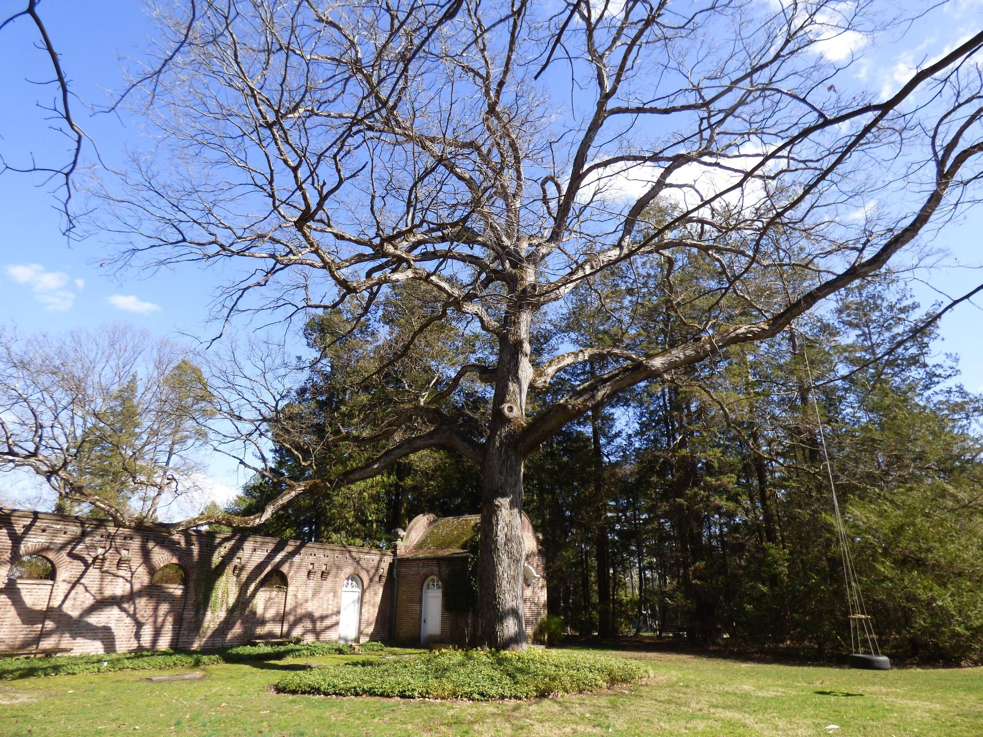
White Oak in 1903
M9Y3Y8X5
White Oak today
Credit: House and Garden Vol 4

Slide 12
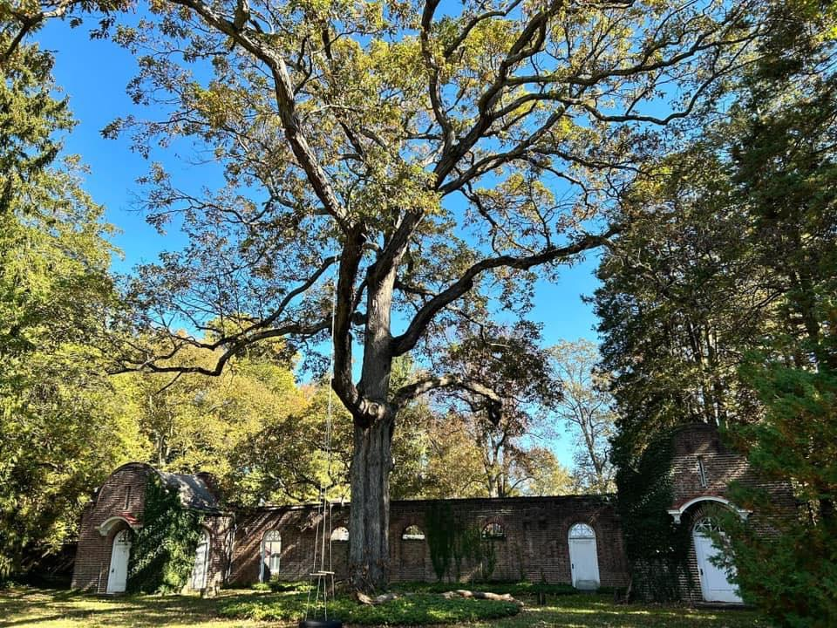
Credit: Save/Preserve Oakwell

Slide 13
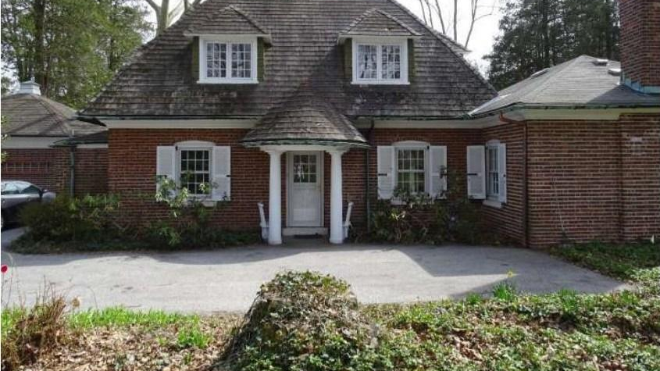
Acorn Cottage (Superintendent Francis Canning)
Credit: Long and Foster Real Estate 2016

Slide 14
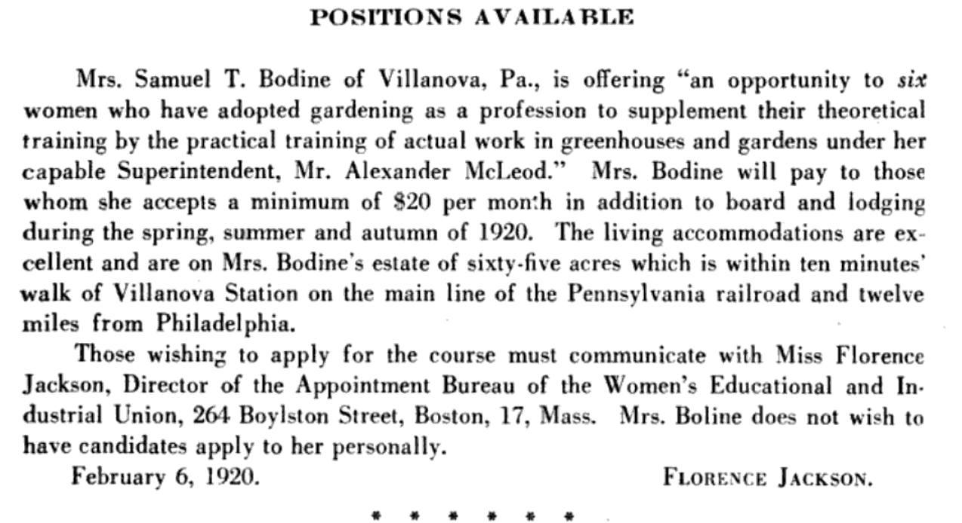
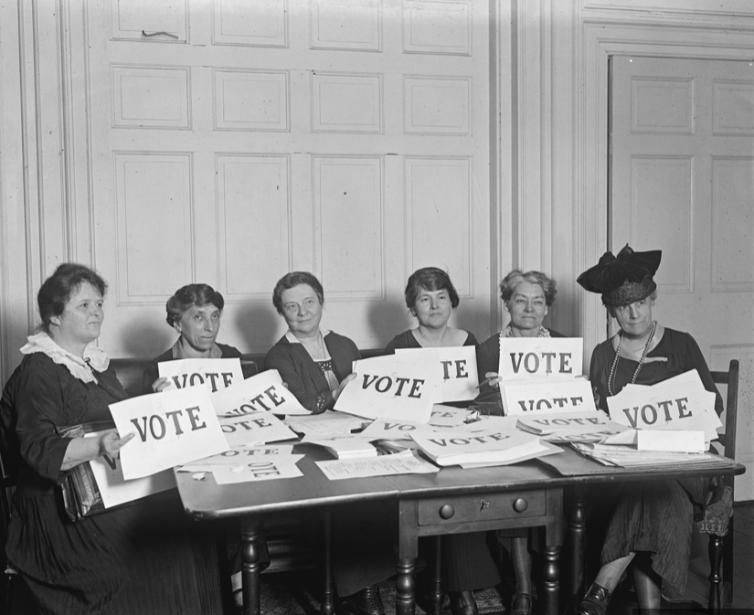
1920:
Mrs. Bodine’s women’s horticultural program
The year women voted for the first time
1920 National Woman’s Farm & Garden Association Bulletin
Notes:
pennsylvania School of Horticulture for Women
In 1920, Eleanor Bodine placed this add in bulletin of the NWFGW
This means - the same year that women finally gained the right to vote in the U.S, Eleanor Bodine was recruiting college-educated women for Stoneleigh’s gardening horticultural training program through the Women’s Educational and Industrial Union headquartered in Boston.

Slide 15
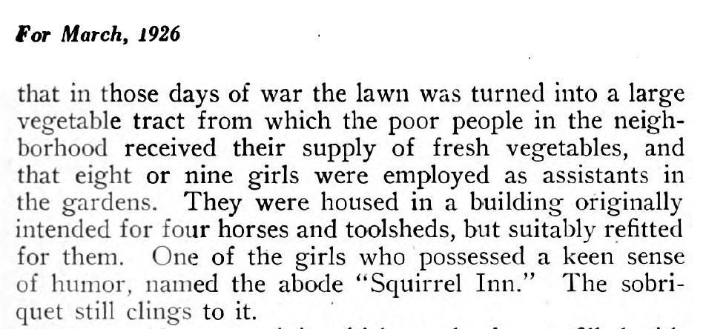
1926 House and Garden issue with mention of Bodine program
Notes:
And there is the evidence that links it all - a 1926 article in House and Garden magazine

Slide 16
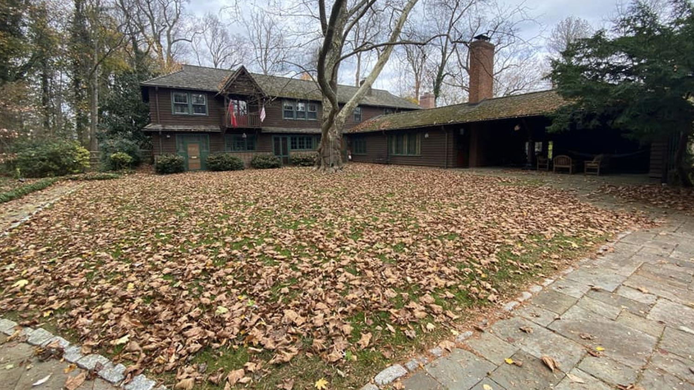
Squirrel Inn
Credit: Save/Preserve Oakwell

Slide 17
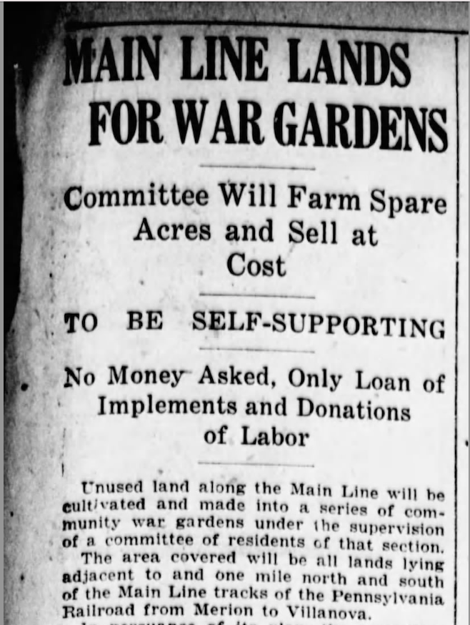
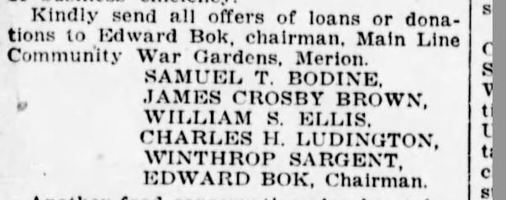
Credit: Evening Public Ledger, April 26, 1917.
Notes:
Through newspapers, we learn that in 1917 his father Samuel T. Bodine was a leader of the “Main Line Community War Garden Committee.” The Committee organized donations of unused land one mile north and south of the Pennsylvania Rail Road all the way from Merion to Villanova along with seed, equipment, horses, and labor to produce potatoes, beans, cabbages, carrots, turnips, and onions that sustained the community through wartime shortages.
We learn that as their high school studies wrapped up for the year, young women in Philadelphia were "registering for farm work during the summer... planting, cultivating, pickling, and canning foods”
By May 1917, over 400 acres had been planted along the Main Line as the Committee worked in conjunction with the National Emergency Food Garden Commission in Washington D.C.
And guess what was happening at Stoneleigh? The Bodines were creating something amazing.

Slide 18
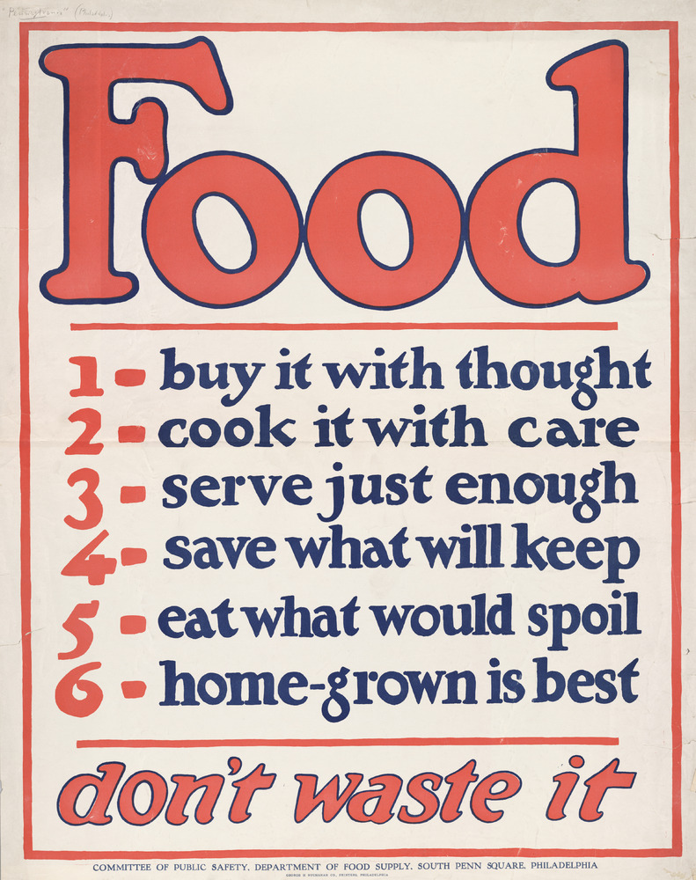
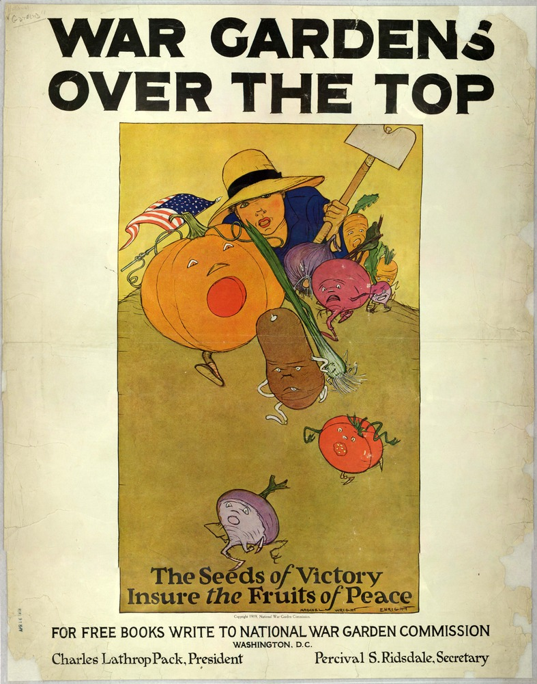
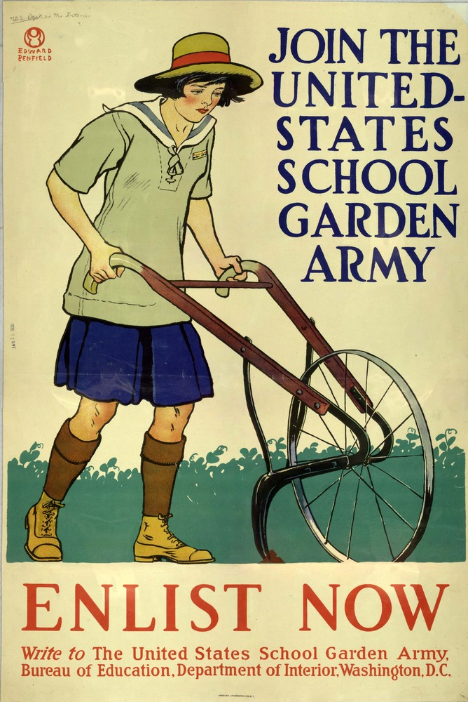
Credit: Special Collections, USDA National Agricultural Library

Slide 19
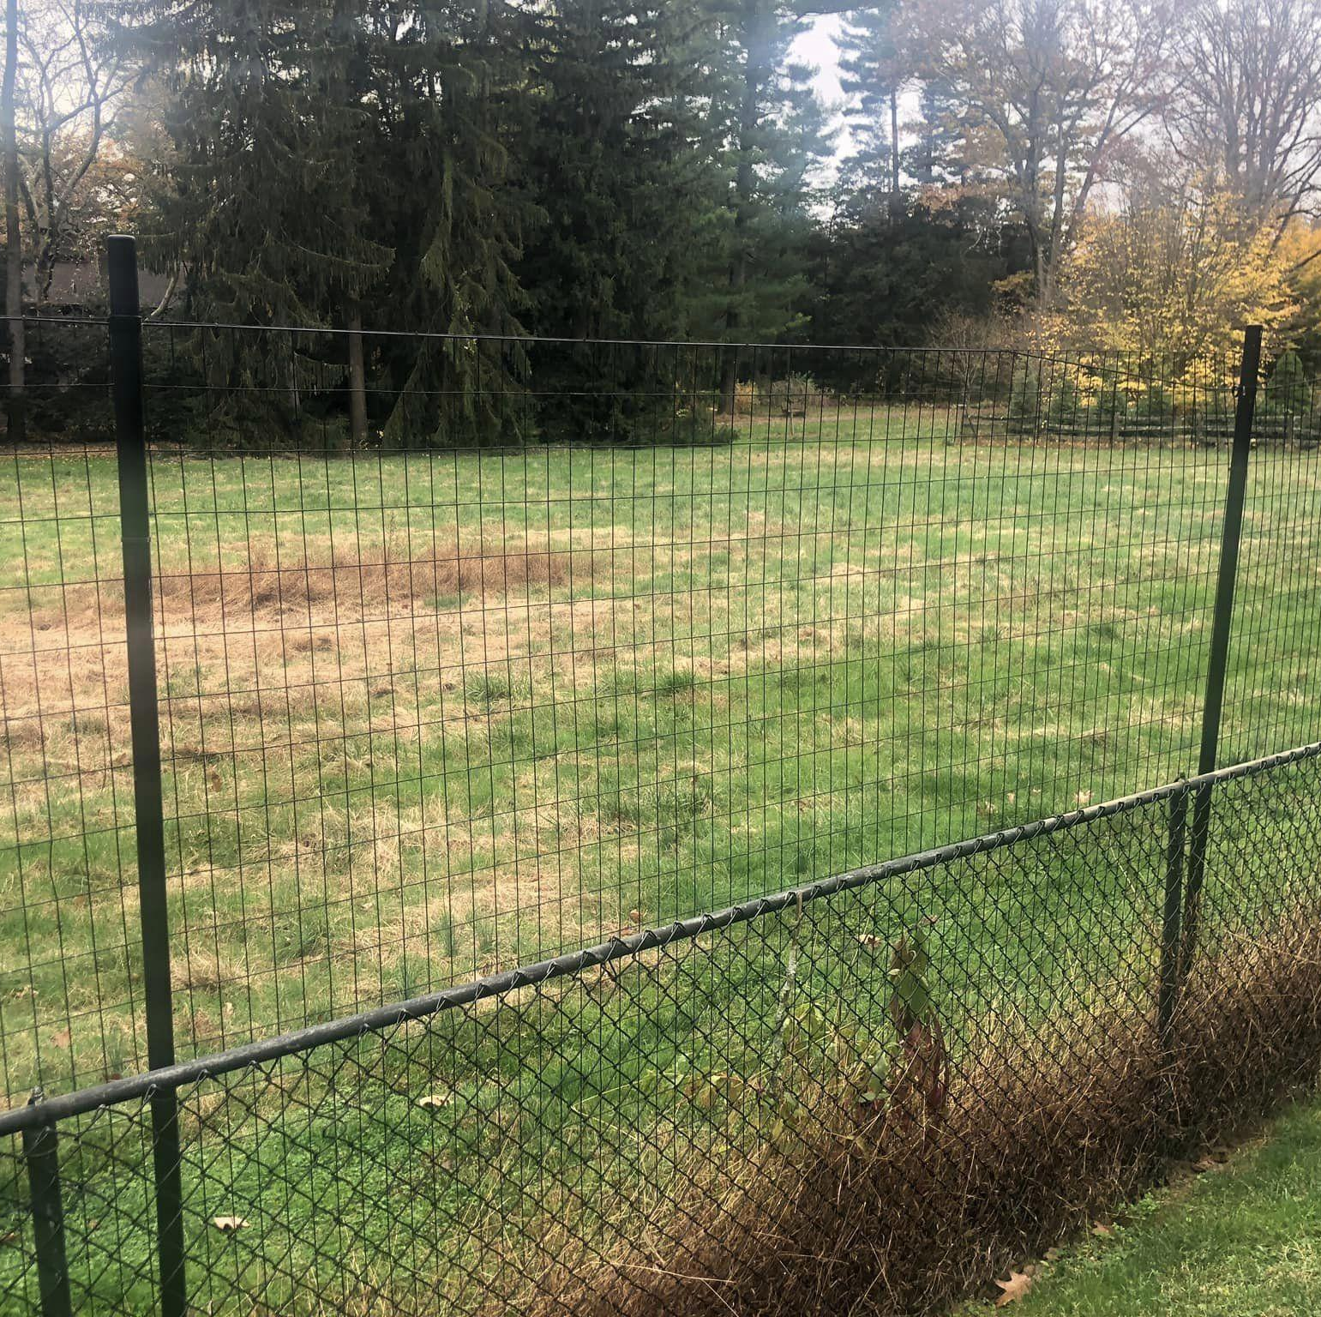
Former Victory Gardens
2.5 acres on Stoneleigh property
Accessed by steps from berm at greenhouse complex
1 acre of apple orchards
Another acre across Spring Mill Rd.
Credit: Singer

Slide 20
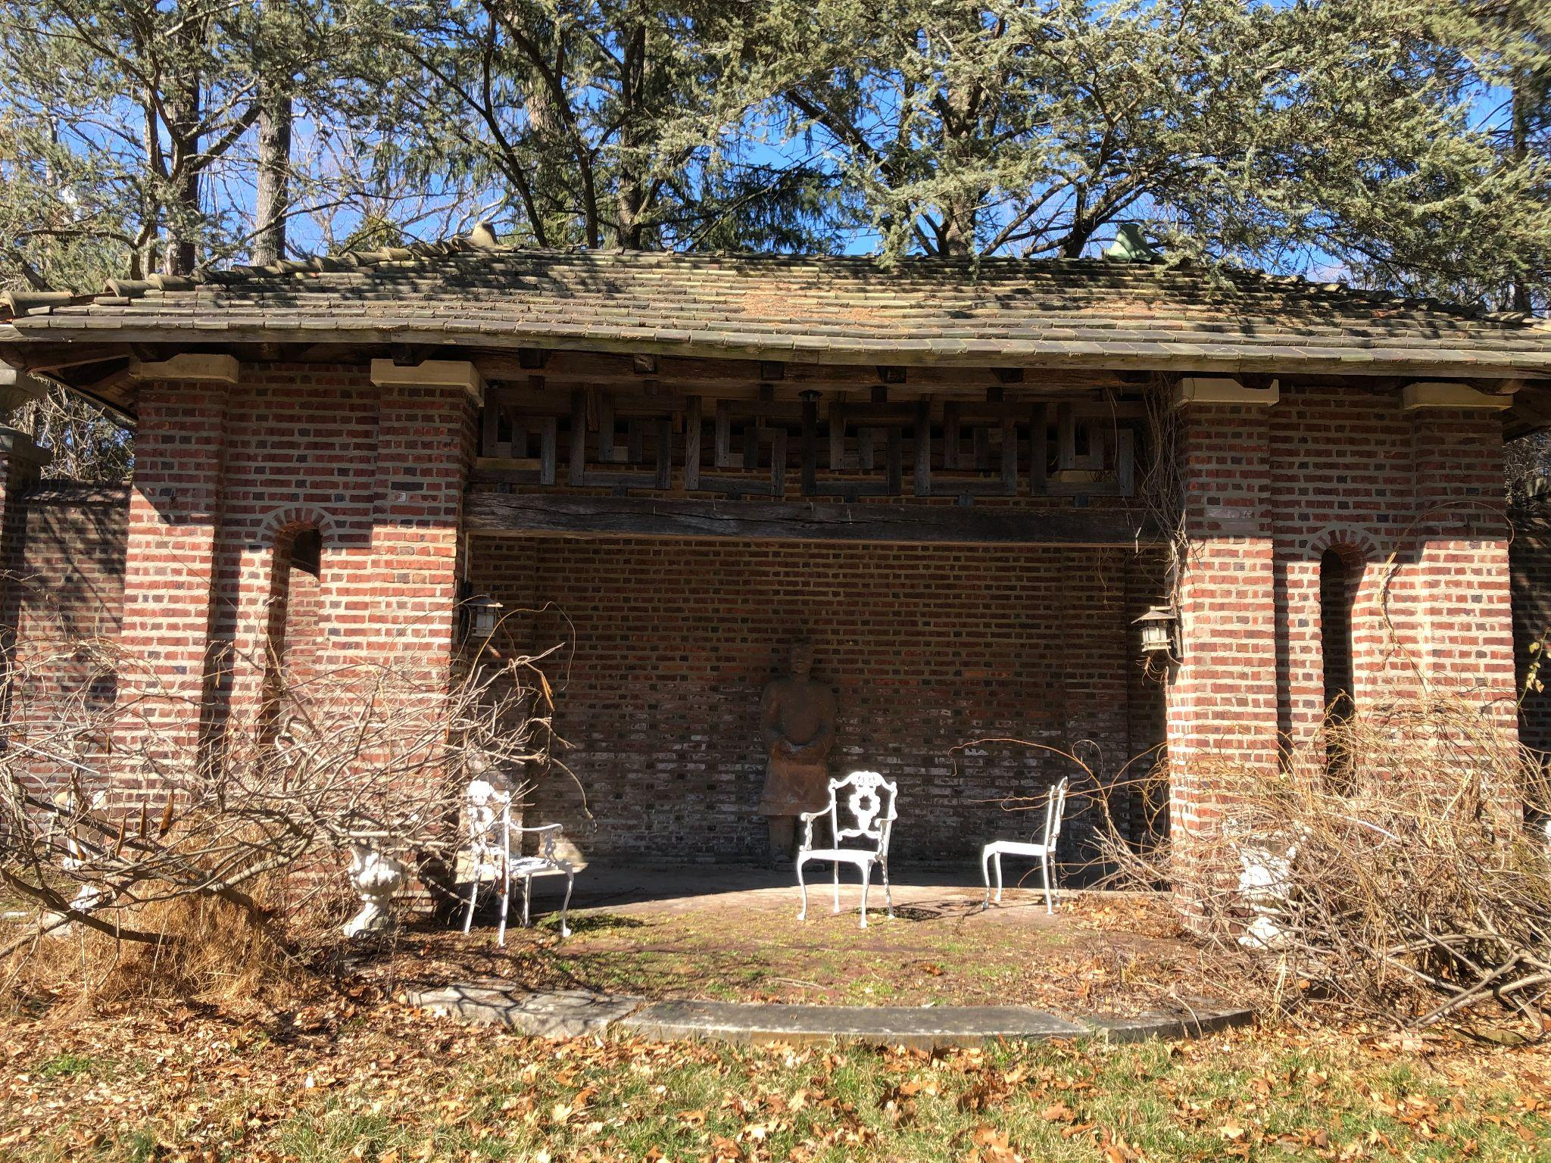
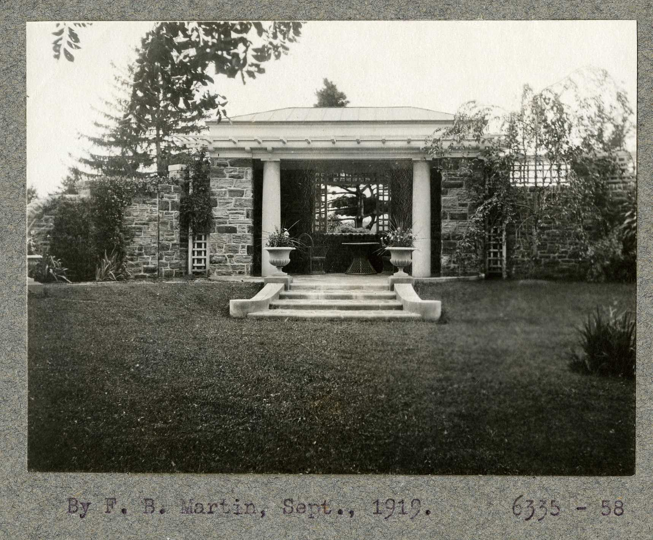
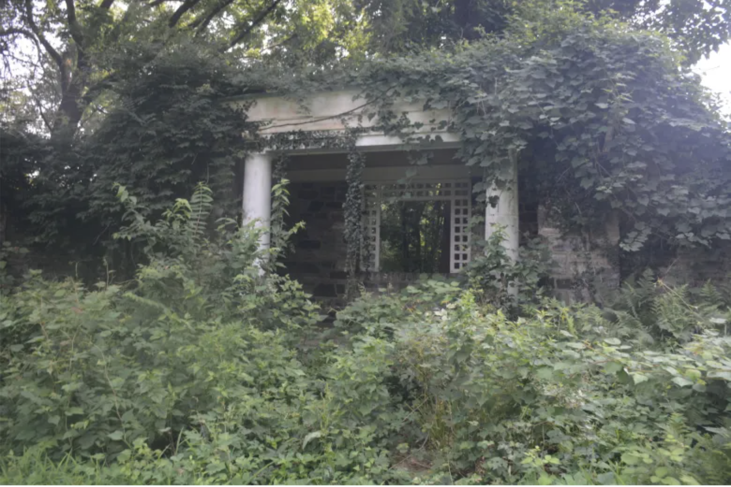
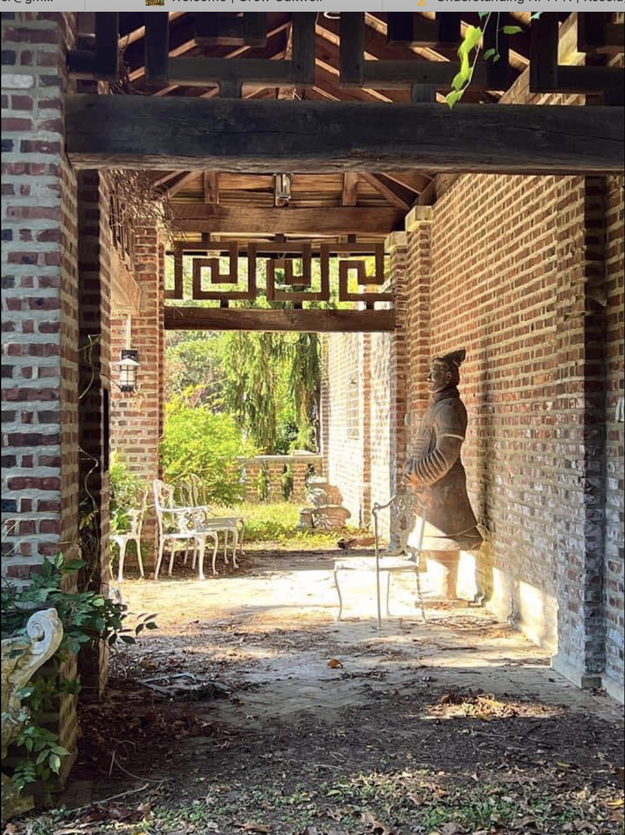
Oakwell 1903 tea house
Clairemont 1919 summer house
Clairemont 1919 summer house (before demolition)
Credit: Betley; NPS Olmsted Archives, Main Line Times & Suburban
Notes:
Tea house built between 1900-1906.
Clairemonet estate - OB built two summer houses. So I have photos sketches - including photos of the horses who graded landscape and moved stone.
Olmsted Brothers at Clairemont

Slide 21
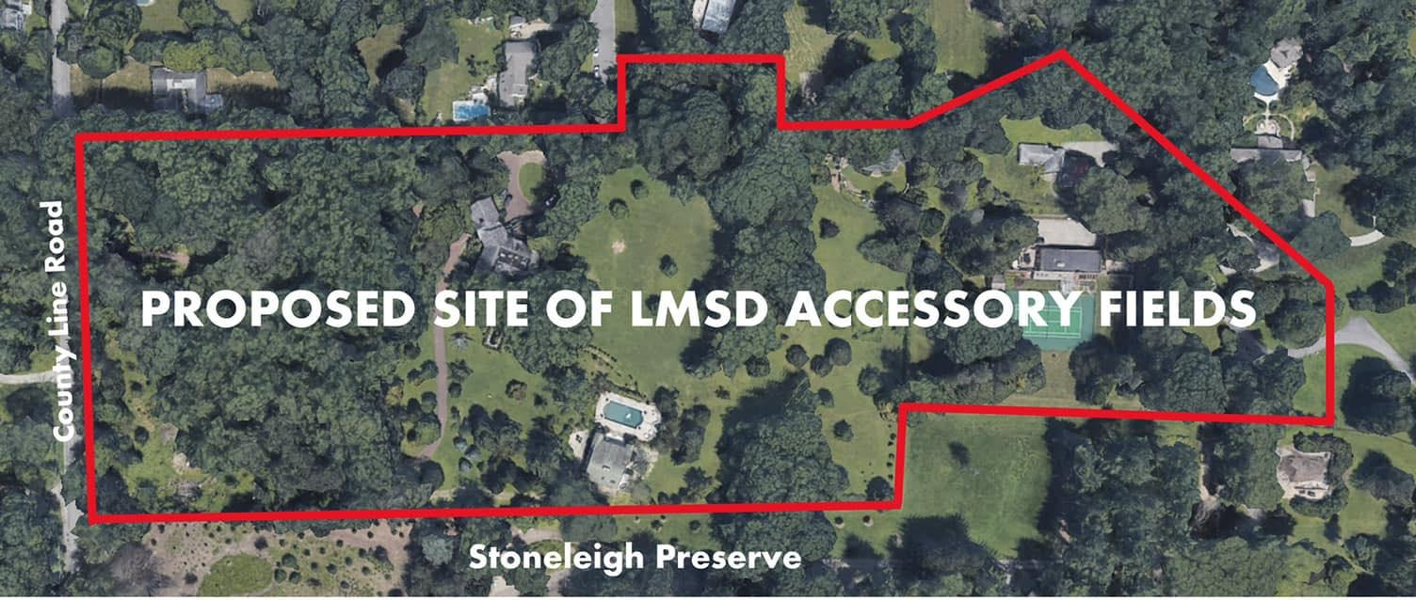
Credit: Save/Preserve Oakwell
Notes:
What does all this history mean for LMSD”s plan?
orgotten history of this part of Stoneleigh - this intact biodiverse landscape is a tremendous opportunity for research, learning, adn education

Slide 22
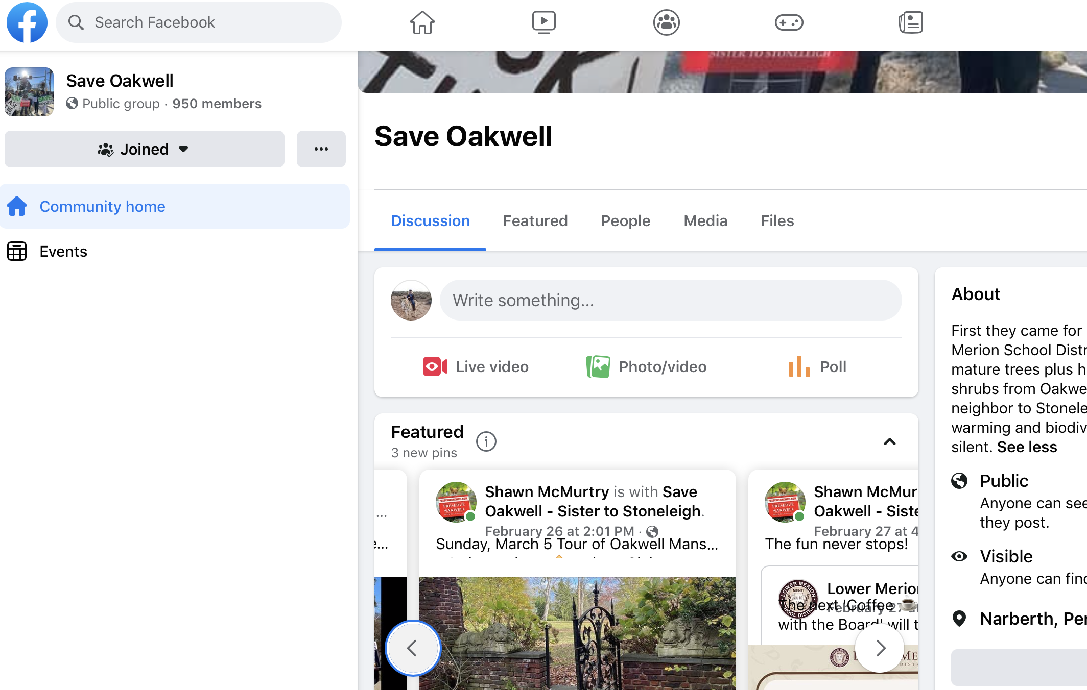
Website and email: Facebook Page: GrowOakwell.com Save Oakwell

Slide 23
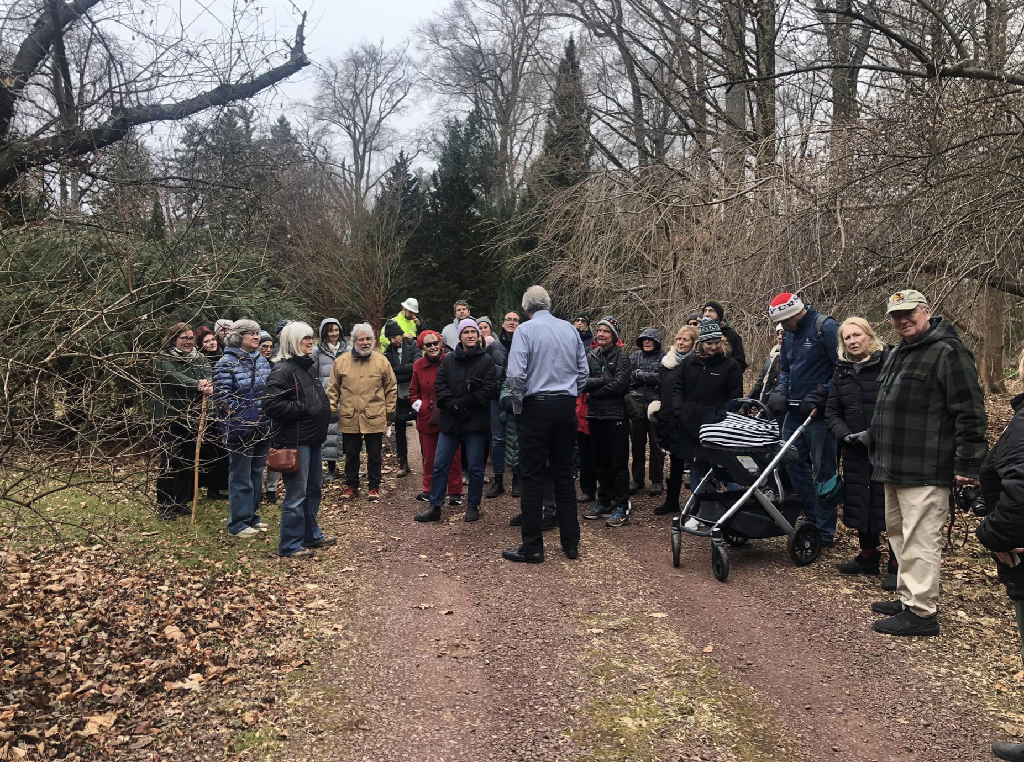
Tour of Oakwell:
Tomorrow, Sunday March 5 at 1:30
1835 County Line Rd., Villanova
Go to SaveOakwell FB page for info
Credit: Singer

Slide 24
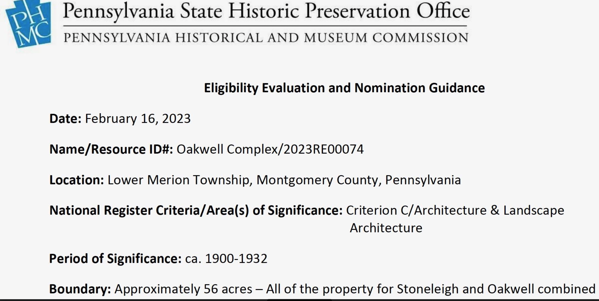
Breaking News!
Stoneleigh and Oakwell District

Slide 25
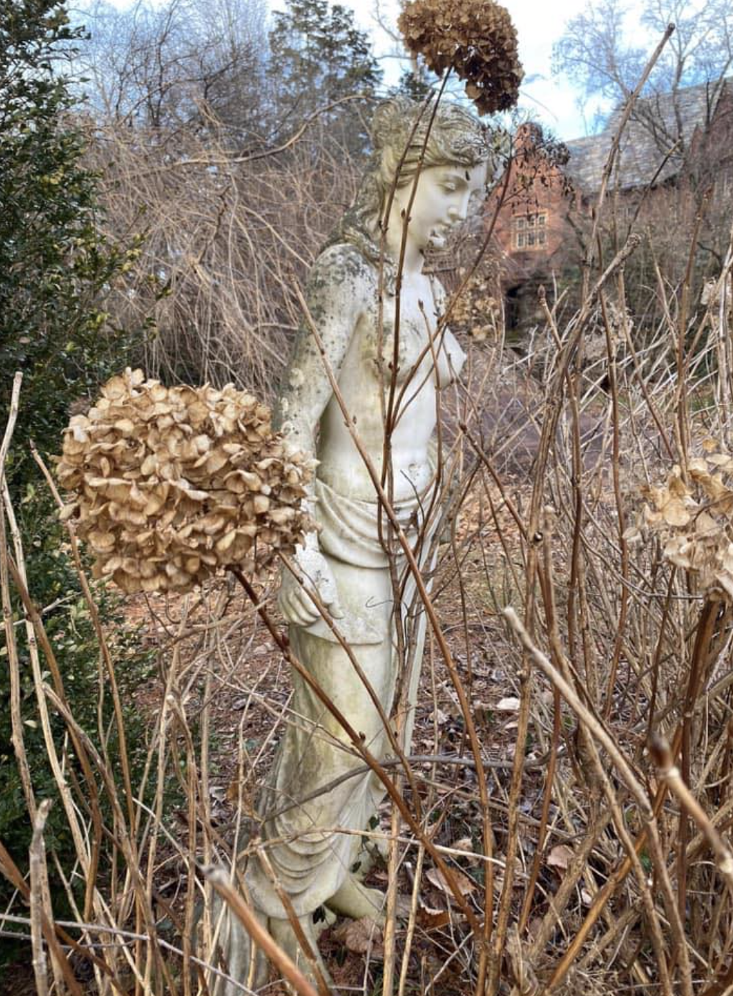
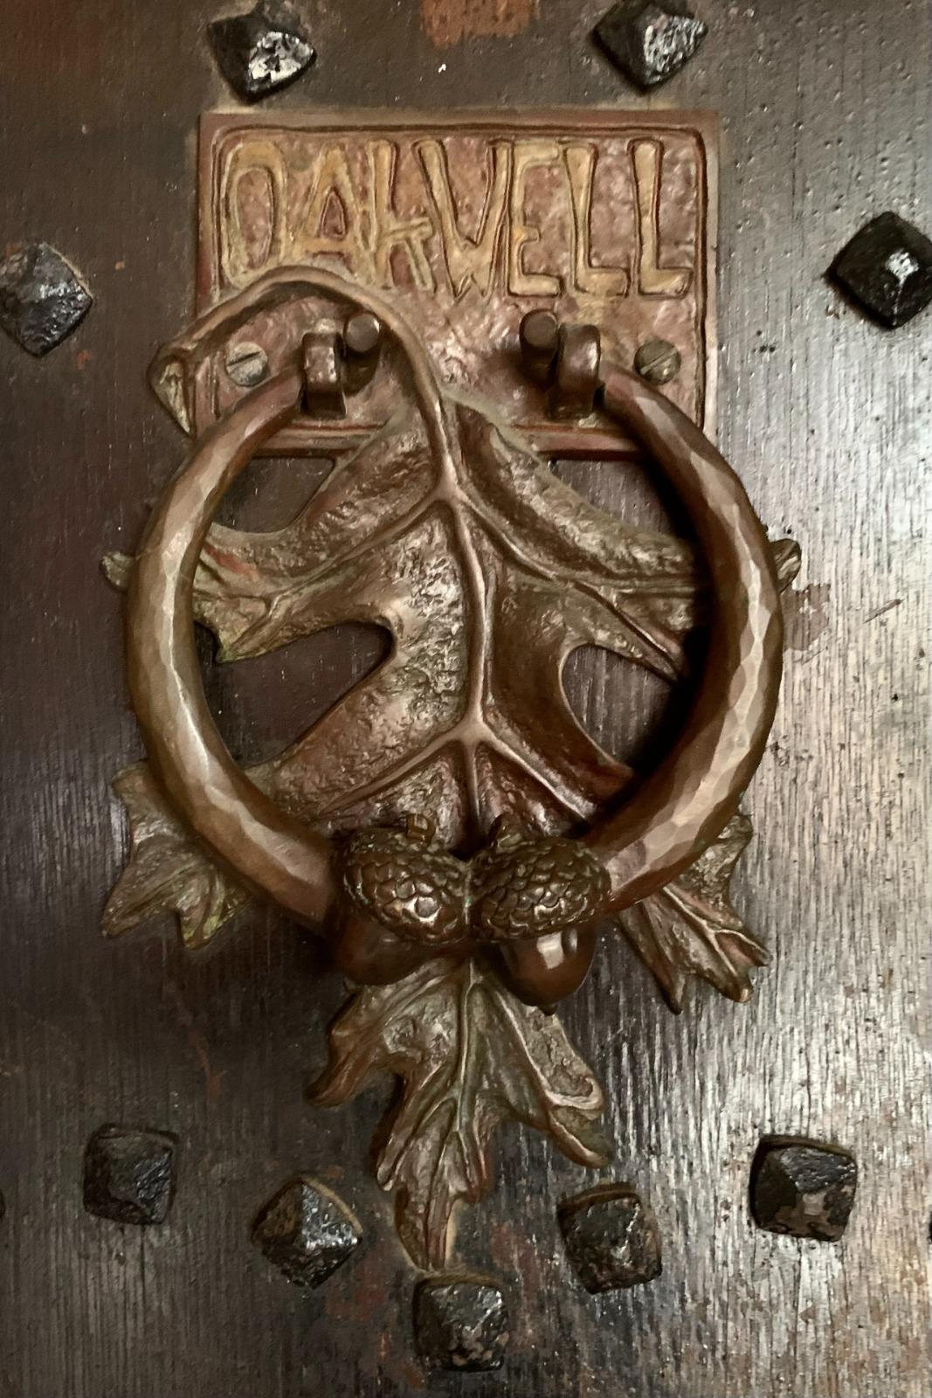
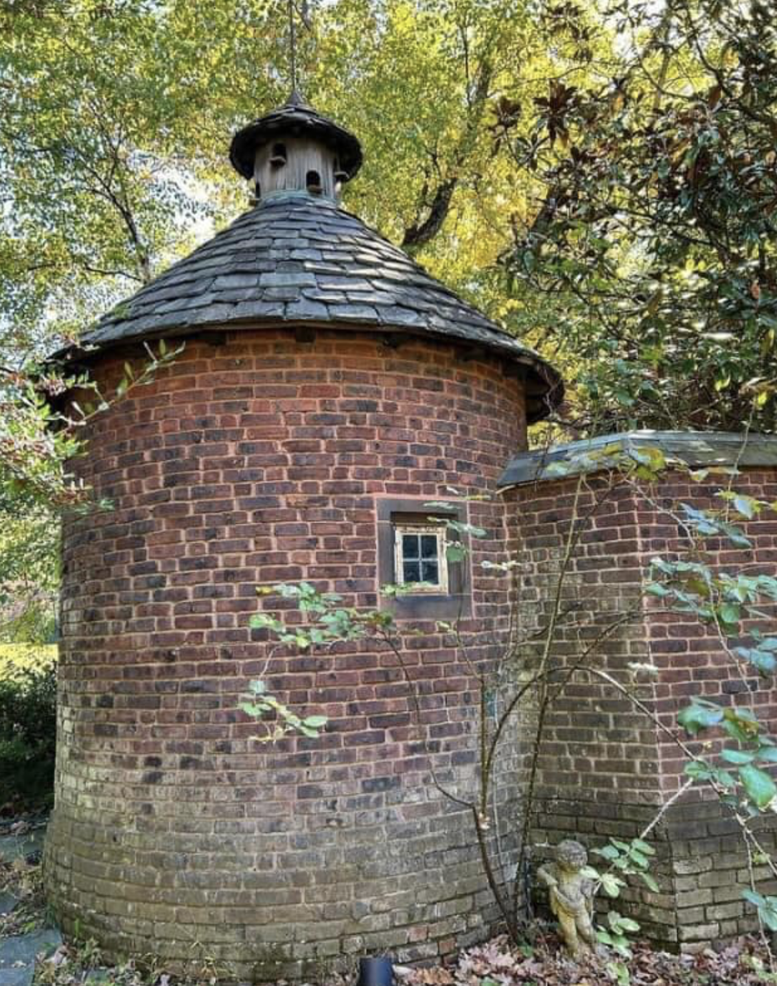
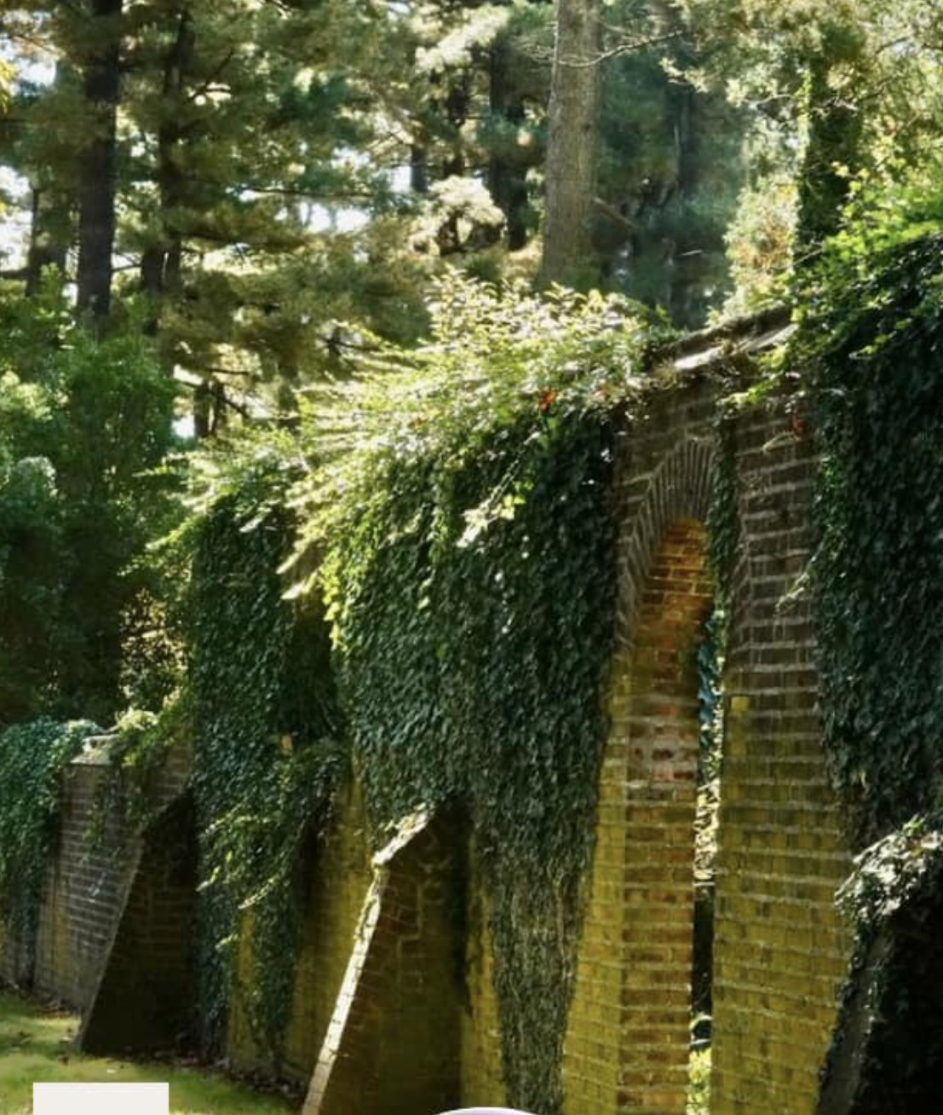
Thank You
Credit: Radnor Historical Society, Save/Preserve Oakwell

