Slide 1
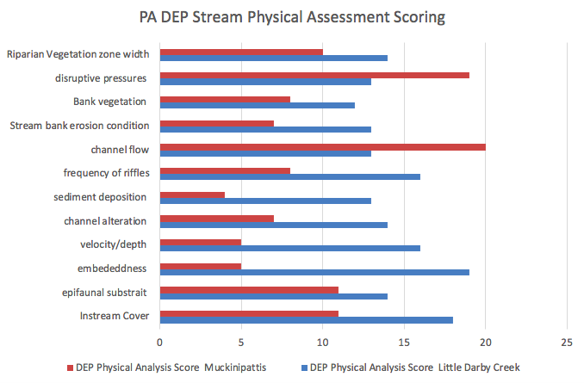
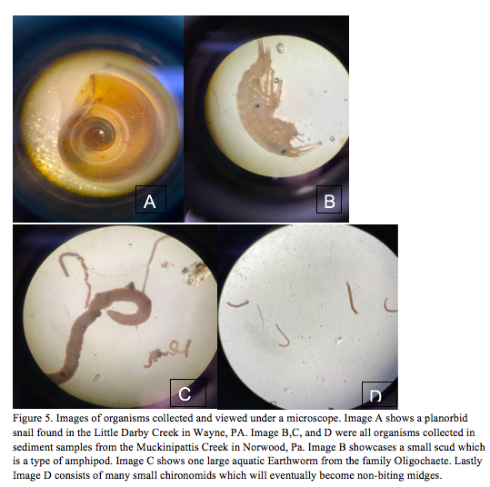
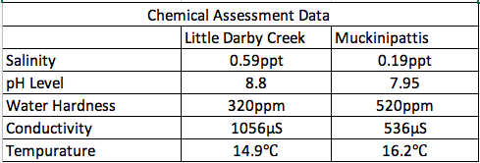
“Comparative analysis of two first order streams in the Darby Creek Watershed in Southeastern Pennsylvania of how impervious surface and land management in the local area may impact stream quality/health” Marie Gazzillo Bachelors of Science in Environmental Science, Fall 2022
Abstract:
Results:
This report looks into the water quality throughout the Darby Creek watershed I study how the location of two first order tributaries, the Little Darby Creek located in the upper watershed and the Muckinipattis Creek found in the south lower watershed experience differences in stream water quality and biodiversity based on the gradual increase of impervious surface and urban development as one moves down the watershed. I predict that the increased percentage of impervious surfaces, human development, and reduction of tree cover in the lower watershed will correlate with a lower IBI score, lower macroinvertebrate biodiversity, and lower EPT taxa richness
The Little Darby Creek had a DEP Physical assessment score of 175. the Muckinipattis DEP score totaled 115. The higher physical assessment score shows that the Little Darby Creek is a suboptimal stream. Muckinipattis creek with a physical assessment score of 115 determines that the stream is “marginal”. The Little Darby Creek had an IBI index score of 38.94. The Muckinipattis stream had an index score of 16.75. The higher the IBI score of the Little Darby supports my hypothesis. Despite having a good physical assessment and IBI score the Little Darby seemed to have higher levels of salinity, pH, and conductivity as shown in the chemical assessments. The Muckinipattis creek scored lower on the DEP physical stream analysis than the Little Darby, and had lower salinity levels, and lower conductivity. The results indicate that the Little Darby Creek has richer biological diversity and EPT taxa than Muckinipattis.
Methods:
Conclusions
I analyzed the stream water quality through physical, biological and chemical tests. The physical assessment classified the two streams based on the Rosgen river classification scale and the PA DEP Habitat Assessment. The chemical test included temperature, pH level, turbidity, dissolved oxygen, and conductivity. Macroinvertebrates were collected at both sites and identified using (Voshell 2022). Biotic indices that measure macroinvertebrate abundance and diversity are helpful indicators of stream health (Herman et al 2015). The samples were assessed using EPT richness and Integrated Biological Index.
I was surprised by the chemical results as it contradicts my original hypothesis. The contradictory chemical and biological integrity tests indicate that there was possibly human error in taking the chemical assessment. The physical and biological assessments of both streams found to be the most successful in determining stream health and biological integrity. The residents who live near the Little Darby Creek have less than 50% of people of color and lower rates of unemployment when compared to the region around the Muckinipattis Creek. Norwood is in the 80 to 90 percentile for unemployment rates with a 70-80 percentile of residents who are people of color. There is also more exposure to regulated environmental hazards such as air pollution or hazardous waste areas in proximity to the Muckinipattis creek. With further scientific and sociological research I plan to research the correlation between stream health and stream access to socioeconomic status.
Acknowledgements:
This independent research study would not have been possible without the help and support of Doctor Kate Goddard. I would also like to thank Ursinus College for providing all the necessary tools and resources for this study to occur.
Works Cited:
Wang, L. and Kanehl, P. (2003), INFLUENCES OF WATERSHED URBANIZATION AND INSTREAM HABITAT ON MACROINVERTEBRATES IN COLD WATER STREAMS.
Voshell, J.R. (2002). A Guide to Common Freshwater Invertebrates of North America.”
Karr, J.R. and D.R. Dudley. 1981. Ecological perspective on water quality goals. Environmental Management

